Slide 2
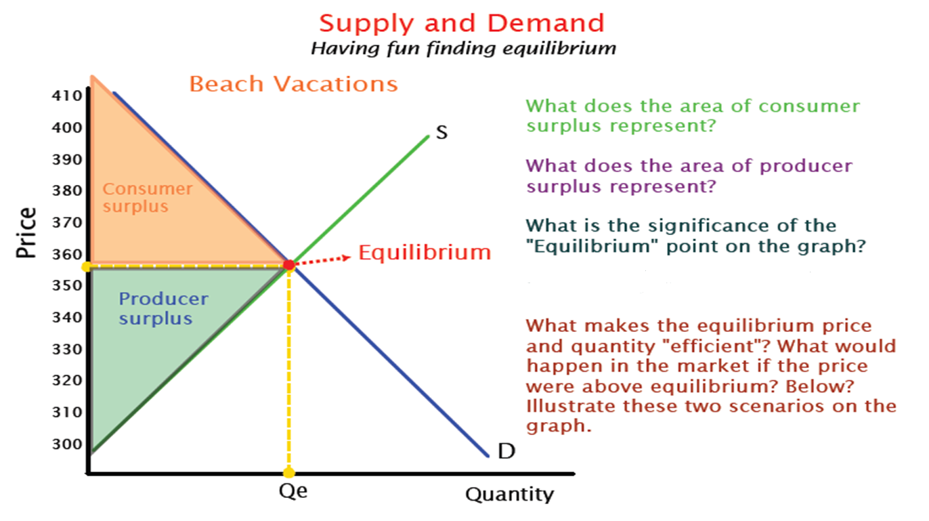

Slide 6
Market Equilibrium – Consumer and Producer Surplus
Graphically, we can identify the areas representing consumer and producer surplus, which together represent total societal welfare, as following areas.
Consumer Surplus: The area on the market graph below the demand curve and above the equilibrium price.
$$\frac{10×\left(5−2\right)}{2}=15$$
Producer Surplus: The area above the supply curve and below the equilibrium price.
$$\frac{10×(2−0.5)}{2}=7.5$$
Total welfare: The sum of the two areas
$$15+7.5=22.5$$
$22.5 represents the total welfare of producers and consumer s in the bread market. At any price other than $2, welfare would be less than $22.5
Price
$5
Market for Bread
S
Consumer Surplus
$2
Equilibrium
Producer Surplus
$.5
D
10
Quantity

