Slide 1
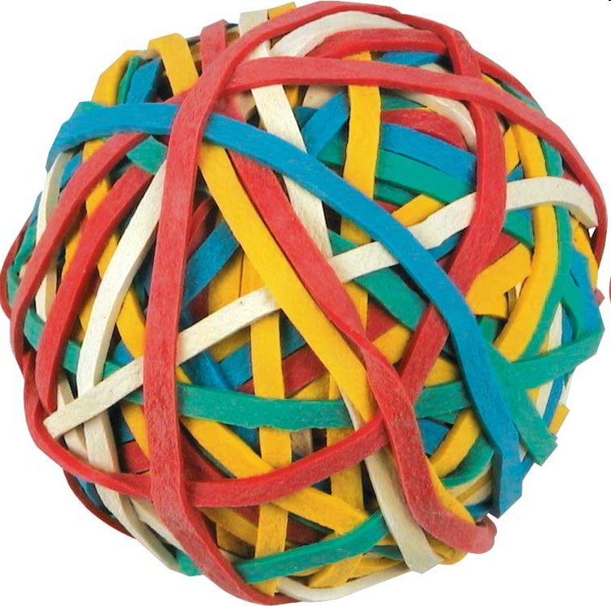
Elasticity
We talked about the direction of changes in quantity when prices rise/fall
Elasticity talks about how much they change
When the price for something goes up, does quantity demanded decrease a lot, little, or not at all?
When prices fall, do manufacturers reduce output a lot, a little, or not at all?
Two types of elasticity:
Demand elasticity
Supply elasticity

Slide 2
Introduction to Elasticities
Elasticity is an economic concept which refers to the responsiveness among consumers or producers to a change in a variable which affects either the market demand or the market supply. There are four types of elasticity that we will study in this unit:
Price Elasticity of Demand (PED): Measures the responsiveness of consumers of a particular good to a change in the good’s price.
Cross-price elasticity of Demand (XED): Measures the responsiveness of consumers of one good to a change in the price of a related good (either a substitute or a complement).
Income Elasticity of Demand (YED): Measures the responsiveness of consumers of a particular good to a change in their income.
Price elasticity of Supply (PES): Measures the responsiveness of producers of a particular good to a change in the price of that good.

Slide 3
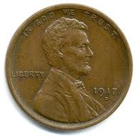
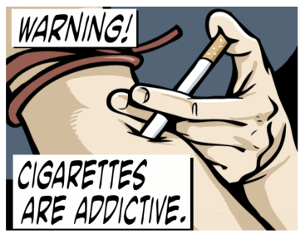
Factors Effecting Demand Elasticity
S | Substitutes | The number of substitutes available. The more substitutes, more elastic demand, as consumers can replace a good whose price has gone up with one of its now relatively cheaper substitutes.
P | Proportion of income | The proportion of income the purchase of a good represents. If a good represent a higher proportion of a consumer's income, his demand tends to be more elastic.
L | Luxury or necessity? | Luxury or necessity? If a good is a necessity, changes in price tend not to affect quantity demand, i.e. demand is inelastic. If it's a luxury that a consumer can go without, consumers tend to be more responsive.
A | Addictive? | If a product is addictive or habit forming, demand tends to be inelastic.
T | Time | The amount of time a consumer has to respond to the price change. If prices remain high over a longer period of time, consumers can find substitutes or learn to live without, so demand is more elastic over time.
VS.
VS.

Slide 4
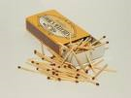
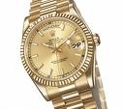
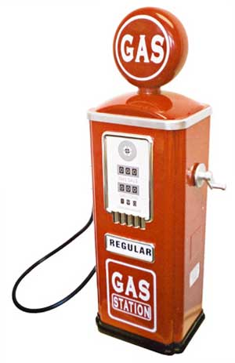
The Determinants of PED
Based on the determinants of PED, organize the items below along the spectrum of elasticity, from those which you believe have relatively inelastic demand to highly elastic demand.

Slide 5
Interpretation of PED
Answer the following questions based on the goods in the table on the previous slide.
Which products are the most inelastic?
What factors would most likely explain why salt is very inelastic?
Why would the demand for tooth picks be inelastic?
Although both short-run and long-run gasoline are both inelastic, why is short-run gasoline more inelastic than long-run gasoline?
What factors would likely explain why Chevrolet cars are very elastic?
Why would tires have unitary elasticity while gasoline is inelastic?

Slide 6
Interpretation of PED
Answer the following questions based on the goods in the table on the previous slide.
Which products are the most inelastic?
What factors would most likely explain why salt is very inelastic?
Why would the demand for tooth picks be inelastic?
Although both short-run and long-run gasoline are both inelastic, why is short-run gasoline more inelastic than long-run gasoline?
What factors would likely explain why Chevrolet cars are very elastic?
Why would tires have unitary elasticity while gasoline is inelastic?
1. [Inelastic goods = salt, matches, toothpicks, short-run airline travel, gasoline, residential natural gas, coffee, fish, tobacco, legal services, physician services, taxi service, automobiles]
2. [Salt is inelastic because there are no good substitutes, it is a necessity to most people, and it represents a small proportion of most people's budget.]
3. [Toothpicks are inelastic because they cost very little and represent a small percentage of a typical grocery budget and have few substitutes.]
4. [Short-run gasoline is more inelastic than long-run because in the short run, we have to buy gas to keep our car going. In the long run, we can switch to more fuel-efficient cars (including hybrid), ride the bus or walk more. But the short-run, less options are available.]
5. [Chevrolet cars would be very elastic because we don't have to buy that brand of car - we have lots of substitutes.]
6. [Even though tires are a want if we drive a car, the decision to buy them is not as immediate as buying gas (unless we have a flat and must buy one to get back on the road). You can shop around for the best price as there are a number of brands and stores that sell tires. You can buy new or used tires so you have some substitutes. So even though we think of tires as wants, there is a greater flexibility in buying tires than in buying gasoline. This contributes to the higher elasticity of tires over gasoline.]

Slide 7
Price Elasticity of Demand – definition and formula
PED has a negative value.
This reflects the law of demand
Whichever direction the price of good moves in, the quantity will always move in the other direction
Since PED will always be negative, we can refer to it in its absolute value. So, the PED for bananas is 0.4
Interpretation of the PED coefficient:
If PED is less than 1: | We say demand is inelastic. This means that the percentage change in the quantity is less than the percentage change in the price.
If PED is greater than 1 | We say that demand is elastic. The percentage change in the quantity is greater than the percentage change in the price.
If PED=0: | Demand is perfectly inelastic. There was no change in quantity resulting from the price change.
If PED=1: | Demand is unit elastic. The percentage change in the quantity was identical to the percentage change in the price.
If PED = infinity: | Demand is perfectly elastic. The smallest increase in price causes the quantity demanded to fall to ZERO.

Slide 8
Inelastic
Salt | 0.1
Matches | 0.1
Toothpicks | 0.1
Gasoline, short-run | 0.2
Gasoline, long-run | 0.7
Residential natural gas, short-run | 0.1
Residential natural gas, long-run | 0.5
Coffee | 0.25
Fish (cod) consumed at home | 0.5
Tobacco products, short-run | 0.45
Legal services, short-run | 0.4
Physician services | 0.6
Taxi, short-run | 0.6
Automobiles, long-run | 0.2
Approximately Unitary Elasticity
Movies | 0.9
Housing, owner occupied, long-run | 1.2
Shellfish, consumed at home | 0.9
Oysters, consumed at home | 1.1
Private education | 1.1
Tires, short-run | 0.9
Tires, long-run | 1.2
Radio and television receivers | 1.2
Highly Elastic
Restaurant meals | 2.3
Foreign travel, long-run | 4.0
Fresh green peas | 2.8
Chevrolet automobiles | 4.0
Fresh tomatoes | 4.6
Interpretation of PED
Demand for bananas was 0.4. Based on our interpretations of PED from the table on the previous slide, we know that demand for bananas is inelastic.
For every 1% increase in the price of bananas between $4 and $6, the quantity demanded fell by 0.4%.
Since price increased by a total of 50%, the quantity fell by a total of just 20%.
Consumers are relatively unresponsive to the price of bananas.
Study the tables on the right and try to determine what the goods in each category have in common.

Slide 9
Calculating Demand Elasticity
% Change in Qty. Demanded
-------------
% Change in Price
Price Elasticity
of Demand
=
Price Elasticity
of Demand
20%
--------
10%
=
=
2
Caution: best to use mid-point method to calculate % Δ

Slide 10
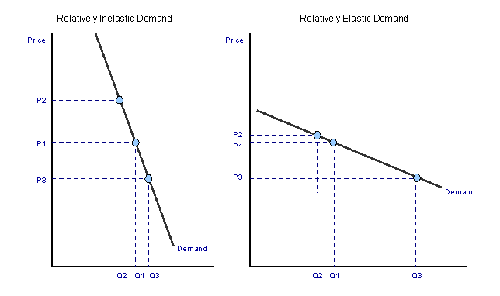
Degrees of Elasticity
E < 1.0 = Inelastic
E > 1.0 = Elastic

Slide 11
PED and the slope of the Demand Curve
PED and slope are different concepts.
Slope of a line measures the rise over the run, or in the demand curve the change in price over the change in quantity.
PED measures the percentage change in quantity over the percentage change in price.
However, by comparing the relative slopes of demand curves plotted on the same axis, we can determine the relative elasticity of different goods.
P
P
D₃
Cigarettes (D₁) and iPhones (D₂)
Heart transplants (D₃), Watermelons (D₄),
Movie Tickets (D₅)
P₂
P₁
P₁
D₄
P₂
D₂
D₁
D₅
Q₂
Q₂
Q₁
Q₃
Q₄
Q
Q₁
Q
Questions:
For which product is demand perfectly inelastic? Perfectly elastic? Closes to unit elastic?
What relationship exists between relative slopes of demand curves and elasticity?
What are two characteristics of cigarettes that make demand for them inelastic?
What are two characteristics of heart transplants that make demand perfectly inelastic?
What are the characteristics of a good for which demand is perfectly elastic?

Slide 12
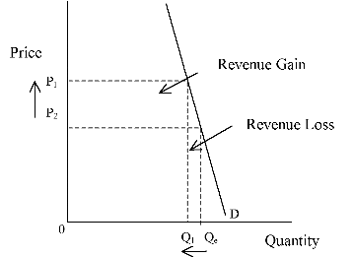
Elasticity and Revenue

Slide 13
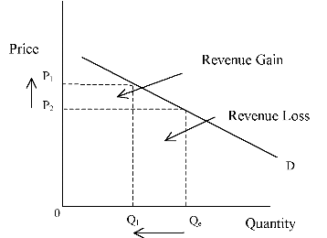
Elasticity and Revenue

Slide 14
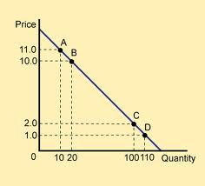
Elasticity Along a Linear Curve
7.0
0.1

Slide 15
Applications of PED
The PED formula is useful for more than just telling us how much consumers respond to price changes. It can be very useful to businesses and government decision making.
Applications of PED for
Businesses | Businesses benefit from knowing how responsive their consumers are to price changes at any given time. If a seller knows demand is HIGHLY elastic, he may wish to lower the price and capture many new customers. If a seller knows demand is highly inelastic, he may wish to raise his price as he will not lose many sellers but will enjoy higher revenues.
Gov. | The government needs to know how consumers will respond to taxes imposed on particular goods. For example, if the government wishes to raise revenues from taxing goods, it should know that: A tax on restaurant meals (relatively elastic) will not raise much revenue because people will just stop going to restaurants. A tax on cigarettes (relatively inelastic) will raise lots of revenue because most people will continue smoking and thus have to pay the tax.

Slide 16
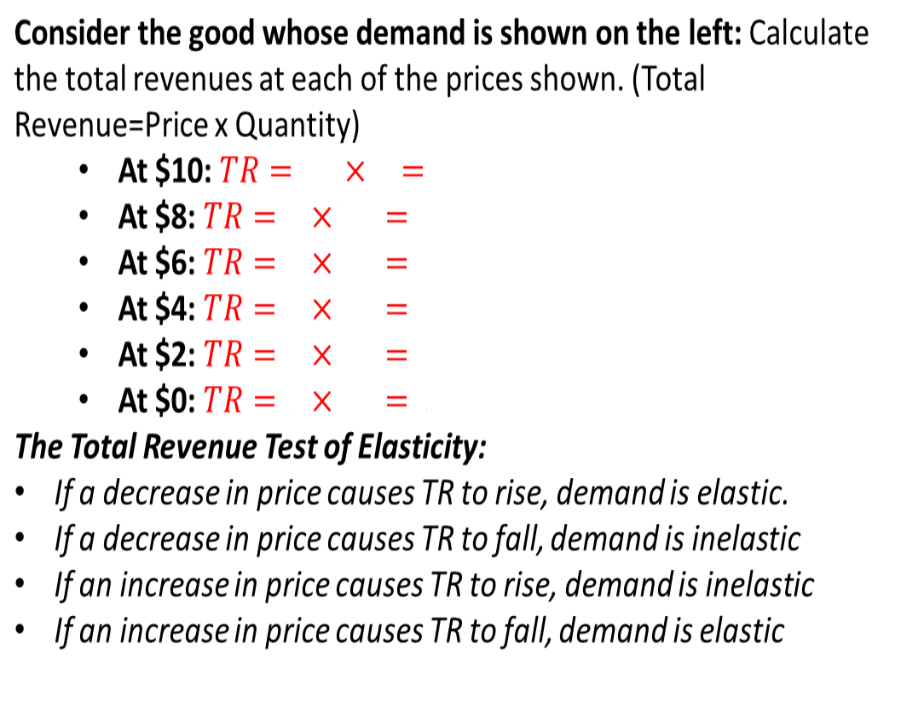
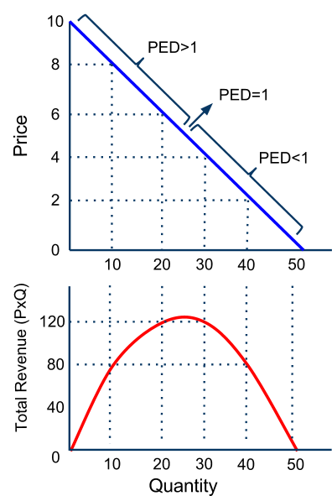
The Total Revenue Test of PED
A quick way to determine whether a demand is elastic or inelastic is to consider whether the revenues of sellers raises or falls as a result of a price change.
PED>1
PED=1
PED<1

Slide 17
Uplands sells bottled iced tea in the school store.
The drink has been so popular with the teachers and students that the store manager decides to raise the price to increase profits.
At rm1.25 per bottle, the store sold 600 bottles per week, after raising the price to rm1.50 per bottle, sales decreased to 400 bottles per week.
Complete the table below and use the revenue test to determine the price elasticity of demand.
Based on the change in total revenue, is demand for the iced tea elastic, unitary elastic or inelastic?
 | Price per Bottle | Quantity Sold | Total Revenue
Week 1
Week 2
What is the PED for the tea?

Slide 18
A private company operates a ferry service that transports commuters from Penang to Butterworth in approximately 10 minutes, which is less than half the time it takes for normal ferry service. The company charges rm5 per trip and has been serving an average of 6,000 passengers per day. In an attempt to increase profits, the management of the company decides to raise the price of to rm7 per trip. After the increase, ridership decreases to an average of 5,000 passengers per day.
Complete the table below and use the revenue test to determine the price elasticity of demand.
Based on the change in total revenue, is demand for the ferry service elastic, unitary elastic or inelastic?
What is the PED for the ferry service?
 | Price per Ride | Quantity Sold | Total Revenue
Week 1
Week 2

Slide 19
PED Discussion Questions
Why do buyers of some products respond to price increases by reducing their purchases more than the buyers of other products?
Why do higher market prices for some products cause producers to greatly increase their output while price rises for other products cause only limited increase in output?
Why does the demand for some products rise a great deal when household income increases while the demand for other products rises just a little?
Is PED for a particular good the same at all prices? Yes or no. If no, then why would PED change as the price changes?
Illustrate the concept of changing PED along a straight line demand curve.
How does the PED for a good affect the producer's decisions on how to set prices?

Slide 20
Cross Price Elasticity of Demand (XED)
Another type of elasticity measures the responsiveness of consumers of one good to a change in the price of a related good.
For Example: Consider apples and pears, two fruits that are close substitutes for one another.
How will demand for pears be affected by an increase in the price of apples?
XED tells us the percentage by which quantity of pears will change following a particular percentage change in the price of apples.
$$XED=\frac{Percentage change in the quantity of Good A}{Percentage change in the price of Good B} or..\frac{\%∆Q_{A}}{\%∆P_{B}}$$
Assume the following:
Apples go from $2 to $2.50
P1=$2, P2=$2.50
The quantity of pears rises from 30 to 50
Q1=30, Q2=50
$${XED}_{AP}=\frac{50−30}{30}÷\frac{2.5−2}{2}=\frac{0.67}{0.25}=2.7$$
Demand for pears is cross price elastic with apples (i.e. XED>1)

Slide 21
Cross Price Elasticity of Demand (XED)
Just like PED, the absolute value of XED can be:
0-1: Inelastic – Consumers of Good A are relatively unresponsive to a change in the price of Good B (the % change in Q_{A} will be smaller than the % change in P_{B})
1: Unit Elastic – Consumers of Good A will respond proportionally to a change in the price of Good B (the % change in Q_{A} will be the same as the % change in P_{B})
>1: Elastic – Consumers of Good A will be relatively responsive to a change in the price of Good B (the % change in Q_{A} will be greater than the % change in P_{B})
Complementary goods: The XED for complementary goods will always be NEGATIVE, because when the price of one complement goes up, the demand for the other will FALL.
Example: Price of hot dogs rises, the demand for hot dog buns will decrease. XED coefficient will be negative, reflecting the inverse relationship
Substitute goods: The XED for substitutes will always be POSITIVE, because when the price of one substitute goes up, the demand for the other will RISE.
Example: The price of beef rises, the demand for pork will rise. XED coefficient will be positive, reflecting the direct relationship

Slide 22
Income Elasticity of Demand (YED)
Another type of elasticity measures the responsiveness of consumers of a good to a change in the income.
For Example: Imagine a country is going into recession, so incomes of the average household are falling. Demand for new cars is falling, but demand for bicycles is rising. YED is a measure of how responsive consumers’ demand for bicycles and cars is to changes in their incomes.
$$XED=\frac{Percentage change in the quantity of a good}{Percentage change in consumers^{′}income} or..\frac{\%∆Q}{\%∆Y}$$
Assume the following:
Incomes in America have fallen by 4%
Bike sales have risen by 8%
Car sales have fallen by 3%
Calculate the YED for bicycles and cars
Y
$${YED}_{bikes}=\frac{8}{−4}=−2$$
$${YED}_{cars}=\frac{−3}{−4}=0.75$$
Notice that YED can be negative (bikes) OR positive (cars)
Demand for bikes is income elastic
Demand for cars is income inelastic

Slide 23
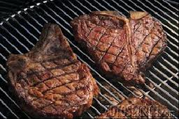
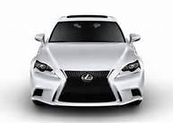
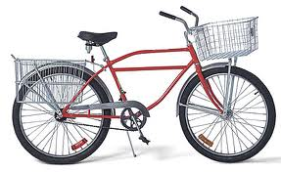
Income Elasticity of Demand (YED)
As with PED and XED, the absolute value of YED can be:
0-1: Inelastic – Demand for the good is relatively unresponsive to changes in consumer income (quantity will change by a smaller percentage than the change in income)
1: Unit Elastic – Demand for the good is proportionally responsive to income changes (quantity will change by the same percentage as the change in income)
>1: Elastic – Demand for the good is relatively responsive to changes in income (quantity will change by a larger percentage than consumers’ income)
Normal goods: A normal good is one with a POSITIVE YED coefficient. There is a direct relationship between income and demand.
Example: As incomes fell, car sales fell as well. If incomes were to rise, car sales would begin to rise. Cars are a normal good.
Inferior goods: An inferior good is one with a NEGATIVE YED coefficient. This is a good that people will buy more of as income falls, and less of as income rises.
Example: Bicycle transportation is an inferior good, because Americans demanded MORE bicycles as their incomes fell. If income were to rise, bicycle sales would begin to fall.

Slide 24
Price Elasticity of Supply (PES)
This is a measure of the responsiveness of producers to price changes. Since there is always a direct relationship between price and quantity supplied, the PES coefficient will always be positive. PES can be calculated using the same formula as the other types of elasticity:
$$PES=\frac{Percentage change in the quantity supplied}{Percentage change in the price} or..\frac{\%∆Q_{S}}{\%∆P}$$
PES in the short-run (1 week after price change) $${PES}_{SR}=\frac{1.1−1}{1}÷\frac{500−400}{400}$$ $$=\frac{0.1}{0.25}=0.4$$
PES in the long-run (3 months after price change) $${PES}_{LR}=\frac{2−1}{1}÷\frac{500−400}{400}$$ $$=\frac{1}{0.25}=4$$
PES will always be positive, since there is a direct relationship between the price of a good and the quantity firms wish to supply.
Consider the following:
The price of tablet computers rises from $400 to $500
In the week that follows, the quantity rises from 1 million to 1.1 million
In the three months that follow, the quantity rise from 1 million to 2 million

Slide 25
The Determinants of PES
The primary determinant of PES is the amount of time producers have to respond to a price change.
In the tablet computer market (previous slide), producers were relatively unresponsive to the rise in price in the one week following the price increase (PES equaled only 0.4)
After three months, producers had the time to increase their production to meet the higher demand, thus they were much more responsive (PES equaled 4)
Three time periods help determine PES:
MARKET PERIOD
Immediately after a change in price. Supply is highly inelastic, because firms cannot immediately produce more of a good. Sm in the graph.
SHORT-RUN
Firms can use their fixed capital more or less intensively, so supply is more slightly more elastic.. Ssr in the graph.
LONG-RUN
Firms have time to vary the amount of capital they use, so supply is highly elastic. In the long-run an increase in price will result in a much greater increase in Qs than in the market period or the short-run. Slr in the graph.
P
S_{m}
S_{sr}
S_{lr}
Q

Slide 26
The Determinants of PES and Applications of PES
In addition to the amount of time following a price change, the following help determine PES:
The mobility of resources: If resources (labor and capital) can be quickly put into or taken out of the production, supply tends to be more elastic. Generally, this applies to low-skilled manufactured goods, the supply of which is more elastic than high-tech, capital-intensive manufactured goods.
The ability to store stocks: If large inventories can be kept, producers can respond to price rises by drawing on those inventories to meet rising demand and to price declines by adding to inventories in response to falling demand. Goods which can be stored tend to have more elastic supply than perishable, non-storable goods.
Applications of PES: Similar to PED, a knowledge of PES can help businesses and the government better plan for the anticipated price changes to particular goods.
Business firms: If a producer expects the price of his product to change in the future, he will want to adjust his output accordingly. Being able to adjust output in a timely manner to price changes is key to maximizing a firm’s profits.
Government: A government must consider the PES for a good if it is considering intervening in the market for that good in any way. For example, if a government is considering imposing price controls (maximum or minimum prices) on an agricultural commodity, the PES should be considered so any changes in output resulting from the government controlled price can be anticipated.

