Slide 1
Supply & Demand

Slide 2
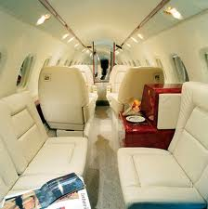
Wouldn’t it be nice to have your own jet?

Slide 3
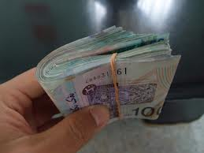
What is the Economic Concept of Demand?
Demand is not just wanting something…
It is “the desire to own something AND the ability to pay for it.”

Slide 4
A Demand Schedule
Price of m&m’s | Qty. Demanded
mr
mr
mr
mr
mr
mr
Individual Demand Schedule for packets of M&M’s

Slide 5
A Demand Schedule
Price of m&m’s | Qty. Demanded
mr
mr
mr
mr
mr
mr
Individual Demand Schedule for packets of M&M’s

Slide 6
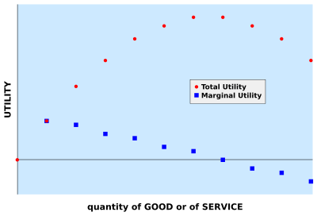
Law of Diminishing Marginal Utility

Slide 7
What is the Law of Demand?
When the price of a good or service is lower, consumers will buy more of it…
when the price is higher, consumers will buy less of it
INVERSE RELATIONSHIP BETWEEN PRICE AND QUANTITY DEMANDED

Slide 8
A Demand Schedule
Price of m&m’s | Qty. Demanded
mr
mr
mr
mr
mr
mr
Market Demand Schedule for packets of M&M’s

Slide 9
Concept of
Ceteris Paribus
“Other things being equal…”
When economists want to look at the effect of changing one variable on the quantity demanded, they need to hold other variables constant
In fact, this is usually impossible in the real word
But for the purposes of discussing economics, economists will assume other variables don’t change
In other words, they might ask “what would happen to the quantity demanded of SUVs if the price of gas increases by $1.00/gallon other things being equal?”

Slide 10
What are the Forces Driving Changes in Quantity Demanded?
i.e. movements along the demand curve
Substitution Effect
when the price of a good or service increases, people will switch to similar goods or services… and vice versa
Income Effect
when the price of a good or service increases, people have less purchasing power and will therefore buy fewer goods or services overall… and vice versa

Slide 11
A Demand Schedule
Demand Schedule for DVDs
Price of DVDs | Qty. Demanded Over One Year
mr30.00 | 0
mr25.00 | 1
mr20.00 | 3
mr15.00 | 6
mr10.00 | 10
mr5.00 | 15

Slide 12
A Demand Curve
Price of DVDs
Quantity of DVDs
Important terminology point: We call movements along the demand curve changes in quantity demanded NOT changes in demand – you will see why later

Slide 13
Changes in Demand
Price of DVDs
Quantity of DVDs
We call this a “change in demand” or a “shift in the demand curve”
Demand has increased at all prices, or the curve has “shifted to the right”

Slide 14
What are the Forces Driving Changes in Demand
i.e. shifts in the demand curve itself
Price of Substitutes – e.g. an increase in price of pork might increase the demand for beef, and vice versa
Price of Complements – e.g. an increase in the price of gas might decrease the demand for SUVs
Price of Complements
Personal Income – usually, when personal income goes up, people tend to spend more freely on a range of things *
Taste – e.g. popularity of coffee in China; demand for cigarettes as health effects become known; etc.
Population – important for looking a demand curves across a country or other group of people (“individual” vs. “market” demand curves)
Price of Complements
Expectations – if you believe prices are going up, you will probably buy more of something now; if there’s a sale coming, you will buy less and wait
Other – e.g. climate, age structure of population, income distribution, government policies, etc.

Slide 15
Again, remember the distinction between movements along the demand curve and changes in the demand curve!
change in price which increases the quantity demanded
shift in demand which increases the demand
P
P
Price of DVDs
Price of DVDs
P¹
Q
Q¹
Q
Q¹
Qty of DVDs
Qty of DVDs

Slide 16
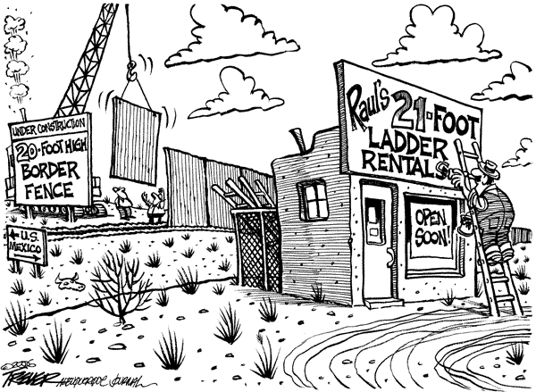
How Does This Relate?

Slide 17
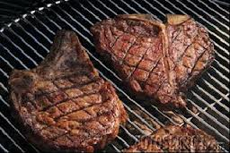
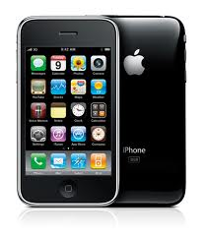
The General Rule
Normal Goods – these are things which we buy more of as their prices get lower and less as the price gets higher. Most goods are normal goods.

Slide 18
Exceptions to the General Rule
Giffen Goods – aka “inferior goods” these are things which we buy less of as our income increases, e.g. potatoes.
Price of Complements
Veblen Goods – these are things which we buy more of as their prices rises above a certain “snob appeal” threshold

Slide 19
What are Some inferior (Giffen) goods?

Slide 20
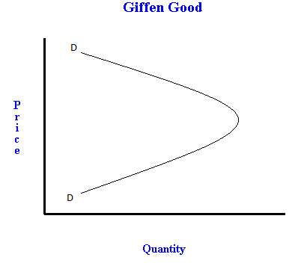
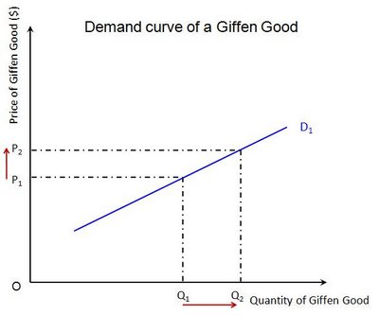

Slide 21
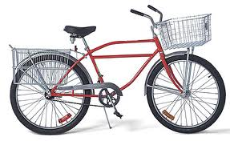
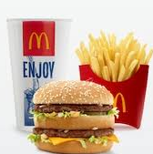
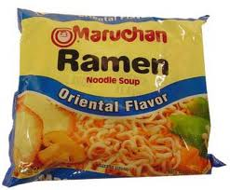
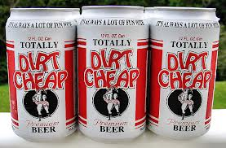
What are Some inferior (Giffen) goods?

Slide 22
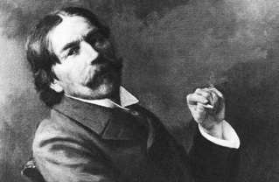
Thorstein Veblen
Veblen goods are named after him, he was a critic of capitalism and consumerism.
Affluenza is a term associated with people buying more and more for their social image.
Affluence + Influenza
D
PRICE ($)
“Snob value status’
D
QTY DEMANDED

Slide 23
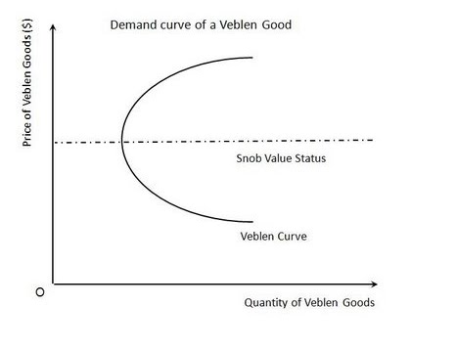

Slide 24
Veblen Goods

Slide 25
Veblen Goods

