Slide 1
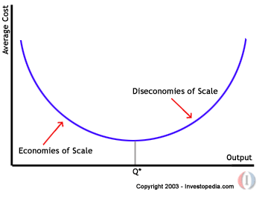
Costs of Production in the Long-run
Long-run is the variable plant period, meaning that firms can open up new plants, add capital to existing plants, or close plans and remove capital if need be.
Because capital and land are variable in the long-run, the law of diminishing returns no longer applies. As a firm’s output increases in the long-run, the firm’s ATC will initially decrease, but eventually increase, based on the following concepts…

Slide 2
Three ranges of a firm’s long-run Average Total Cost curve
Increasing Returns to Scale (Economies of scale): the range of plant size over which increasing output leads to lower and lower average total cost. As new plants open, ATC declines. WHY? ·better specialization, division of labor, bulk buying, lower interest on loans, lower per unit transport costs, larger and more efficient machines, etc...
Constant Returns to Scale: The minimum level of output a firm must achieve to achieve the lowest average total cost.
Decreasing Returns to Scale (Diseconomies of Scale): When a firm becomes "too big for its own good" it experiences diseconomies of scale. Continuing to add plants and increase output causes ATC to rise. WHY? Mostly due to control and communications problems, trying to coordinate production across a wide geographic may make firm less efficient. The best thing a firm experiencing diseconomies of scale can do is reduce its size or break into smaller firms.

Slide 3
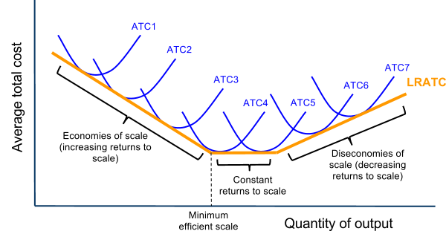
Costs of Production in the Long-run
The concept of economies of scale explain why a firm adding new plants and capital equipment to its production will become more efficient as it expands: Examine the long-run average total cost curve below (the orange line)

Slide 4
Revenues
Costs are only half the calculation a firm must make when determining its level of economic profits. A firm must also consider its revenues.
Revenues are the income the firm earns from the sale of its good.
Total Revenue = the price the good is selling for X the quantity sold
Average Revenue = The firm’s total revenue divided by the quantity sold, or simply the price of the good
Marginal Revenue = the change in total revenue resulting from an increase in output of one unit
Market Structure and Price Determination:
For some firms, the price it can sell additional units of output for never changes. These firms are known as “price-takers”, and sell their output in highly competitive markets
For firms, the price must be lowered to sell additional units of output. These firms are known as “price-makers” and have significant market power, selling their products in markets with less competition.

Slide 5
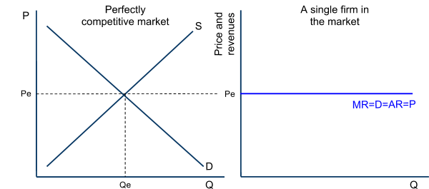
Revenues for a Perfect Competitor
A firm selling its product in a perfectly competitive market is a “price-taker”. This means the firm can sell as much output as it wants at the equilibrium price determined by the market.
The marginal revenue the firm faces, therefore, is equal to the price determined in the market.
The average revenue is also the price in the market.
The MR=AR=P line for a perfectly competitive firm also represents the demand for the individual firm’s product. Because a perfectly competitive seller is one of hundreds of firms selling an identical product, the firm cannot raise its price above that determined by the market.
Demand for the perfectly competitive firm’s output:
Demand is perfectly elastic
The firm has no price-making power.
The price in the market equals the firm’s marginal revenue and average revenue

Slide 6
Revenues for an Imperfect Competitor
A firm with a large share of the total sales in a particular market is a “price-maker”, because to sell more output, it must lower its prices. For this reason…
The marginal revenue the firm faces is less than the price at each level of output.
The average revenue is also the price in the market.
Because a firm with market power is selling a unique or differentiated product, it faces a downward sloping demand curve. Consider the data in the table below, which shows the price, total revenue and marginal revenue for an imperfectly competitive firm:
Quantity of output (Q) | Price (P) = Average Revenue (AR) | Total Revenue (TR) | Marginal Revenue (MR)
0 | 450 | 0 | -
1 | 400 | 400 | 400
2 | 350 | 700 | 300
3 | 300 | 900 | 200
4 | 250 | 1000 | 100
5 | 200 | 1000 | 0
6 | 150 | 900 | -100
7 | 100 | 700 | -200
8 | 50 | 400 | -300

Slide 7
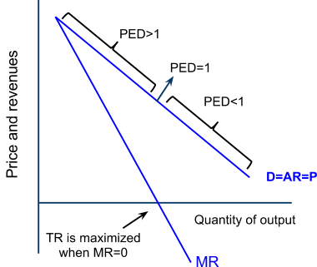
Revenues for an Imperfect Competitor
The firm whose revenues were in the table on the previous slide will see the following Demand, Average Revenue, Marginal Revenue and Total Revenue:
Points to notice about the imperfect competitor:
To sell more output, this firm must lower its price
As it sells more output, its MR falls faster than the price, so the MR curve is always below the Demand curve (except at an output of 1 unit, when MR=P)
The firm’s total revenues rise as its output increases, until the 6th unit, when the firm’s MR has become negative. MR is the change in TR, so when MR is negative, TR begins to fall.
The firm would never want to sell more than 5 units. This would cause the firm’s costs to rise while its revenues fall, meaning the firm’s profits would be shrinking.
The demand curve has an elastic range and an inelastic range, based on the total revenue test of elasticity

Slide 8
The Profit Maximization Rule
Considering its costs and revenues, a firm must decide how much output it should produce to maximize its economic profits.
Economic Profits = Total Revenues – Total Costs
Per-unit Profit = Average Revenue – Average Total Cost
The Profit-Maximizaton Rule: To maximize its total economic profits, a firm should produce at the level of output at which its marginal revenue equals its marginal cost
For a perfect competitor, the P=MR, so the profit-maximizing firm should produce where its MC=P.
For an imperfect competitor, the P>MR, so the profit-maximizing firm will produce at a quantity where its MC=MR.
Rationale for the MC=MR Rule: If a firm is producing at a point where its MR>MC, the firm’s total profits will rise if it continues to increase its output, since the additional revenue earned will exceed the additional costs. If a firm is producing at a point where MC>MR, the firm should reduce its output because the additional costs of the last units exceed the additional revenue.
When MC=MR, the firm’s total profits are maximized

Slide 9
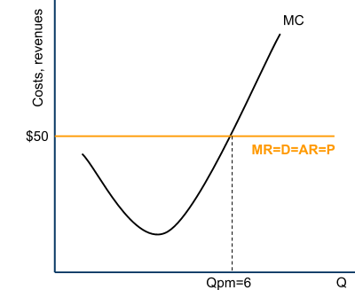
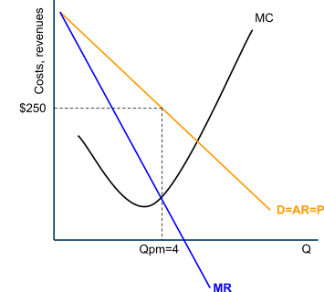
The Profit Maximization Rule .
The Profit-Maximizaton Rule: To maximize its total economic profits, a firm should produce at the level of output at which its marginal revenue equals its marginal cost
For a perfect competitor, the P=MR, so the profit-maximizing firm should produce where its MC=P.
For an imperfect competitor, the P>MR, so the profit-maximizing firm will produce at a quantity where its MC=MR.
Normal profit: the minimum level of profit needed just to keep an entrepreneur operating in his current market. If he does not earn normal profit, an entrepreneur will direct his skills towards another market.
Economic profit: also called “abnormal profits". When revenues exceed all costs and normal profit. Firms are attracted to industries where economic profits are being earned.
Perfectly Competitive Firm
Imperfectly Competitive Firm

Slide 10
Costs of Production Practice Questions
State the law of diminishing returns and explain how it affects a firm's short-run costs of production. (10 marks)
Explain the relationship in the short run between the marginal costs of a firm and its average total costs. (10 marks)

Slide 11
Costs of Production Practice Questions and Answers
State the law of diminishing returns and explain how it affects a firm's short-run costs of production. (10 marks)
The law of diminishing returns states that as more units of a variable resource (such as labor) are added to fixed resources, the amount of output attributable to additional units will eventually decline, due to the lack of tools and space available to additional workers. Assuming constant wages, a firm's short-run costs are inversely related to the output of its workers. As additional labor creates increasing marginal product, the firm's marginal costs will decline. When diminishing returns result in less additional output for each worker hired, the marginal cost to the firm of increasing output will begin to increase
.
Explain the relationship in the short run between the marginal costs of a firm and its average total costs. (10 marks)
The short-run refers to the "fixed-plant period" when capital and land are fixed and labor is the only variable resource. As output increases in the SR, marginal product of labor increases at first due to increased specialization, then diminishes as more labor is added to fixed land and capital. Marginal cost, which is the cost to the firm of the last unit produced, will fall as MP increases since the firm gets more output per dollar spent on inputs, then increases as MP decreases.
Average total cost, which is the cost per unit of output, will fall as long as the marginal cost is lower than the average. MC will eventually increase due to diminishing returns, and intersect ATC at its lowest point. When MC is higher than ATC, ATC will begin to rise since the last unit produced cost more to the firm than the average cost.

