Slide 1
Jan 2013 was 87 yen to the dollar
Jan 2014 is 104 yen to the dollar
200 yen for a glass of beer
150 yen for a bowl of edamame

Slide 2
Short-run versus Long-run Costs of Production
When examining a firm’s costs, we must consider two periods of time.
The short-run: The period of time in which firms can vary only the amount of labor and the raw materials it uses in its production. Capital and land resources are fixed, and cannot be varied.
Example: When the demand for American automobiles fell in the late 2000s, Ford and General Motors responded in the short-run by reducing the size of their workforces.
The long-run: The period of time over which firms can vary the quantities of all resources they use in production. The quantities of labor, capital and land resources can all be varied in the long-run.
Example: When demand for American automobiles remained weak for over two years, Ford and General Motors began closing factories and selling off their capital equipment to foreign car manufacturers.
Variable costs and fixed costs: A firm’s variable costs are those which change in the short-run as the firm changes its level of output. Fixed costs, on the other hand, remain constant as output varies in the short-run.
In the long-run, all costs are variable, since all resources can be varied…

Slide 3
Total Costs in the Short-run
A firm’s costs in the short-run can be either fixed or variable. The table below presents some of the primary costs a firm faces, and indicates whether they are fixed costs or variable costs.
Resource costs in the short-run
Fixed Costs in the short-run | Rent - the payment for land: Rent is fixed in the short-run since firms cannot add this resource to production. Rents must be paid regardless of the level of the firm's output.
 | Interest - the payment for capital: Interest is fixed in the short-run since firms cannot add this resource to production. Interest must be paid on loans regardless of the level of the firm's output.
Variable Costs in the short-run | Wages - the payment for labor: Wages are variable in the short-run, since firms can hire or fire workers to use existing land and capital resources. Wage costs increase when new workers are hired, and decrease when workers are laid off.
 | Transportation costs: Firms pay lower transport costs at lower levels of output.
 | Raw material costs: vary with the level of output
 | Manufactured inputs: fewer parts are needed from suppliers when a firm lowers output.

Slide 4
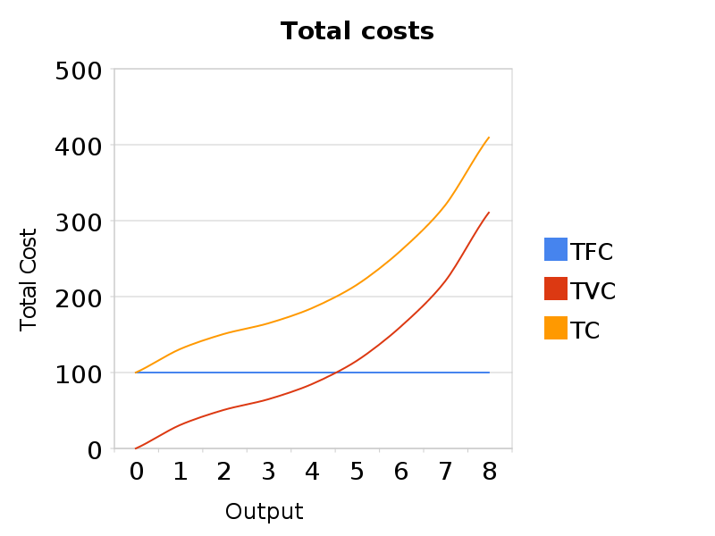
Total Costs in the Short-run
A firm’s total costs include the costs of labor (variable costs) and the costs of capital and land resources (fixed costs).
Total Costs in the Short-run
Total fixed costs (TFC): These are the costs a firm faces that do not vary with changes in short-run output. Could include rent on factory space, interest on capital (already acquired).
Total variable costs (TVC): These are the costs a firm faces which change with the level of output in the short-run. Could include payment for raw materials, fuel, power, transportation services, wages for workers, etc…
Total cost: TFC + TVC at each level of output
The firm above pays total fixed costs of $100.
Its TVC increases at a rate determined by the law of diminishing returns
Its total cost equal its TFC + TVC

Slide 5
Total Costs in the Short-run
A firm’s total costs include the costs of labor (variable costs) and the costs of capital and land resources (fixed costs).
Diminishing Returns and the short-run costs of production:
Notice that TC and TVC increase at a decreasing rate at first. This is when marginal product is increasing as more labor is employed (firms get "more for their money")
However, beyond some point, costs begin to increase at an increasing rate. This is where diminishing returns set in and MP is decreasing. The firm is getting less additional output from each worker hired, but must pay the same wages regardless. (The firm gets "less for its money")

Slide 6
Per-unit Costs in the Short-run
Firms make decisions about their levels of output based not on total costs, rather on per-unit and marginal costs.
Per-unit Costs in the Short-run
Average fixed cost: AFC=TFC/Q | AFC will decline as output rises, but it will never increase. This is because the fixed cost (which never goes up) is “spread out” as output increases. This is called “spreading the overhead”
Average variable cost: AVC = TVC/Q | For simplicity, we will assume that labor is the only variable input, the labor cost per unit of output is the AVC
Average total cost: ATC = TC/Q | Sometimes called unit cost or per unit cost. ATC also equals AFC + AVC
Marginal Cost: MC = ∆TVC/∆Q | The additional cost of producing one more unit of output.

Slide 7
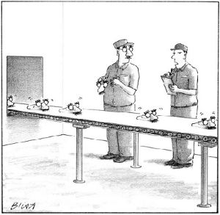
OUTPUT
The number of goods produced. E.g. if 1 car is produced it is 1 unit of output, if 100 cars are produced it is 100 units of output.

Slide 8
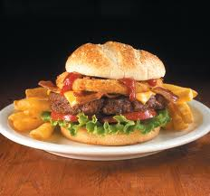
Productivity
This is the measure of the efficiency of the inputs in relation to the rate of output.
It is the measure of output per unit of input –
One burger maker produces 100 burgers : 100/1 is the productivity of labor = 100
Two burger makers make 300 burgers :
300/2 = 150

Slide 9
Production
This is the total output or quantity of goods and services produced
This involves the resources (factors of production) being inputs and transformed in some way to become goods and services
Production = productivity X output
Productivity = output/input

Slide 10
Determining Short-run Costs of Production
The primary determinant of a firm’s short-run production costs is the productivity of its short-run variable resources (primarily the labor the firm employs).
Productivity: The output produced per unit of input
The greater the average product of variable resources, the lower the average costs of production in the short-run
The lower the productivity of the variable resource, the higher the average costs of production
Since in the short-run, only labor and raw materials can be varied in quantity, LABOR IS THE PRIMARY VARIABLE RESOURCE…
Labor productivity in the short-run: As different amounts of labor are added to a fixed amount of capital, the productivity of labor will vary based on the law of diminishing returns, which states…
The Law of Diminishing Returns: As more and more of a variable resource (usually labor) is added to fixed resources (capital and land) towards production, the marginal product of the variable resource will increase until a certain point, beyond which marginal product declines.

Slide 11
Let’s play the game!

Slide 12
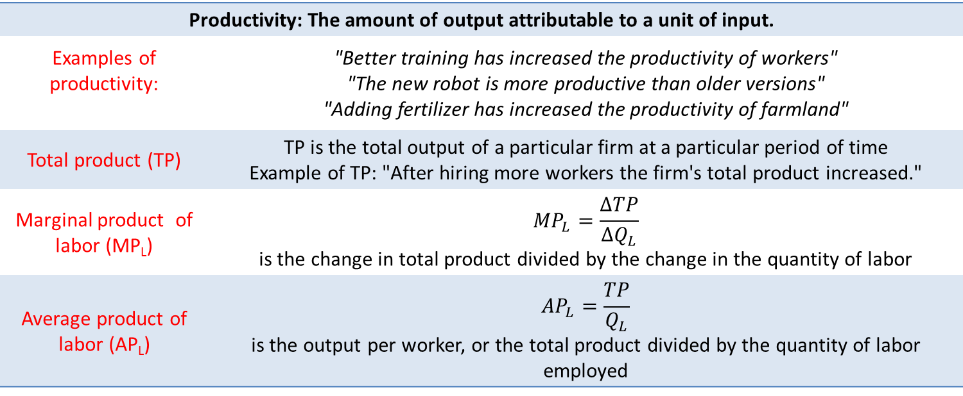
Productivity in the Short-run
The productivity of labor is the primary determinant of a firm’s short-run production costs. The table below presents some of the key measures of productivity we must consider when determining short-run costs.
Productivity: The amount of output attributable to a unit of input.
Examples of productivity: | "Better training has increased the productivity of workers" "The new robot is more productive than older versions" "Adding fertilizer has increased the productivity of farmland"
Total product (TP) | TP is the total output of a particular firm at a particular period of time Example of TP: "After hiring more workers the firm's total product increased."
Marginal product of labor (MP_{L})
Average product of labor (AP_{L})

Slide 13
Productivity in the Short-run
Assume a mint with three presses wishes to start making coins. To do so, it must hire workers. How many workers should the mint hire? That depends on the productivity of the labor as more workers are added to the three presses.
The table presents a realistic estimate of the productivity of labor in the short-run
Total product increases as more workers are hired, UNTIL the 8th worker, then total product decreases
Marginal product (the output contributed by the last worker hired) increases until the 4th worker, and then marginal product begins decreasing.
Average product (the output per worker) increases until the marginal product becomes lower than AP (at the 5th worker) and then begins decreasing.
The productivity of labor is at its greatest at around 3 or 4 workers, which means the mint’s average costs will be minimized when employing approximately 4 workers.
Quantity of labor (Q_{L}) | Total Product | Marginal Product | Average Product
0 | 0 | - | -
1 | 4 | 4 | 4
2 | 9 | 5 | 4.5
3 | 15 | 6 | 5
4 | 20 | 5 | 5
5 | 24 | 4 | 4.8
6 | 26 | 2 | 4.33
7 | 26 | 0 | 3.7
8 | 24 | -2 | 3

Slide 14
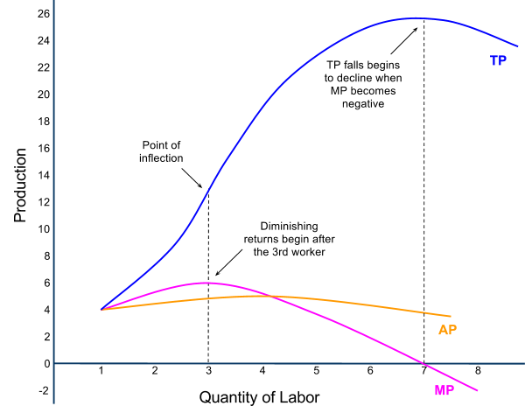
Productivity in the Short-run
The data from our productivity table can be plotted in a graph, with the quantity of labor on the horizontal axis and the total, marginal and average product on the vertical axis.
Key observations about short-run production relationships:
The MP is the rate of change in the TP. As MP is increasing, TP becomes steeper, but when MP decreases, TP becomes flatter. When MP becomes negative, TP begins decreasing.
MP intersects AP at its highest point. Whenever MP>AP, AP is increasing, but when MP<AP, AP is decreasing.
The mint begins experiencing diminishing marginal returns (the output of additional workers begins decreasing) after the third worker

Slide 15
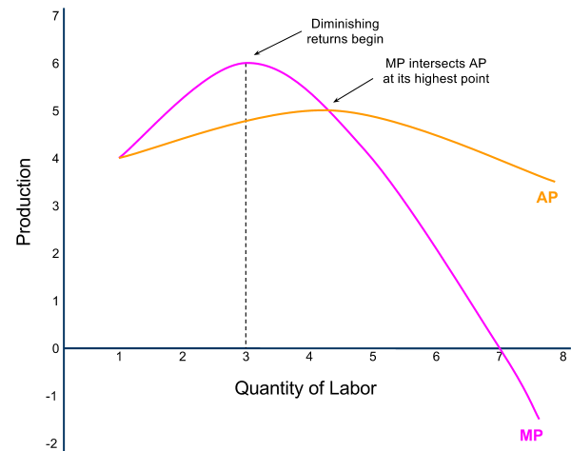
Productivity in the Short-run
If we look more closely at just the marginal product and average product curves, we can learn more about the relationship between these two production variables.
Explanation for diminishing returns:
With only three presses in the mint, the output attributable to the 4th – 8th worker becomes less and less.
This is because there is not enough capital to allow additional workers to continue to be more and more productive!
Up to the 5th worker, adding additional workers caused the average product to rise, since the marginal product was greater than the average.
But beyond the 5th worker, diminishing returns was causing marginal product to fall at such a rate that it was pulling average output down with it. Worker productivity declines rapidly after four workers.
A mint wanting to minimize costs will not hire more than four workers.

Slide 16
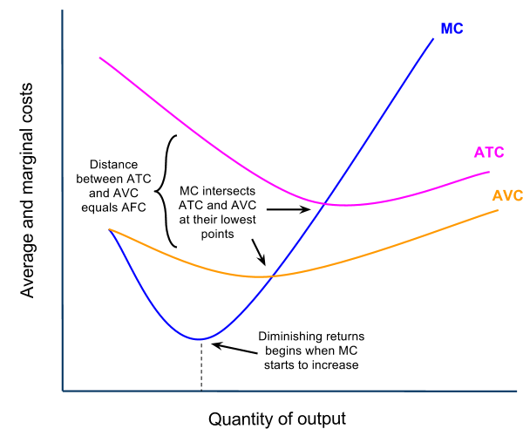
Graphing Per-unit Costs in the Short-run
The relationships between a firm’s short-run per unit costs are dictated by the law of diminishing marginal returns
Short-run Cost Relationships
ATC=AFC + AVC | The vertical distance between ATC and AVC equals the AFC at each level of output.
MC and ATC/AVC | MC intersects both AVC and ATC at their minimum. This is because if the last unit produced cost less than the average, then the average must be falling, and vis versa (just like your test scores!)
MC and diminishing returns | MC is at its minimum when MP is at its maximum, because beyond that point diminishing returns sets in and the firm starts getting less for its money!

Slide 17
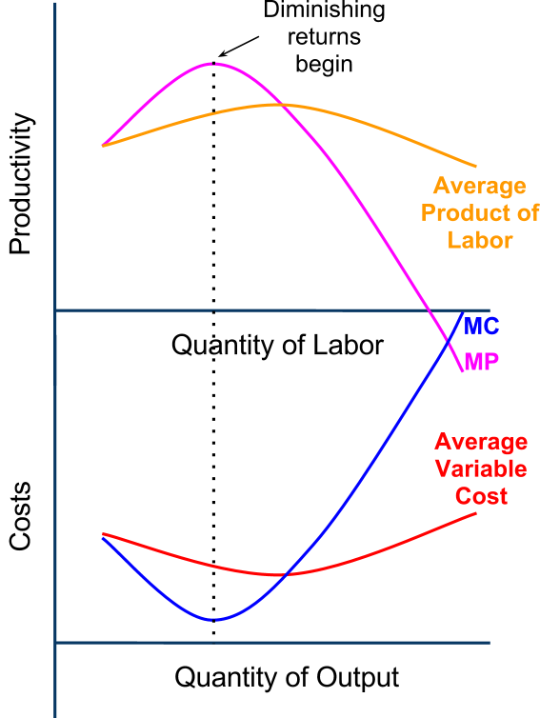
From Short-run Productivity to Short-run Costs
As worker productivity increases, firms get "more for their money", meaning per-unit and marginal cost decrease. When productivity decreases, costs increase.
The relationship between productivity and costs
When productivity of its workers is rising, a firm’s per unit costs are falling, since they're getting more output for each dollar spent on worker wages.
When marginal product is increasing (increasing returns) marginal cost is falling. When average product is rising, average variable cost is falling.
When MP and AP are maximized, MC and AVC are minimized
When workers begin experiencing diminishing returns, MP falls and MC begins to rise.
MP intersects average product at its highest point, and MC intersects average variable cost at its lowest point

