Slide 1
Introduction to Supply-side Policies
Demand-side policies have one major weakness: they are not effective at promoting long-run economic growth.
Supply-side policies increase productivity and reduce production costs, shifting AS outwards. Output increases and the average price level decreases
Supply-side policies: Measures undertaken by the government aimed at increasing the level of aggregate supply in a nation, and thereby meant to promote long-run economic growth. Examples include:
Lower business and income taxes
Elimination of a minimum wage
Reducing labor union power
Reducing unemployment benefits
Deregulation
Trade liberalization
Investments in human capital
Investments in physical capital
PL
LRAS
LRAS₁
SRAS
SRAS₁
P₁
P₂
Y_{fe}
Y_{fe1}
real GDP

Slide 2
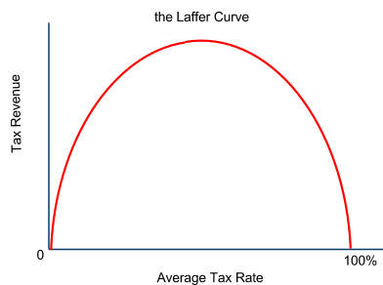
Supply-side Policies - Tax Reform
Reducing business and personal income taxes can positively impact aggregate supply in two ways:
Business taxes are a cost of production: Lowering taxes on firms reduces the cost of doing business. Allowing business owners to keep a larger share of their earned revenues should incentivize new investments in capital and technology, which increase the productivity of labor and reduce costs, shifting AS outwards.
Income taxes serve as a disincentive to work: One argument against high marginal income taxes on households goes that if you tax higher income at higher rates, households have a disincentive to work hard and earn higher incomes.
This theory argues that at a certain point, an increase in tax rates will lead to a decrease in tax revenues, if the tax rate is so high that less output is produced.
In contrast, if tax rates are lowered below this level, then tax revenues may actually increase.
The Laffer Curve: Shows the theoretical relationship between the tax rate and tax revenues. Commonly used to support the supply-side argument for lowering taxes

Slide 3
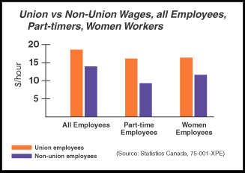
Supply-side Policies - Labor Market Reforms
Labor is the most important (and the most costly) resource for most nations' producers. Reforms of the labor market that bring down the cost of labor will increase a nation's aggregate supply and lead to growth in national output. Supply-side Labor Market Reforms include:
Reducing or eliminating the minimum wage: Minimum wage laws increase the cost of hiring workers in certain industries (typically the low- skilled sectors). Reducing or eliminating minimum wages may lead firms to hire more workers and thereby produce more output at a lower per unit cost
Reducing labor union power: Labor unions are organizations of workers in particular industries that negotiate with employers for better worker benefits, such as higher wages, more paid vacation, better health care and so on. Such benefits add to firms' production costs.
Reducing government spending on unemployment benefits: Reducing these benefits would create an incentive for unemployed workers to accept a new job more quickly and at a lower wage rate than they otherwise might accept.

Slide 4
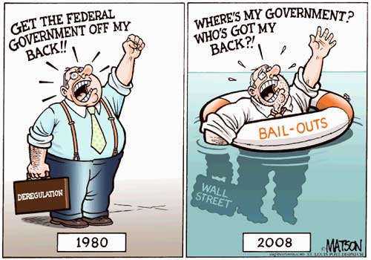
Supply-side Policies – Deregulation
The goals of regulation are often to reduce the impact of negative externalities arising from the production or consumption of certain goods.
Example: The United States Environmental Protection Agency is often accused of imposing harmful regulations on producers of good ranging from automobiles to electricity to agricultural products.
The benefit of environmental regulations is the reduced emissions of harmful toxins that affect human health and the environment.
The cost of environmental regulations is the impact they have on employment and the price level. Reducing them will lead to more output and lower prices in the regulated industries, however the tradeoff may be increased environmental degradation and reduced human health

Slide 5
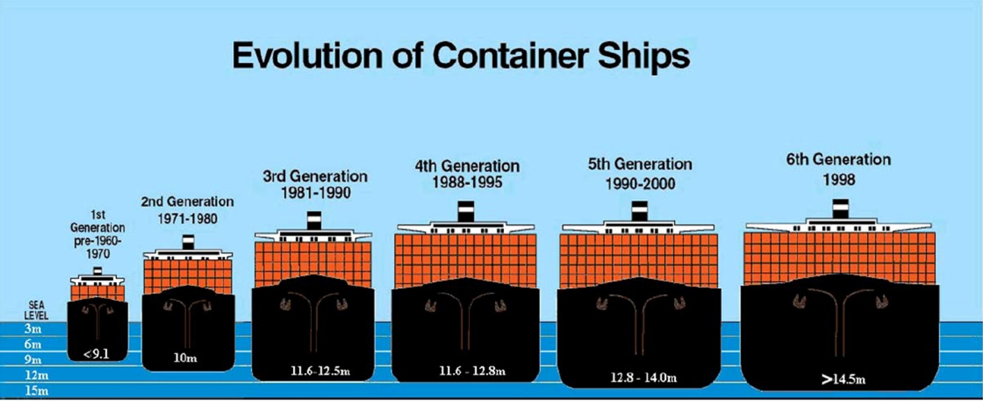
Supply-side Policies - Trade Liberalization
Protectionism: The use of tariffs, quotas or other measures aimed at making domestic producers more competitive with foreign producers by limiting the quantity of imports into the nation.
Tariffs: Taxes place on imported goods, services or resources
Quotas: A physical limit on the quantity of a good, service or resource that may be imported
The supply-side effects of trade liberalization:
Reducing protectionism will allow some producers in a nation to import raw materials and other imported factors of production more cheaply, lower their average production costs
More competition from foreign producers will force domestic firms to use their resources in a more efficient manner, since they will either have to reduce their production costs or lose out to foreign competition.
Both lower production costs and increased competition lead to an increase in the nation's aggregate supply and contribute to long-run economic growth.

Slide 6
Supply-side Policies - Investments in Human and Physical Capital
Education as a merit good: Because the benefits of having an educated population are social in nature, it is often up to the government to promote education through public schools.
A better educated workforce is more productive, and provides firms with higher skilled workers to produce more and better output
A better educated workforce will earn higher incomes and thus pay more in taxes, allowing government to earn more revenues with which it can provide other merit and public goods
Infrastructure as a public good: Due to the fact that is non-excludable, certain types of infrastructure (roads, sanitation, electricity grids, communication infrastructure) may need to be provided by the government
Better infrastructure reduces the costs for private businesses and allows them to operate more efficiently
Because private firms do not have to build their own roads or railways, they are able to produce and sell their products at lower costs. A modern, efficient infrastructure allows for AS to increase over time.

Slide 7
Evaluation of Supply-side Policies
A policy that increases aggregate supply appears to be overwhelmingly beneficial for a nation's economy.
The average price level of goods and services decreases, while...
Output increase, and...
Employment increases...
However, such policies are often difficult to undertake and may have some undesirable consequences:
Increased inequality:
Supply-side labor market reforms often result in lower incomes for the working class in a nation, as unemployment benefits, labor union power and minimum wages are all reduced.
Supply-side tax reforms may also redistribute the total burden of taxes in a nation away from the higher income earners and more onto the middle and lower income earners
Environmental concerns:
Decreased regulation of the private sector may lead firms to find new ways to externalize costs on third parties, often times meaning increased environmental damage
Political realities:
Increasing spending on education and infrastructure is often times politically difficult due to the fact that the payoff from such investments are often not seen for years or even decades, long after the members of the current government are out of office

