Slide 1
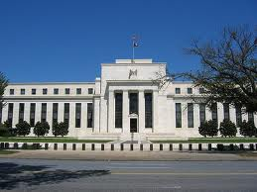
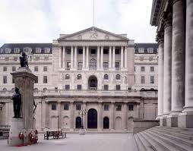
Introduction to Monetary Policy
Monetary Policy: A central bank’s manipulation of the money supply and interest rates in an economy aimed at stimulating or contracting aggregate demand to promote the achievement of the macroeconomic objectives of
Full employment, Economic growth, and most importantly to monetary policymakers, Price level stability
What is a Central Bank? A central bank is the institution in most modern, market economies that controls the overall supply of money in the nation’s economy. Most central banks act independently of the nation’s government and are in theory, insulated from political agendas and influence.
In the US: The Federal Reserve Bank
In the UK: The Bank of England
In China: The People’s Bank of China
In the Eurozone: The European Central Bank
In Switzerland: The Swiss National Bank
In Japan: The Bank of Japan

Slide 2
The Role of a Central Bank
Every major world economy has a central bank. Below is a snapshot of CB roles in the nation’s banking system and wider economy
Actions of Central Banks
Functions of the Federal/Central Reserve Bank | Issue currency: the central bank can inject new currency into the money supply by issuing Federal Reserve Notes (currency) to commercial banks to be loaned out to the public. Setting reserve requirements: this is the fraction of checking account balances that commercial banks must keep in their vaults. The larger the reserve requirement, the less money commercial banks can loan out. Lending money to banks: The central bank charges commercial banks interest on loans, this is called the "discount rate“ or base rate. Controlling the money supply: this in turn enables the Fed to influence interest rates.

Slide 3
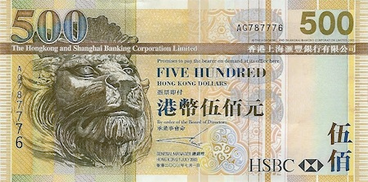
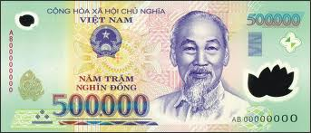
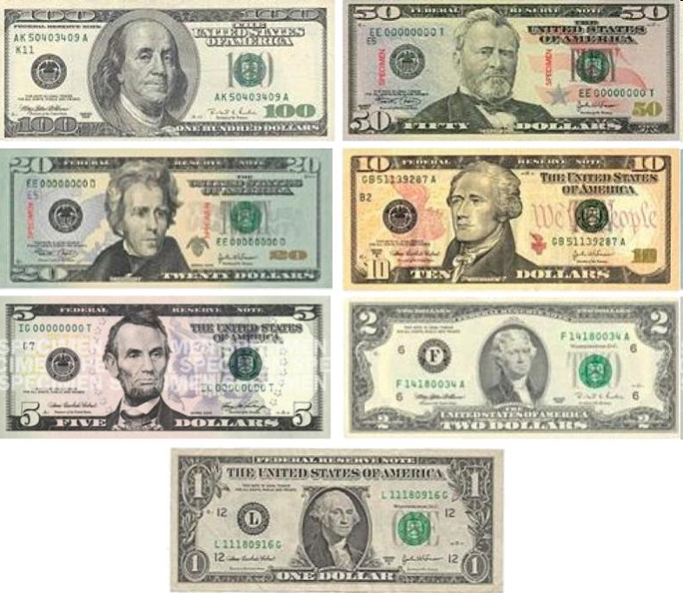
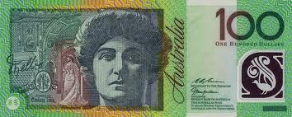
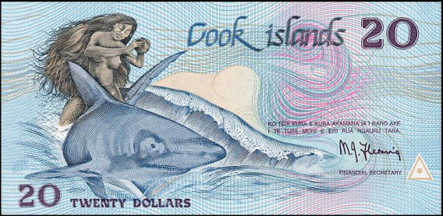
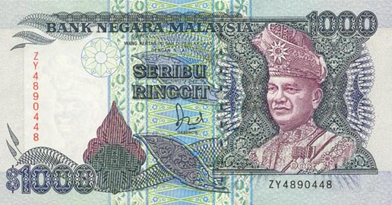
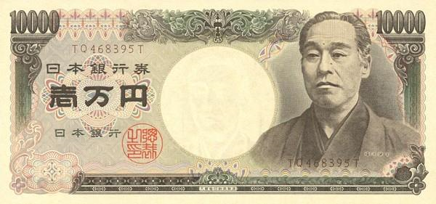
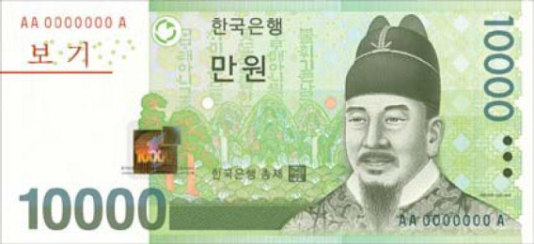
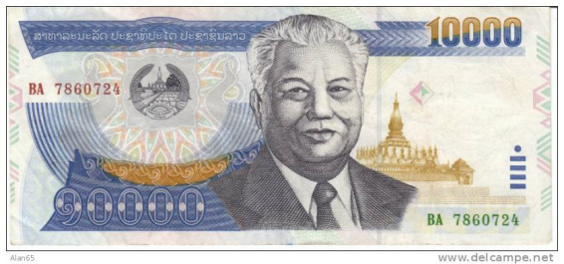
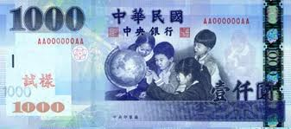
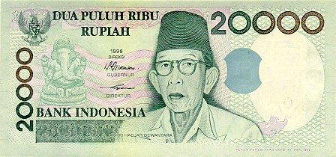
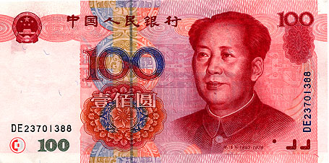
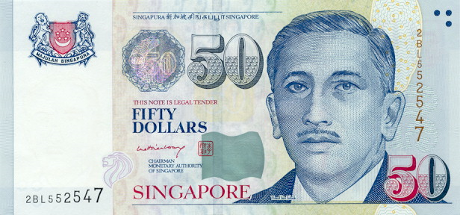
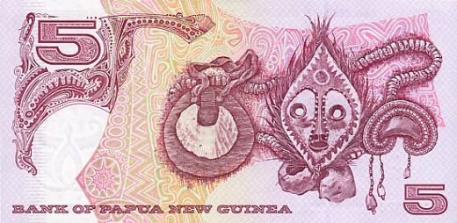
What is money?
Laos
Malaysia

Slide 4
Barter – what’s the problem
“Double Coincidence of Wants”
Notes:
Double coincidence of wants…
You have a pig to sell – need to find someone who wants it at the right price
You want to buy a TV – need to find someone who has it to sell at the right price
What are the chance of you finding both at once?
Barter = high level of self sufficiency and low level of voluntary trade
4

Slide 5
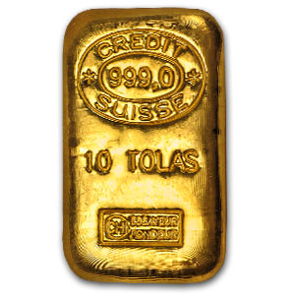
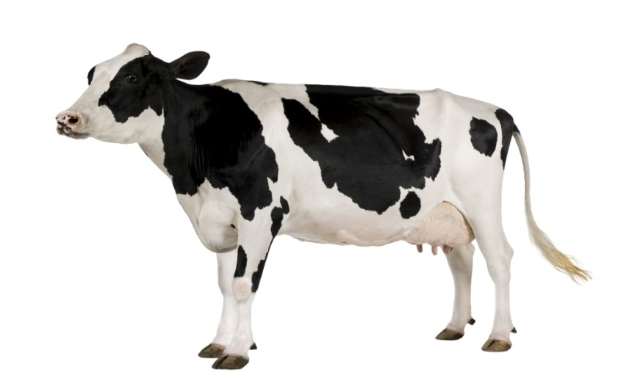
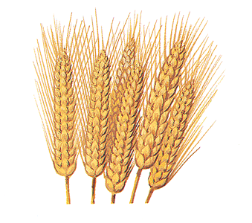
What do these things have in common?
Notes:
All have been used as money in the past
We call it “commodity money” because it consists of items which have intrinsic value (as a consumption item)
Cows
Salt
Bronze arrowheads
Wheat and barley
Cigarettes
Beaver Pelts
Gold / Silver / Copper (?)
Cowrie Shells (?)
5

Slide 6
Source of value
Commodity money; that which is a commodity, something traded, with value. Salt, cattle, stones, corn, etc. have all been commodity money
Representative money; that which is nothing of value, but represents value such as receipts, bills, checks, etc.
Fiat money; that which has value because the government decrees it to be acceptable.

Slide 7
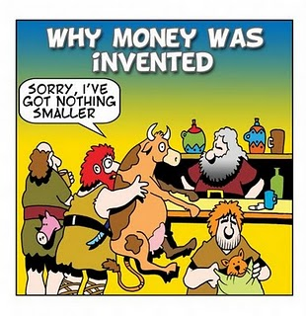
Sources of Value: Trade/Commodity
Notes:
Illustration of portability and divisibility problems….
Uniformity and durability are also issues here
Probably passes the acceptability and supply criteria
7

Slide 8
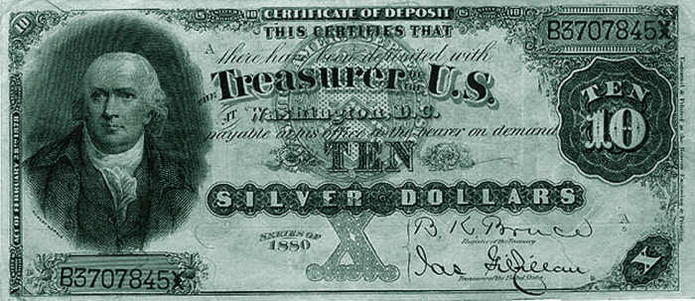
Sources of Value: Representative Money
Notes:
Early notes were simply certificates of claim on commodity money (silver)
In fact, they were rarely if ever exchanged for the underlying commodity
8

Slide 9
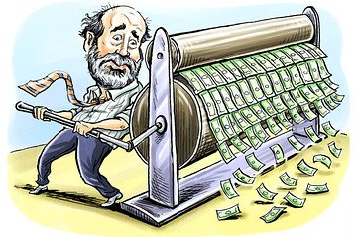
Sources of Value: Fiat Money
Notes:
Money by government decree
Government says it’s is legal tender to pay debts – if someone doesn’t accept, he can’t enforce the debt
Government says it’s good for payment of taxes
As long as there is trust in government to preserve the value, it can work
(predictable erosion of value is OK – you can manage it)
9

Slide 10
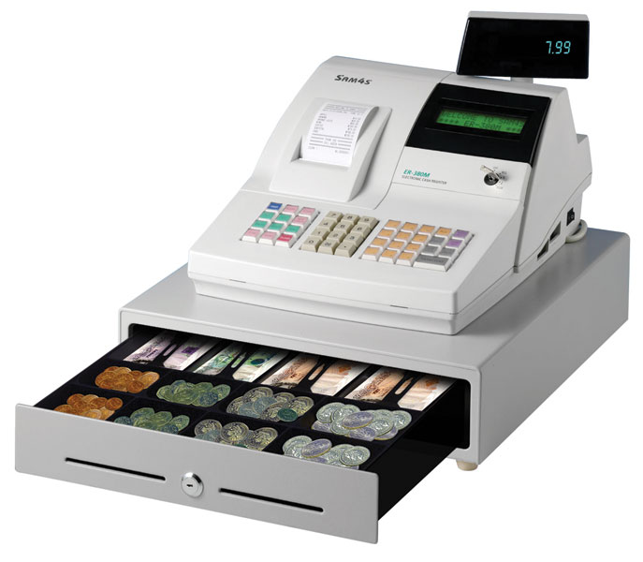
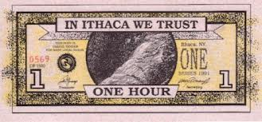
Four Uses of Money
Medium of Exchange
It is a medium of exchange. Money is valuable because it is accepted in buying and selling goods and services. Money makes trading easier than would be the case with bartering.
It is a store of value. Money is a way of storing wealth. For example, if you work today, you can get paid in money and wait to spend it in the future.
It is a standard for a deferred payment. Borrowers able to take it and pay it back later.
It is a measure of value. Money can be used to state how much things are worth. The value of goods and services can be expressed in money prices, allowing for easy comparison
Unit of Account
Standard for a deferred payment.
Store of Value
Notes:
Medium of Exchange - an item that buyers give to sellers when they want to purchase goods and services
“When you buy a shirt at a clothing store, the store gives you the shirt, and you give the store your money. This transfer of money from buyer to seller allows the transaction to take place. When you walk into a store, you are confident that the store will accept your money for the items it is selling because money is the commonly accepted medium of exchange.”
Unit of Account - the yardstick people use to post prices and record debts
“When you go shopping, you might observe that a shirt costs $20 and a hamburger costs $2. Even though it would be accurate to say that the price of a shirt is 10 hamburgers and the price of a hamburger is 1/10 of a shirt, prices are never quoted in this way. Similarly, if you take out a loan from a bank, the size of your future loan repayments will be measured in dollars, not in a quantity of goods and services. When we want to measure and record economic value, we use money as the unit of account.”
Store of Value - an item that people can use to transfer purchasing power from the present to the future
“When a seller accepts money today in exchange for a good or service, that seller can hold the money and become a buyer of another good or service at another time. Of course, money is not the only store of value in the economy, for a person can also transfer purchasing power from the present to the future by holding other assets. The term wealth is used to refer to the total of all stores of value, including both money and nonmonetary assets.”
Liquidity - the ease with which an asset can be converted into the economy’s medium of exchange
“Tradeoff between liquidity & effectiveness as a store of value. When people decide in what form to hold their wealth, they have to balance the liquidity of each possible asset against the asset’s usefulness as a store of value. Money is the most liquid asset, but it is far from perfect as a store of value.”
Three types of money (next)
10

Slide 11
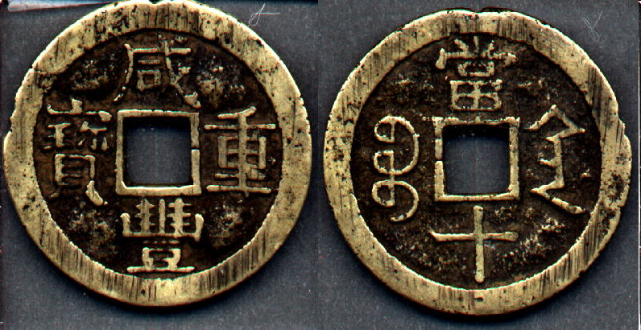
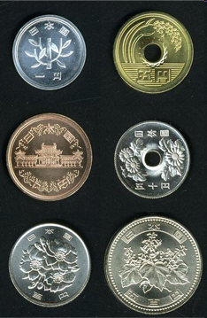
Six characteristics of Money
Durable; Made of something that is not easily destroyed.
Portable; Can easily take it with you when traveling
Divisible; Can be divided into smaller denominations

Slide 12
Notes:
Portability – no, but it didn’t matter to them
Divisibility – no, so could only be used for large transactions
Uniformity – no, but they seemed to know the relative value of the stones based on difficulty of bringing the stone to Yap
Durability – yes
Limited Supply – yes
Acceptability – yes, at that time
Story of stone that fell to the bottom of the sea – still in memory and still used as currency
Money as memory of contribution to society and claim on society
12

Slide 13
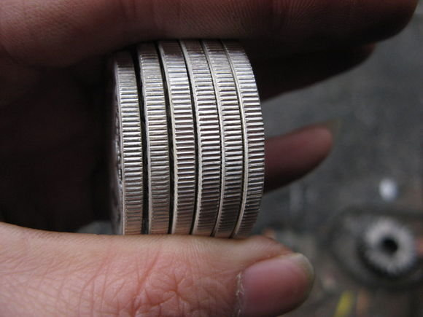
Notes:
Why are edges ribbed? To prevent “shaving” and thereby maintain uniformity
13

Slide 14
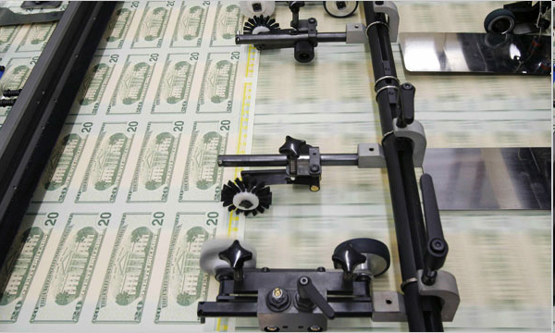
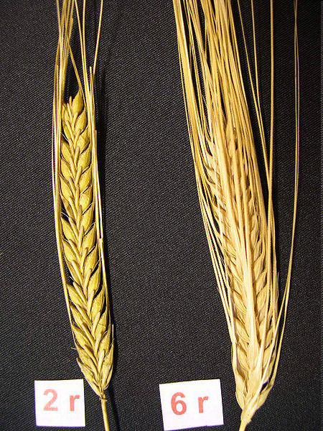
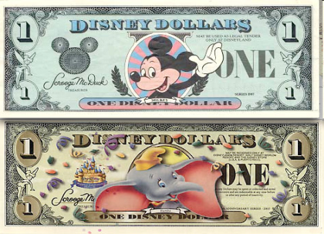
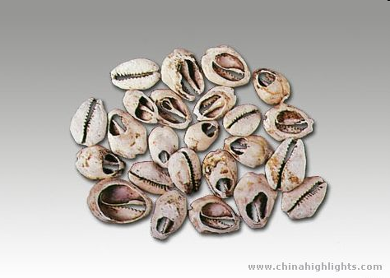
Six characteristics of Money
Uniform; any two units of the same value must be uniform or the same in what they buy. Size, color, and depictions help with uniformity
Limited; cannot be easily reproduced or collected
Acceptable; everyone must agree on the worth

Slide 15
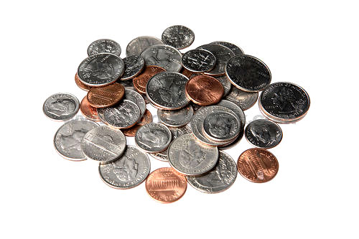
Pros and Cons
VS.
Notes:
Disadvantages of commodity money? Six ideal characteristics of money:
Portability – high value relative to weight & transport costs
Divisibility – easily divided into sub-units without each sub-unit losing value
Durability – it will last intact and doesn’t cost a lot to preserve it
Uniformity – fungible; every unit as good as the next (RIBBED EDGES)
Supply (limited, but not too limited) – can’t have too much but also can’t have too little
Acceptability – not easily counterfeited
15

Slide 16
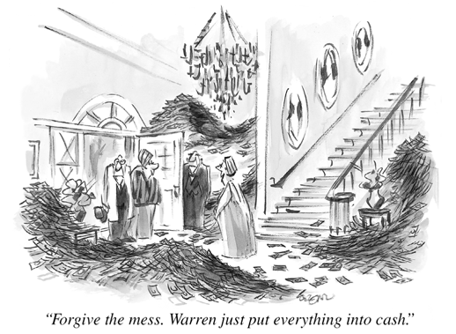
The Money Supply
The supply of money in a nation consists of more than just the bills and coins in people’s wallets, and there are less-liquid (i.e. immediately spendable) forms of money that are also part of the total money supply in an economy.
Types of Money, from most liquid to least liquid
M1 | Currency and checkable deposits, this is the most liquid form of money, what can be spent NOW All paper currency and coins placed in circulation by the central bank. Money in checking accounts is included in M1, since it can be spent almost as readily as currency and can easily be changed into currency.
M2 | M2 = M1 + some less liquid forms of money, including: Savings deposits and money market deposit accounts. Long-term deposits which can only be withdrawn after a certain period of time
M3 | M3 = M1+M2 + less liquid forms of money, including: Long-time deposits that require substantial penalties to withdraw before maturity Money market mutual funds, which include money invested in long-term government bonds and other relatively illiquid investments

Slide 17
The Demand for Money and Interest Rates
Money, like other assets, has a price. The price of money is the interest rate. Interest rates communicate two important pieces of information to savers and borrowers
To potential savers: The interest rate is the opportunity cost of holding money as an asset. If a households chooses to keep cash as an asset itself, what that households gives up is the interest rate the money could be earning in a bank. The interest rate is the price of holding onto money
At higher interest rates, the opportunity cost of holding money increases so the quantity demanded of money as an asset decreases as more households will wish to invest their money in banks and other institutions that offer a return on the investment
At lower interest rates, the opportunity cost of holding money decreases and the quantity of money demanded as an asset increases.
To potential borrowers: The interest rate is the cost of borrowing money. When a household or firm considers borrowing money to invest in a home or in capital, the interest rate is the percentage above and beyond the amount borrowed that must be repaid. It is the ‘price of money’.
At higher interest rates, the quantity demanded of money for by borrowers is lower since the cost of repaying the money borrowed is greater.
At lower interest rates, the quantity of money demanded by borrowers is greater because it is cheaper to pay back.
The Demand for Money is inversely related to the interest rate, thus slopes downwards

Slide 18
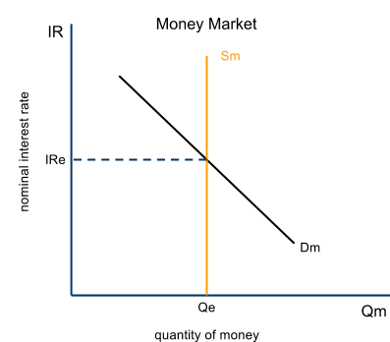
The Money Market
Since the interest rate is the ‘price of money’ and we have determined that there is also a supply of and demand for money in a nation, we can illustrate a money market by putting these variables together in a graph
Money Supply:
The supply of money (Sm) is vertical and determined by the monetary policies of the Central Bank.
Sm is perfectly inelastic, because central bankers do not respond to changes in the interest rate, rather they set the interest rate by controlling the money supply
Money Demand:
Money demand (Dm) slopes downwards because at lower interest rates, households and firms demand more money as an asset and for transactions.
Dm will SHIFT if there is a change in the total output of the nation. At higher levels of output, more money is demanded (Dm shifts right), and at lower levels of output, less money is demanded (Dm shifts left)

Slide 19
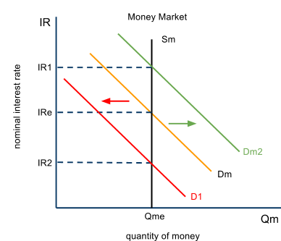
The Money Market – Changes in the Demand for Money
The demand for money is inversely related to the interest rate. A change in the interest rate will therefore cause a movement along the money demand curve. But if national output and income change (GDP), the entire money demand curve will shift
Increase in the Demand for Money:
If the nation’s GDP rises, more money is demanded since households are earning higher incomes and wish to consume more stuff.
An increase in demand for money (to Dm2), ceteris paribus makes it more scarce. Banks find they must raise interest rates as money demand rises.
Decrease in the Demand for Money:
If a nation goes into a recession, less money will be demanded since there is more unemployment, fewer workers to pay, and less demand for goods and services
Dm will shift left (to D1) and money becomes less scarce. Banks will lower interest rates to try and keep borrowers coming through the doors

Slide 20
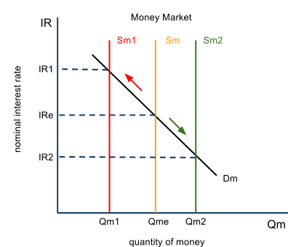
The Money Market – Changes in the Money Supply
If the supply of money changes, the equilibrium interest rate will change in the economy. Money supply changes result from monetary policy actions taken by the central bank.
Increase in the Money Supply:
An action by the central bank which causes the money supply to increase (from Sm to Sm2) will cause interest rates to fall
Banks have more money in their reserves, which they wish to loan out, so they will lower the rates they charge to attract more borrowers. Money becomes less scarce.
Known as an expansionary monetary policy
Decrease in the Money Supply:
An action by the central bank which causes the money supply to decrease (from Sm to Sm1) will cause interest rates to rise.
Banks have less money in their reserves, therefore have less to loan out. Money becomes more scarce and thus the cost of borrowing it rises.
Known as a contractionary monetary policy

Slide 21
Monetary Policy and Aggregate Demand
Two of the components of AD are interest sensitive, meaning they will change when the interest rate changes.
The demand for funds for investment and consumption is inversely related to the interest rate, therefore, higher interest rates will CONTRACT aggregate demand and lower interest rates will EXPAND aggregate demand
Consumption and interest rates: At higher interest rates, the level of consumption will fall because households will prefer to save their money rather than spend it. Also, some types of consumption is often financed with borrowed money (cars, durable goods, and so on), so consumers will choose to delay consumption.
Investment and interest rates: At higher rates, firms will choose to undertake fewer investments in new capital, since the expected rate of return on an investment is less likely to exceed the borrowing cost the higher the interest rate.
The Aggregate Demand Curve
Average Price level
P1
AD2
AD1
AD3
Y3
Y1
Y2
Real Gross Domestic Product (rGDP)

Slide 22
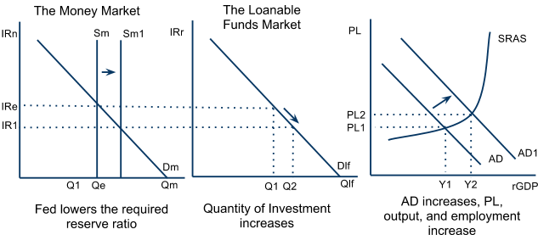
Expansionary Monetary Policy
Assume an economy is experiencing a demand-deficient recession. Unemployment is greater than the natural rate, there is deflation, and output is below the full employment level.
Assume the US Federal Reserve Bank increases the money supply:
As you can see above, an increase in the money supply will lead to lower interest rates,
which will lead to an increase in the quantity demanded of funds for investment and consumption,
stimulating AD and moving the economy back to full employment

Slide 23
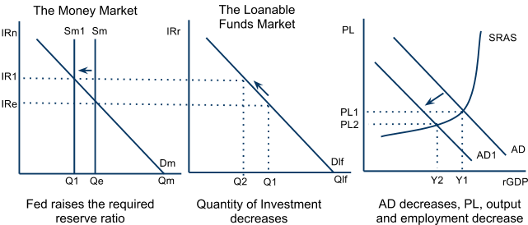
Contractionary Monetary Policy
Assume an economy is producing beyond its full employment level, meaning inflation is undesirably high, unemployment is below its natural rate, and the economy is overheating
Assume the US Federal Reserve Bank decreases the money supply:
A decrease in the supply of money will lead to higher interest rates,
which will lead to a decrease in the quantity of funds demanded for consumption and investment
Reducing AD and moving the economy back to full employment

Slide 24
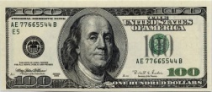
What Banks Do
PROJECTS
SAVINGS
10%
5%
($900K)
$9M Loans
$10M
Deposits
($500K)
Liabilities
Assets
$1M Reserves
$1M
Investment
Shareholder’s
Equity
Interest Spread = $400K
Notes:
Financial intermediation
Savers can lend directly to investors – this does happen in certain markets (equity, government bonds, corporate bond, 会 systems, etc.
Problem? 1) lenders lose liquidity, 2) lenders may not be skilled enough to lend to anything other than friends/neighbors or large, well known corporations/government
How do you get financing for smaller businesses?
Banks provide two services: credit assessment/enforcement; liquidity bridging (borrow short, lend long)
24

Slide 25
Fractional Reserve Banking and Monetary Policy
By accepting deposits from households, then lending out a proportion of those deposits to borrowers, which themselves end up being deposited and lent out again and again, banks create new money through their every-day activities.
Required Reserves: Commercial banks are required to keep a certain percentage, determined by the central bank, of their total deposits on reserve at all times. For example:
A reserve requirement of 20% would mean that a bank with total deposits equaling $1 million would have to keep $200,000 on reserve at the central bank. This money may NOT be loaned out by the commercial bank.
With the other $800,000, the bank can make loans and charge interest on those loans. The bank’s business model is to charge a higher interest rate to borrowers than it pays to households saving money with the bank.
Excess reserves: Actual reserves minus required reserves are called excess reserves. This is the proportion of total reserves that a bank is allowed to lend out.
Money Creation: Because banks can lend out their excess reserves banks can actually create new money whenever a deposit is made.

Slide 26
Fractional Reserve Banking
River
Bank
Blood
Bank
Cloud
Bank
Tyra
Bank
$100
$90
$81
$72.9
New
Deposits
Required
Reserves
$10
$9
$8.1
$90
$81
$72.9
Loanable
Funds
$90
$81
$72.9
Loan
Money Multiplier:
1/RR x Initial Deposit
Notes:
The banking systems “creates money” if money is defined broadly as potential spending power
The system doesn’t create wealth
Banks aren’t getting money for free – they are paying depositors for it, they are taking risk (credit, inflation, etc.)
Repayments contract money supply until money is relent
Note: banks don’t lend 100% of loanable funds; households don’t put 100% of their money in the bank
26

Slide 27
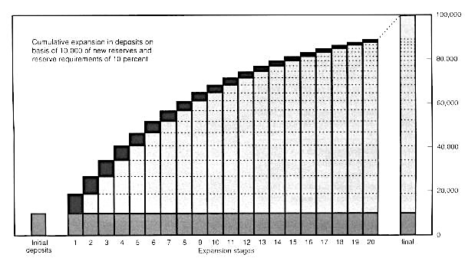
Fractional Reserve Banking
Notes:
Illustration of how $10K of “base money” can multiply into $100K of broad money (M2)
27

Slide 28
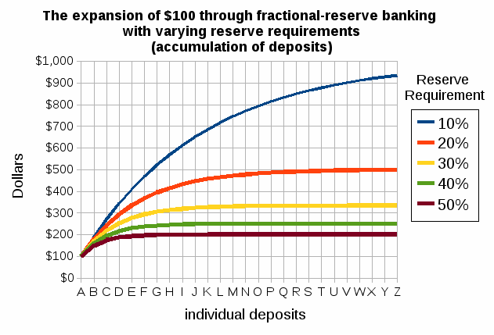
Reserve Ratios
The sledge hammer
Very rarely used
Increasing RRR => reduction in excess reserves => reduction in loans
Decreasing RRR => increase in excess reserves => potential increase in loans
Some countries, e.g. China, use RRR policy actively

Slide 29
Three Tools of Monetary Policy
Changing “Required Reserve Ratios” (RRR) for banks The percentage of their total deposits commercial banks must keep in reserve
Raising/lowering the “Discount Rate” This is the interest rate the central bank charges commercial banks for short-term loans.
Conducting “Open Market Operations” Government bonds (or securities) are held by every major commercial bank in the world.

Slide 30
The Relative Importance of the Three Monetary Policy Tools
The three tools outlined on the previous slides are called into action to varying degrees by the world's central banks. The most commonly used tool is open market operations, while reserve ratios and discount rates tend to be changes less frequently.
Relative Importance of the Monetary Policy Tools
Open Market Operations | Open-market operations is the buying and selling of government bonds in the financial market. Because it is the most flexible, bond holdings by the central bank can be adjusted daily, and have an immediate impact on banks' reserves and the supply of money in the economy
Reserve Ratio | The required reserve ratio is RARELY changed. RRR in the US has been .10 since 1992. Reserves held by the Central Bank earn little or no interest, so if RRR is raised, banks' profits suffer dramatically since they have to deposit more of their total reserves with the Fed where they earn almost no interest. Banks prefer to be able to lend out as much of their total reserves as possible
Discount Rate: | Until recently, the discount rate in the US was rarely adjusted on its own, and instead hovered slightly above the federal funds rate. In 2008, the US Fed lowered the discount rate to very low levels as uncertainty among commercial banks brought private lending to a halt. The "discount window" is only supposed to be used in the case of private lenders being unable to acquire funds, hence the Fed is the lender of last resort

Slide 31
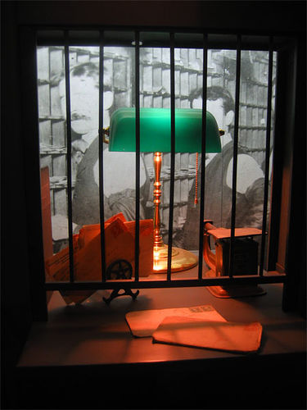
Discount Rate
“Discount Window lending” is the term for Fed’s program of emergency loans to banks
The interest rate on discount window lending = discount rate
Banks don’t like to borrow at the discount window – it implies they are in trouble and they pay a “penalty rate” of interest
So the rate doesn’t have much effect – it’s mostly for signaling central bank intentions (psychological)
Notes:
Current discount rate is 0.75% pa
Current fed funds rate is 0.25% pa
So, “penalty” is 0.50% pa

Slide 32
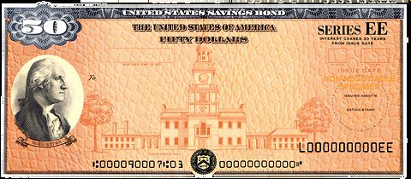
Open Market Operations
Day to day tool of monetary policy
Central Bank sells T-bonds to “soak up” money from the system
Central Bank buys T-bonds to “inject” money into the system
All this is done by changing bank reserves (base money) which then ripples through the system via the money multiplier process
Ultimate goal is to manage an interbank lending rate called the Federal Funds Rate (in the case of the US)
Notes:
Fed funds rate is the rate on overnight loans between banks (now at 0.25% pa)
Why do banks lend to each other overnight? Because some have excess reserves and don’t want them to sit around not earning interest while others have short falls and need cash to deposit into reserve accounts at Fed; typically, banks that collect deposits (smaller regional banks) have surpluses where banks that focus on loans (big NYC banks) have shortfalls.
When buying (selling) T-bonds, the Fed credits (debits) banks’ reserve accounts; that changes supply of reserves which then changes the Fed Funds rate.
Other short term rates are effected by Fed Funds rate
Long term rates (e.g. fixed mortgage rates) are not directly effected by the Fed Funds rate but that’s a more complicated subject
NOTE: the Fed doesn’t “set” the Fed Funds rate per se – it is freely negotiated between the banks – but it can guide it to where it wants via OMOs

Slide 33
M V = P Q
M; the supply of money in the economy
V; the velocity of money, or the number of times a year that the average dollar (monetary unit) is spent on final goods and services
P; the overall price level in the economy, reflecting the average price at which all output is sold
Q; the quantity of all goods and services produced; also known as real output

Slide 34
Expansionary Monetary Policy and the Federal Funds Rate
The following example illustrates how a central bank can target the federal funds rate and thus influence commercial interest rates in the economy
Assume Bank A finds at the end of the day that it has received more deposits than withdrawals, and it now has $1m more in its reserves than it is required to have. Bank A wants to lend that money out as soon as possible to earn interest on it.
Bank B, on the other hand, received more withdrawals than it did deposits during the day, and is $1m short of its required reserves at day’s end. Bank B can borrow Bank A’s excess reserves in order to meet its reserve requirement.
Bank A will not lend it for free, however, and the rate it charges is called the “federal funds” rate, since banks’ reserves are held predominantly by the Federal Reserve Bank (in the United States).
Funds at the regional Federal Reserve Bank ("federal funds") will be transferred from Bank A's account to Bank B's account. Both banks have now met their reserve requirements, and Bank A earns interest on its short-term loan to Bank B.
When the CB buys bonds, all banks experience an increase in their reserves, meaning the supply of federal funds increases, lowering the interest rate on federal funds.
Lower interest rates on overnight loans will encourage banks to be more generous in their lending activity, allowing them to lower the prime interest rate (the rate they charge their most credit-worthy borrowers), which in turn should have a downward effect on all other interest rates.

Slide 35
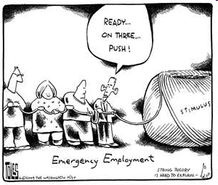
Pulling on a string
Monetary policy can act like a string. At times it is easy to pull in one direction to make changes (decrease money supply to reduce inflation) but other times its near impossible to push a string and make something move (low interest rate, but reluctant borrowers)

Slide 36
Expansionary Monetary Policies
An economy in recession is facing high unemployment and possibly deflation. If the central bank wishes to stimulate aggregate demand, it must increase the money supply. To do this it can:
Reduce the required reserve ratio (RRR):
Banks immediately see an increase in their excess reserves, giving them more money to loan out
The money multiplier increases, increasing the money creating ability of the banking system
At an RRR of 0.2, the multiplier=$\frac{1}{0.2}=5$
At an RRR of 0.1, the multiplier= $\frac{1}{0.1}=10$
Reduce the Discount Rate:
Commercial banks can borrow money more cheaply from the central bank, they will be willing to make more loans and borrow from the CB to make up any shortfalls in their required reserves
Expansionary Monetary Policy
S
S₁
Interest rate
5%
4%
D_{money}
Q₁
Q₂
Quantity of money
Buy bonds on the open market: An open market purchase of government bonds by the CB increases the amount of liquid money in the economy and leads to lower interest rates, more spending and more AD

Slide 37
Contractionary Monetary Policies
An economy facing demand-pull inflation with unnaturally low unemployment is over-heating. To bring inflation down, the central bank has the following policy tools at its disposal:
Increase the RRR:
Banks must call in some of their loans and make fewer loans to meet the higher reserve requirement
The money multiplier decreases, reducing the money creating ability of the commercial banks.
Raise the Discount Rate:
Commercial banks now find it more costly to borrower from the central bank. They will be less willing to make loans beyond their excess reserves, since a short-fall in required reserves will be more costly to make up with funds borrowed from the CB
Sell bonds on the open market : An open market sale of government bonds by the CB reduces the amount of liquid money in the economy and leads to higher interest rates, less spending and a decrease in AD
Contractionary Monetary Policy
S₁
S
6%
Interest rate
5%
D_{money}
Q₂
Q₁
Quantity of money

Slide 38
Evaluating Monetary Policy
To determine the likely effect of a particular monetary policy at stabilizing prices levels or reducing unemployment, several factors must be considered.
Factors that may limit the effectiveness of Monetary Policy
The degree of inflation: | In periods of extremely high inflation, it is unlikely that a contractionary monetary policy alone will be adequate to bring inflation under control. The expectation of high inflation creates a strong incentive among households and firms to spend money in the present rather than waiting till the future, when prices are expected to be higher. A substantial increase in interest rates (to a level higher than the expected inflation rate) would be required to reign in present spending reduce aggregate demand Contractionary fiscal policy (higher taxes, reduced government spending) may be needed to support higher interest rates during periods of high inflation
The depth of the recession: | In periods of weak demand, high unemployment and deflation, it is unlikely that an expansionary monetary policy alone will be adequate to bring an economy back to full employment When private spending (consumption and investment) are deeply depressed, a decrease in interest rates may not be enough to stimulate spending and AD With the expectation of future deflation, the private sector has a strong incentive to save, since money saved now will be worth more in the future. Expansionary fiscal policy may be needed to reinforce the decrease in interest rates to boost demand to its full employment level.

Slide 39
Evaluation – Arguments Against
Policy Achieves…. But risks……..
Inflation
Exp. Monetary
Policy
Increased Growth and Reduced Unemployment
Lower Exchange Rate
- Higher Import Prices
Lower Growth and Higher Unemployment
Contract. Monetary Policy
Reduced Inflation
Higher Exchange Rate – Reduced Exports

Slide 40
Evaluating Monetary Policy – Supply-side Effects
While monetary policy is generally considered a demand-side policy (since changes in interest rates directly effect investment, a component of AD), it can also have supply-side effects that should be considered.
PL
LRAS
LRAS₁
Consider the economy to the right:
Assume the central bank lowers interest rates to stimulate AD.
Lower interest rates lead to more investment and consumption, so AD increases.
More investment leads to an increase in the nation’s capital stock
More capital makes labor more productive and reduces production costs over time, increasing SRAS and LRAS (to Y_{fe1})
SRAS
SRAS₁
P_{e}
AD₁
AD
Y₁
Y_{fe}
Y_{fe1}
real GDP
If the economic conditions are right (e.g. firms are willing to invest), expansionary monetary policy can contribute to long-run economic growth!

