Slide 1
Introduction to Fiscal Policy
Fiscal Policy: Changes in the level of government spending and taxation aimed at either increasing or decreasing the level of aggregate demand in an economy to promote the macroeconomic objectives. Fiscal policy is a type of demand-side policy
Economy A) An economy producing at full-employment is not in need of any fiscal policy actions, however…
Economy B) An economy in a recession could benefit from expansionary demand-side policies that increase AD and therefore employment and output closer to the full employment level.
Economy C) If AD is too high and has high inflation an economy could benefit from contractionary demand-side policies that reduce AD.
PL
LRAS
SRAS
A)
P_{e}
AD
Y_{fe}
LRAS
real GDP
PL
SRAS
PL
LRAS
SRAS
B)
P_{e}
C)
P_{e}
AD
AD
Y₁
Y₁
real GDP
real GDP

Slide 2
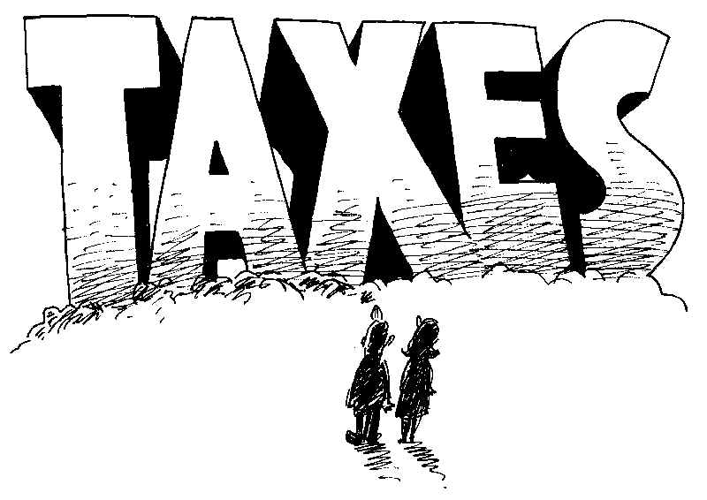
The Government Budget – Sources of Revenue
Tax revenues: A government’s primary source of revenues is through the collection of taxes.
Direct taxes: Taxes on incomes earned by households and firms. These are usually progressive in nature, meaning that the percentage paid increases as income increases, or proportional, meaning that all individuals (or firms) pay the same percentage no matter what their income.
Indirect taxes: Taxes on consumption are indirect, meaning they are actually paid by the sellers of goods, but they are born by both producers and consumers.
Other sources of revenue: To a lesser extent, a government may earn revenue from:
The privatization of state-owned enterprises to private sector investors
The sale of goods and services,
The sale of government property
Nationalized (public) firms that earn a profit

Slide 3
The Government Budget – Types of Expenditures
While a government’s revenues come from the taxes it collects. Its expenditure depend on the goods and services the government provides the nation. Government expenditures include:
Current Expenditures: This is the day to day cost of running the government. The wages and salaries of public employees, including local, state and national government, such as police, teachers, legislatures, military servicemen, judges, etc…
Capital Expenditures: These are investments made by the government in capital equipment and infrastructure, such as money spent on roads, bridges, schools, hospitals, military equipment, courthouses, etc...
Transfer payments: This type of government spending does not contribute to GDP (unlike those above), because income is only transferred from one group of people to another in the nation. Includes welfare and unemployment benefits, subsidies to producers and consumers, etc… Money transferred by the government from one group to another, without going towards the provision of an actual good or service.

Slide 4
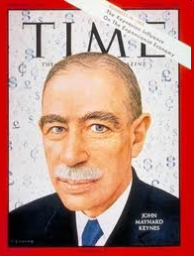
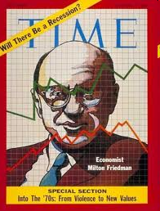
Fiscal Policy and the Economy
The total level of government spending can be changed to help increase or decrease the output of the economy.
Expansionary Policies
Fiscal policies that try to increase output are known as expansionary policies.
Contractionary Policies
Fiscal policies intended to decrease output are called Contractionary policies.

Slide 5
The Government Budget – Surpluses and Deficits
In a particular year, a government’s budget can either be balanced, in surplus or in deficit.
A balanced budget: A government’s budget is in balance if its expenditures in a year equals its tax revenues for that year. A balanced budget will have no net effect on aggregate demand since the leakages (taxes collected) equal the injection (expenditures made).
A budget surplus: If, in a year, the government collects MORE in taxes than it spends, the budget is in surplus. A surplus may sound like a good thing, but in fact the net effect of a budget surplus on AD is negative, since leakages exceed injections. A budget surplus will reduce the national debt.
A budget deficit: If a government’s expenditure in a year a greater than the tax revenue it collects, the government’s budget is in deficit. A deficit has a positive net effect on AD, since injections exceed leakages from the government sector. A budget deficit will add to the national debt.
The national debt: A nation’s debt is the sum of all its past deficit minus its past surpluses. If this number is negative, then it means the government has borrowed money over the years to finance its deficits that it has not paid back through accumulated surpluses
Debt Clocks

Slide 6
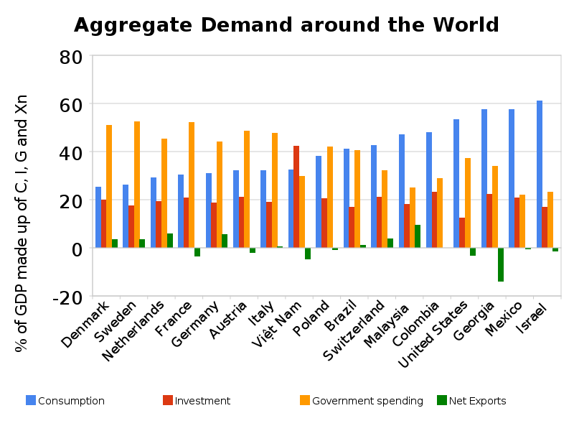
The Role of Fiscal Policy
A size of the government sector relative to a nation’s economy varies greatly between countries.
Government spending as a proportion of total AD: Study the chart to the right.
Notice that government spending is the largest component of GDP for the countries on the left, and
A much smaller component of GDP for the countries on the right.
In a country where government spending is a larger component, the impact of fiscal policy can be greater than where it is a smaller proportion of GDP
Fiscal policy provides government with a tool for managing the level of AD through changes in taxation and government spending

Slide 7
The Role of Fiscal Policy – During a Recession
If an economy has experienced a fall in aggregate demand, it might be in a demand-deficient recession.
Assume an economy is experiencing a recessionary gap as seen here:
Private spending in the economy has fallen (C, I or Xn)
To make up the gap, the government can attempt to use expansionary fiscal policies. These include:
A reduction in taxes, and / or
An increase in government spending
The size of the tax cut or increase in government spending needed depends on two factors:
The size of the recessionary gap, and
The size of the spending multiplier
LRAS
SRAS
PL
P_{fe}
P₂
AD₁
AD₂
Y₂
Y_{fe}
real GDP
Recessionary Gap

Slide 8
The Role of Fiscal Policy – During a Recession
Determining the size of a tax cut or of an increase in government spending depends on the size of the recessionary gap and the size of the spending multiplier
Study the graph:
The economy in the left is producing a level of output $500 million below its full employment level.
Assume the marginal propensity to consume (MPC) equals 0.75
The government wishes to stimulate spending by enough to return the economy to full employment
How much would government spending have to increase by to increase AD back to full employment?
How much would the government have to reduce taxes by to increase AD back to full employment?
LRAS
SRAS
PL
P_{fe}
P₂
AD₁
$500 million
AD₂
Y₂
Y_{fe}
real GDP
$$Spending Multiplier=\frac{1}{1−MPC}$$
$$Tax multiplier=\frac{−MPC}{MRL (or MPS)}$$

Slide 9
Expansionary Fiscal Policy - Tax Cuts versus Spending Increases
With a $500 million gap between its current output and its full employment output, and with an MPC of 0.75:
How much would government spending have to increase by to increase AD by $500 million?
$$Spending Multiplier=\frac{1}{1−MPC}=\frac{1}{1−0.75}=4$$
Desired change in total spending = $500 million.
Needed change in government spending =$\frac{desired change in AD}{the spending multiplier}=\frac{500 m}{4}=\$125 million$
A $125 million increase in government spending should stimulate total demand in the economy by $500 million and shift AD back to its full employment level
How much would the government have to reduce taxes by to increase AD by $500 million?
$$Tax multiplier=\frac{−MPC}{MRL (or MPS)}=\frac{−0.75}{0.25}=−3$$
Desired change in total spending = $500 million
Needed change in taxes =$\frac{desired change in AD}{the tax multiplier}=\frac{500 m}{−3}=−\$167 million$
A $167 million decrease in taxes is needed to stimulate total demand by $500 million

Slide 10
Expansionary Fiscal Policy – Impact on Deficits and Debt
To achieve a particular increase in AD, taxes would have to be CUT by more than spending would have to INCREASE. There is a reason for this:
A tax cut is an INDIRECT injection into the nation’s economy.
A tax cut increases the disposable incomes of households
Higher disposable incomes leads to more consumption, but also increases savings and imports, both leakages.
The actual increase in spending, therefore, is less than if the government were to increase AD directly through new government spending.
Fiscal stimulus (both tax cuts and spending increases) lead to a budget deficit
Assuming a government started with a balanced budget, if it wanted to stimulate AD, the government would have to incur a deficit.
A tax cut will require the government incurs a LARGER deficit in order to stimulate AD by a certain amount than a spending increase.

Slide 11
Expansionary Fiscal Policy – Illustrating the effect
The impact of a tax cut or increase in government spending can be illustrated as follows
On AD: AD increases by an amount determined by the initial change in spending from AD1 to AD2, and then ultimately to AD3 depending on the size of the multiplier
On real GDP (output): Output increases as the total demand in the economy increases. Firms respond to growing demand by producing more output.
On employment: In order to increase their output in the short-run, firms must hire more workers, reducing unemployment in the economy
On the price level: The increase in total spending increases the scarcity of output and resources, causing demand-pull inflation.
LRAS
SRAS
PL
P_{fe}
P₂
AD₃
AD₂
AD₁
Y₂
Y_{fe}
real GDP

Slide 12
Expansionary Fiscal Policy – When the Economy’s at Full Employment
What if a government implements an expansionary fiscal policy when the economy is already producing at its full employment level?
An increase in AD when the economy is already at full employment will cause:
Only a slight increase in total output:
The nation’s resources are already fully employed
Firms are unable to hire the workers they need to meet growing demand
A significant increase in the average price level:
The economy is now producing beyond full employment
Demand-pull inflation results
LRAS
SRAS
PL
P₂
AD₂
P_{fe}
AD₁
Y_{fe}
Y₂
real GDP
Fiscal policy alone cannot lead to long-run economic growth, since it is first and foremost a ‘demand-side’ policy. Growth requires an increase in AS and AD.

Slide 13
The Role of Fiscal Policy – To Combat Inflation
If an economy is experiencing abnormally high inflation as a result of an increase in AD beyond the full employment level, contractionary fiscal policy can be used to reduce AD and bring inflation under control.
The economy to the left is experiencing an inflationary gap of $100 billion.
Inflation is higher than desired and output is beyond the full employment level
The government can bring AD down by using contractionary fiscal policy.
An increase in taxes on households and firms, or
A decrease in government expenditures
Either of these policies will reduce total spending, income and employment, and the average price level.
LRAS
SRAS
PL
P₂
AD₁
P_{fe}
AD₂
Y_{fe}
Y₂
real GDP
$100 billion

Slide 14
Contractionary Fiscal Policy – Illustrating the effects
The multiplier effects described on an earlier slide works in the opposite direction as well.
Assume the MPC is 0.75, the spending multiplier is 4 and the tax multiplier is -3.
To reduce a $100 million inflationary gap:
Increase taxes:
A tax increase of $33.3 million will lead to a decrease in total spending of 33.3*-3 = $100 million.
Disposable incomes will fall, consumption and investment will decrease and AD will shift left, reducing the inflationary pressure
Reduce government spending:
A decrease in government spending of $25 million will reduce total spending by 25*4= $100 million.
Employment and income will fall, putting downward pressure on the price level and moving output closer to the full employment level
LRAS
SRAS
PL
P₂
P_{fe}
AD₁
AD₂
Y_{fe}
Y₂
real GDP
$100 million

Slide 15
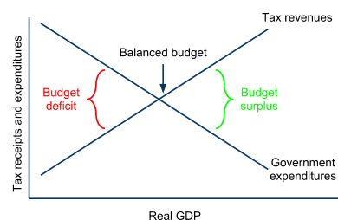
Automatic Stabilizers and Fiscal Policy
Not all changes to fiscal policy require explicit action by the government. In most economies, changes to the level of taxation and the level of government spending happen automatically. Study the graph below.
When output falls:
Tax revenue automatically decreases:
Incomes and revenues decrease when AD decreases
At lower incomes levels, households pay lower tax rates
Government spending increases automatically:
More households receive government welfare payments.
More workers receive government unemployment benefits
When output increases:
Tax revenues increase because households incomes and firms revenues increase. Some households move up to higher tax brackets and pay higher rates.
Government spending decreases because fewer households depend on government support.

Slide 16
Fiscal Policy and Long-run Economic Growth
Recall from the previous unit that Economic Growth, defined as an increase in total output over time, is only possible in the long-run if both AD and AS increase. Therefore, demand-side fiscal policies alone cannot produce economic growth. However, some fiscal policies can have positive supply-side effect as well.
Supply-side effects of fiscal policy: Certain types of government spending and tax policies can promote increases in aggregate supply, and thereby contribute to long-run economic growth:
Infrastructure spending: When government supports a modern infrastructure, including for transportation and communications, the private sector is given the resources it needs to grow and succeed in the long-run
Education spending: Human capital is perhaps the most important resource a nation requires for long-run economic growth. Public, government funded schools and programs to improve skills in the labor can contribute to long-run growth.
Research and development: Government-funded research and development can lead to scientific, technological, and medical breakthroughs that may spur new industries and promote growth across the private sector.
Incentives for private investment: Creating a tax policy that rewards innovation and entrepreneurship, rather than punishes it by taking the ‘winners’ in an economy will encourage private businesses to invest and thereby help the economy grow.

Slide 17
Fiscal Policy and the Crowding-out Effect
Expansionary fiscal policy’s effect on the interest rate: Fiscal stimulus requires that a government increases its deficit. This means the government must borrow money in order to stimulate AD. Government borrowing is done using government bonds.
Government bonds: These are certificates of debt that a government sells in order to borrow money to finance an expansionary fiscal policy.
The cost of borrowing: When a government has a history of balanced budgets, investors will be willing to lend it money at very low interest rates, therefore the government does not need to offer a high rate of interest on its bonds. Fiscally responsible nations can borrow money cheaply. But if a government has a history of large deficits, investors will demand a higher rate of interest in order to lend it money.
Crowding-out: The increase in interest rates that often accompany a deficit-financed fiscal stimulus may cause private investment and consumption in the economy to decrease. Therefore, any increase in AD from new government spending may be off-set by a decrease in private spending, which is crowded-out by higher borrowing costs.

Slide 18
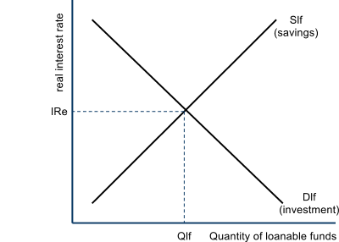
Illustrating the Crowding-out Effect
Interest rates paid by private borrowers in a nation are a primary determinant of the levels of savings, investment, and consumption. The market in which private interest rates is illustrated is called the loanable funds market.
The Loanable Funds Market: A nation's loanable funds market represents the money in commercial banks that is available to be loaned out to firms and households to finance private investment and consumption.
The price of loanable funds is the real interest rate
The market shows relationships between real returns on savings and real price of borrowing and the private sector's willingness to save and invest.
The supply curve represents household savings
At higher interest rates, households save more
At lower rates, households save less
The demand curve represents investment
At higher interest rates, firms invest less
At lower interest rates, firms invest more

Slide 19
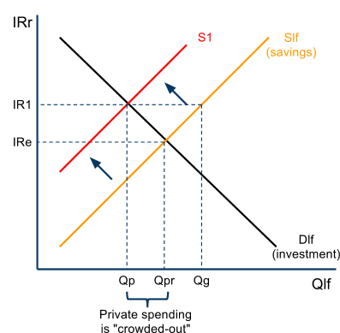
Illustrating the Crowding-out Effect in the Loanable Funds Market
When a government borrows in order to finance a budget deficit, it must increase the interest rates on its bonds in order to attract more lenders.
Higher rates on government debt will lead households to take their savings out of private banks and lend it to government instead
This causes the supply of loanable funds to decrease, leading to higher borrowing costs in the private sector.
Before the expansionary fiscal policy, the level investment was Qpr.
Higher interest rates on government bonds cause the supply of loanable funds to decrease to S1.
Less money in banks leads to higher interest rates. The quantity funds demanded for private investment falls to Qp.
Overall spending increases to Qg, but there is a decrease in private investment of Qp-Qpr
Private sector spending is ‘crowded-out’ by the government’s deficit spending. This means AD will not increase by as much as the spending multiplier would predict.

Slide 20
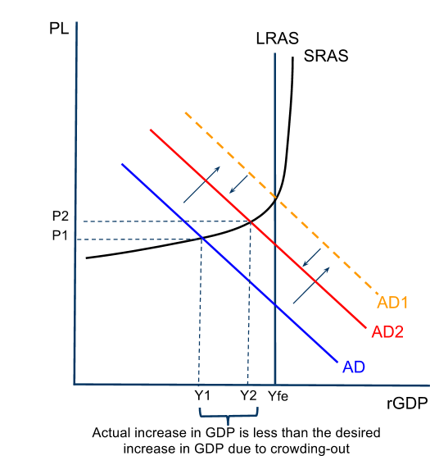
Illustrating the Crowding-out Effect in the AD/AS Model
Say a government increases spending by $100 million, without raising taxes. This money must be borrowed. Assume the multiplier is 4.
The fiscal policy should lead to an increase in AD of $400 million. However…
If the government’s borrowing reduces the supply of funds available to the private sector, then higher interest rates might cause private investment to fall, therefore,
The total increase in AD will be less than that which was predicted by the multiplier.
To reach full employment, AD would have to increase to AD1.
But due to crowding-out, it only increases to AD2.
A much larger stimulus would be needed than the multiplier predicts, further increasing national debt!

Slide 21
Evaluating the Crowding-out Effect
Whether crowding-out will actually occur depends primarily on the depth of the recession the economy was in when the government undertook its expansionary fiscal policy.
LRAS
SRAS
LRAS
SRAS
PL
PL
P_{fe}
P_{fe}
P₂
P₂
AD₁
AD₁
AD₂
$500 million
AD₂
$100 million
Y₂
Y_{fe}
real GDP
Y₂
Y_{fe}
real GDP
During deep recessions: Crowding-out is unlikely to occur; private sector investment is already deeply depressed. There is very little spending to crowd out, and government should be able to borrow without raising interest rates by much
During mild recessions: Crowding-out is more likely to occur; resources are close to being fully-employed, and private sector spending is relatively high. Government will have to offer higher rates to attract lenders, which could cause private investment to fall

