Slide 1
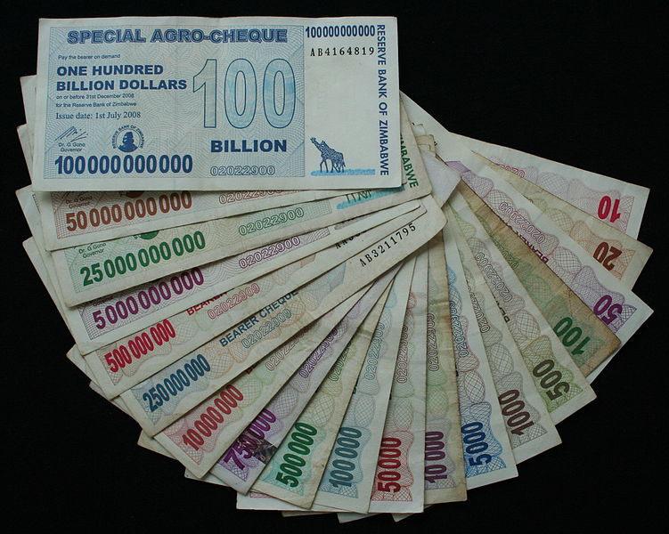
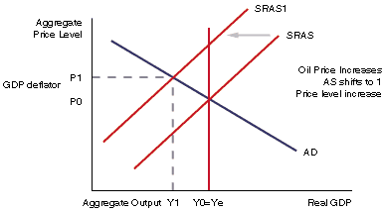
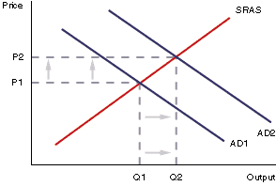
Inflation
Economists have different ideas about what causes inflation…
Quantity (aka monetary) theory MV=PQ
Demand-pull theory
Cost-push theory
Most economists believe that a steady inflation rate of 1-2% is ideal…
Notes:
Quantity (aka “monetary”): MS growth > output growth = inflation (M. Friedman – U of Chicago)
Demand pull: demand shock=>upward pressure on prices until supply can respond (e.g. war, consumer sentiment, foreign demand for domestic exports)
Cost-push: supply shock => oil price hikes; wage hikes (aka “wage-push”); currency depreciation => higher producer input costs
Demand-pull and cost-push usu. interact to cause spiral
Nominal vs. real interest rates

Slide 2
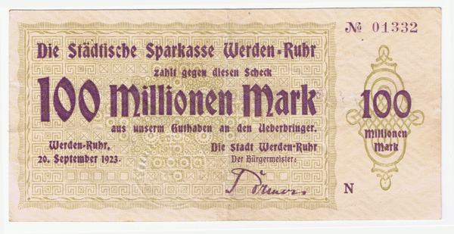
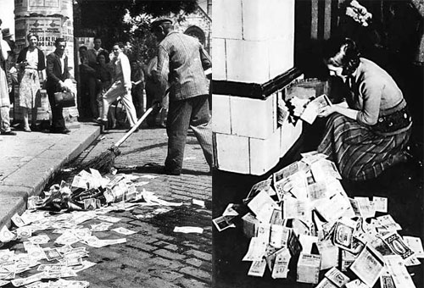

Slide 3
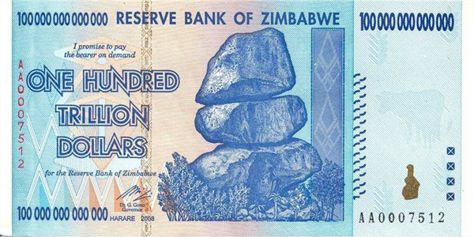
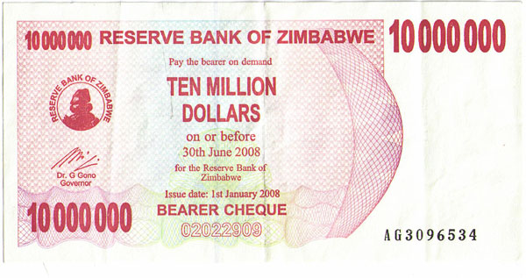

Slide 4
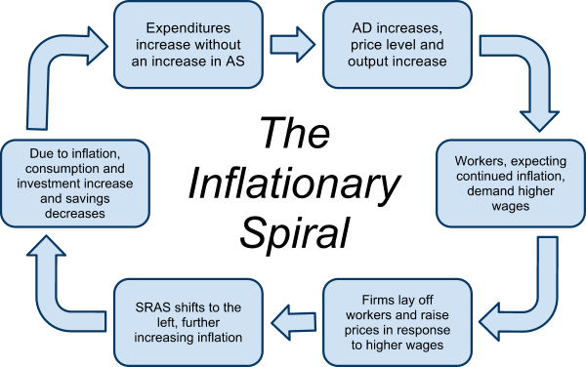
Negative effects of inflation
Transfer of wealth from savers to borrowers
Disincentives to save
Loss of purchasing power for those on fixed income
Business uncertainty
Loss of international competitiveness
Labor unrest

Slide 5
Demand-pull inflation: Occurs when there is an increase in total demand for a nation’s output, either from domestic households, foreign consumers, the government or firms (C, Xn, G or I). When demand increases without a corresponding increase in aggregate supply, the nation’s output cannot keep up with the demand, and prices are driven up as goods become more scarce.
Cost-push inflation: Occurs as the result of a negative supply shock, arising from a sudden, often unanticipated, increase in the costs of production for the nation’s producers. Cost-push inflation could result from any of the following:
LRAS
LRAS
SRAS
SRAS₂
PL
PL
P₃
SRAS₁
AD₃
P_{fe}
P₂
AD₁
P_{fe}
AD
real GDP
Y_{fe}
Y₃
Y₂
Y_{fe}
Inflationary Gap
real GDP
Demand-pull inflation: When AD increases beyond the full-employment level of output the economy experiences an increase in the average price level
Cost-push inflation: When AS decreases from the full-employment level, there is an increase in the average price level.

Slide 6
Degrees of inflation
‘Price level stability’ is a primary macroeconomic objective; but what is considered ‘stable’ inflation? Is NO inflation (0%) desirable? What about negative inflation? We must distinguish between different degrees of inflation to know what is a desirable inflation rate.
Degrees of Inflation, from low to high
Deflation: | Deflation refers to a decrease in the average price level of goods/services over time. If the CPI for one year is smaller than the CPI from a previous year, then the inflation rate will be negative. Deflation is considered highly undesirable because it discourages investment and consumption (households and firms prefer to postpone spending until prices are lower in the future) and therefore can lead to recession and rising unemployment.
Low inflation: | Inflation rates of between 0-5% are considered low and stable. This is the desired range for most countries, over which consumers’ confidence over the stability of future prices is sound; businesses and households can invest, spend and save without fear of future erosions in the values of their savings and investments.
High inflation: | Inflation rates of greater than 5% are considered high in most countries At high inflation rates, firms and households will rush to spend their money now before its value is eroded by higher prices. The race to spend while money is dear causes AD to grow rapidly, causing demand-pull inflation, reducing real incomes and contributing to instability across the economy

Slide 7
Consequences of Inflation
High inflation, like high unemployment, has several negative effects on households, firms and the overall economy.
The Consequences of High Inflation
Lower Real Incomes | A households’ real income is its nominal income adjusted for any inflation in the economy. The more prices rise, the less a certain amount of income can buy for households. Higher inflation makes consumers feel poorer, since the real value of their incomes falls when inflation rises.
Lower Real Interest Rates for Savers | The real interest rate is the nominal interest rate minus the inflation rate. For example, if you have a savings account offering a 5% interest rate, and inflation is 2%, the real return on your savings is only 3%. But if inflation increases to 4%, your real return is just 1%.
Higher nominal interest rates for borrowers | When banks anticipate high inflation in the future, they will raise the interest rates they charge borrowers today. This increases the cost of borrowing money to invest in new capital or to buy homes or expensive durable goods,.
Reduced international competitiveness | A country experiencing high inflation will find demand for its goods fall among international consumers, as they become more expensive compared to other country’s goods. Also, higher prices and wages will reduce foreign investment in the country as firms do not wish to produce where costs are rising, rather where costs will be low in the future.

Slide 8
What is in and out of the CPI basket and What is inflation?
The Meaning of Inflation
An increase in the average price level of goods and services of a nation over time

Slide 9
Calculating the Inflation Rate
To calculate inflation between two years, we first must determine the CPIs for the two years in question. Assume the CPI is made up of just three goods, whose prices during two years are indicated in the table below.
Good or service | Price in 2011 | Price in 2012
Pizza | 10€ | 10.50€
Haircuts | 20€ | 19€
Wine | 8€ | 10€
Total basket price | 38€ | 39.50€
Determining the CPI: Assume 2011 is the base year, and we want to calculate inflation between 2011 and 2012
CPI for 2011 = $\frac{Price of the basket of goods in 2011}{Base year price}=\frac{38}{38}=1×100=100$
CPI for 2012 = $\frac{Price of the basket of goods in 2012}{Base year price}=\frac{39.5}{38}=1.039×100=103.9$
With the CPIs known, we can calculate the rate of inflation:
$The Inflation Rate=\frac{{CPI}_{year 2}−{CPI}_{year 1}}{{CPI}_{year 1}}×100=\frac{103.9−100}{100}=0.039×100=3.9\%$

Slide 10
Using a Weighted Price Index to Calculate Inflation
Because not all the goods measured in a nation’s Consumer Price Index are equally important to the typical household, governments weight particular types of consumption more than other types.
For example, food and beverages make up approximately 15% of the typical household’s budget in a given year. But housing (either rental payments or mortgage payments) make up 40%.
In this example, housing prices should be weighted more heavily than food and beverages
Consider the table showing the prices of the three goods measured in a CPI in two years, including the weight given to each good based on the percentage of the typical consumer’s income spent on it.
..\video and audio\The_Drawing_Board____The_Median_Consumer_Price_Index_(Median_CPI).mp4
Good | Price in 2009 | Price in 2010 | Weight
Banana | $2 | $1.50 | 25%
Haircut | $11 | $10 | 30%
Taxi ride | $8 | $10 | 45%
To establish a price index with 2009 as the base year, we must calculate the weighted price of the basket of goods for 2009. To do this, we multiply the average price of each good by its weight, expressed in hundredths.
2009:
Banana = 2 x 0.25 = 0.5, plus
Haircut = 11 x 0.3 = 3.3, plus
Taxi ride = 8 x 0.45 = 3.6
Price index for 2009 = 7.7
2010:
Banana = 1.5 x 0.25 = 0.375, plus
Haircut = 10 x 0.3 = 3, plus
Taxi ride = 12 x 0.45 = 5.4
Price index for 2010 = 8.775
$$Inflation rate=\frac{8.775−7.7}{7.7}=0.14×100=14\%$$

Slide 11
Consequences of Deflation
Deflation, a decrease in the average price level, sounds like a good thing. But it is not, and in some circumstances can be worse for an economy than mild inflation. Here’s why…
The Consequences of Deflation
Rising Unemployment: | With the expectation of lower future prices for their output, and with low demand for goods and services, firms are likely to lay off workers, leading to higher unemployment and downward pressure on workers’ wages across the economy
Delayed consumption: | With the expectation of future price decreases, households will increase savings and decrease spending. The decrease in current consumption can lead to further deflation and contribute to a deflationary spiral, in which lower prices lead to lower AD which leads to even lower prices
Declining investment: | If firms expect less demand for their output in the future, they'll invest less now, which could result in slower economic growth, as the nation’s capital stock depreciates over time and is not being replenished at a rate that will promise sustained growth
Cost to borrowers: | Deflation causes the value of money to increase over time. Therefore, the real debt burden of borrowers increases as the price level falls. Bankruptcies result as borrower's incomes fall while the value of the money they must pay back increases.

Slide 12
Deflation
There is good deflation and bad deflation
Good deflation
This comes about from the LRAS shifting
Output will increase and price levels with fall
This assumes that AD remains (ceteris paribus)
This will also give a lower level of unemployment (derived demand for labour from the increased demand for goods and services
Deflation – a persistent fall in the average price level in the economy usually measured with the CPI (Consumer Price Index)

Slide 13
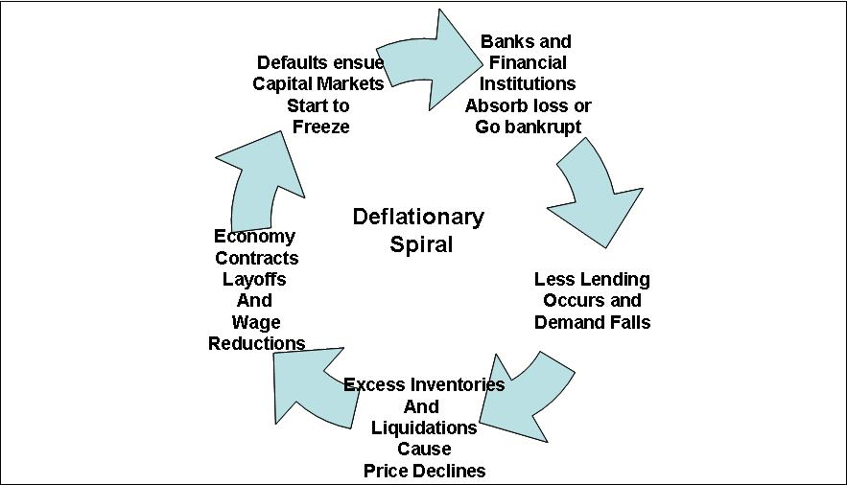
Negative effects of deflation
Transfer of wealth from borrowers to savers
Incentives to save
Increase of purchasing power for those on fixed income
Business uncertainty
Loss of international competitiveness
Labor unrest

Slide 14
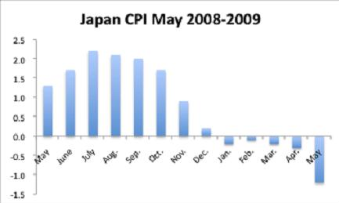
Deflation
Japan has a problem with deflation
Banks collapsed due to bad debts and bad investments in their own stock market
People built up precautionary savings in case they lost their jobs
This depressed consumption and AD
Interest rates were cut to 0.25% but it didn’t work
Consumer and business confidence crumbled with people and firms reluctant to spend
Don’t confuse deflation with a falling rate of inflation (this is called disinflation)

Slide 15
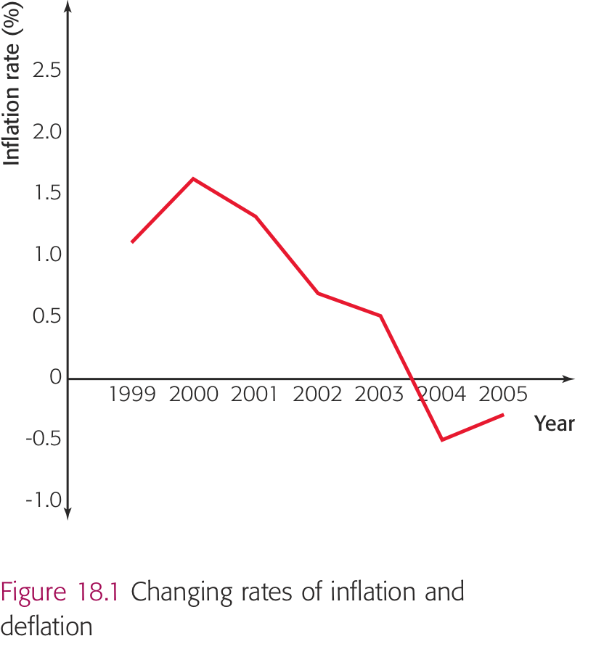
Deflation/Disinflation
From 1999 to 2000 the inflation rate rose from 1.2% to 1.6%
From 2000 to 2001 the inflation rate fell from 1.6% to 1.3%
the average level of prices rose but at a lower rate than the previous year – disinflation
In the next two years the inflation rate continued to fall (prices were still rising but by a smaller and smaller amount)
In 2004 the country started to experience deflation (the average level of prices fell by 0.5%)
From 2004 to 2005 the country was still in a period of deflation where average prices fell by 0.3%

Slide 16
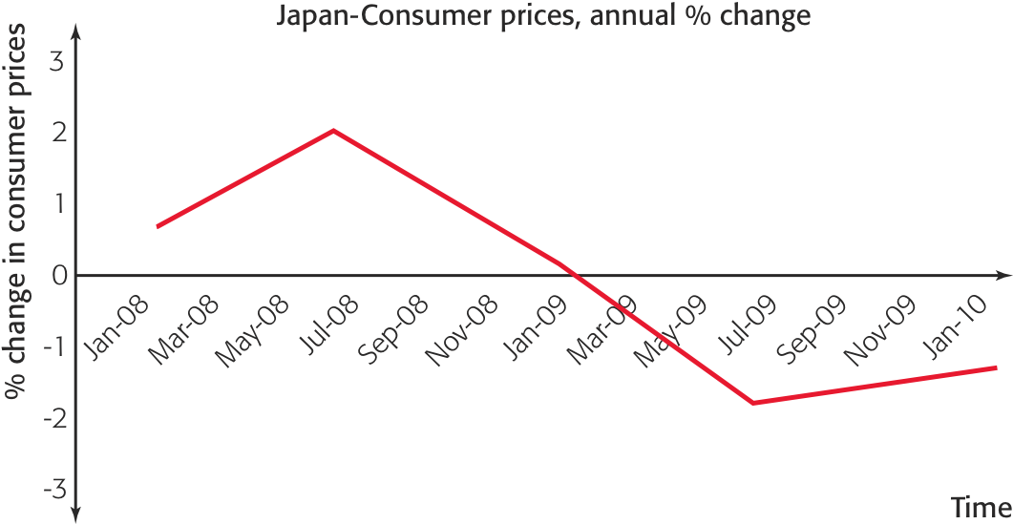
Do you understand which period of time did Japan experience:
Inflation
Disinflation
deflation

Slide 17
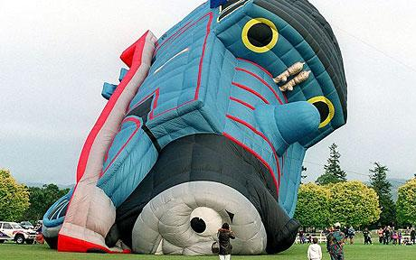
Costs of Deflation
Although consumers may be pleased with falling prices there are many problems with deflation
Deflation is also a bit of an unknown so it is more difficult to deal with than inflation
Some economists argue that the costs of deflation are higher than inflation
Unemployment
If AD is low businesses may lay off workers
If prices fall consumers will put off purchasing
Firms will have to drop prices to encourage consumption
Consumers will again put of purchasing believing that prices will fall further (deferred consumption)
Consumer confidence drops further depressing AD
This is known as a deflationary spiral
Investment will also be put off

Slide 18
Costs of Deflation
Costs to debtors
Anyone who has taken a loan (including house buyers who have taken a mortgage) suffers from deflation because the value of their debt rises
If profits are low businesses will find it difficult to pay back loans
There may be many bankruptcies
This will make business confidence even worse
Play Japan deflation video

Slide 19
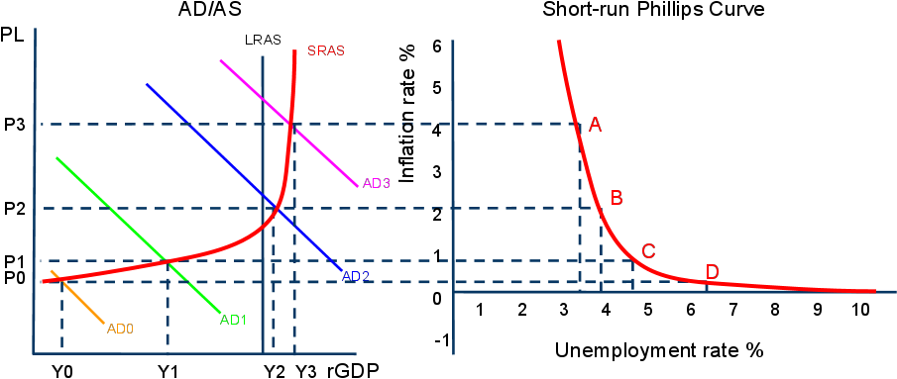
The Phillips Curve A graph which shows the relationship between unemployment and inflation in the short-run:
At point A: Aggregate demand is very high (probably beyond full employment) since inflation is higher than desired and unemployment is very low.
At point B: AD has fallen to a level around full employment. Inflation is stable and unemployment is at a more natural rate of 3.5%
At point C: AD has fallen, and the economy is probably in a recession. Inflation is very low and unemployment is relatively high.

Slide 20
Rationale for the Phillips Curve Relationship
Why do inflation and unemployment move in opposite directions in the short-run? It all has to do with the amount of available labor in the economy at different levels of aggregate demand.
When AD is weak: If AD intersects SRAS at a level of output below full employment…
Firms have cut back on output and reduced their prices to try to maintain sales during the period of weak demand. Inflation is therefore low.
As workers have been laid off by firms, the number of people who are unemployed grows. Unemployment is therefore high.
When AD is strong: If AD intersects SRAS at a level of output beyond full employment…
Firms have seen their sales grow and have begun raising their prices as a result. The nation’s output is becoming more and more scarce, and consumers are willing to pay more, leading to inflation.
In an effort to meet the growing demand for output, firms have begun hiring new workers, reducing the level of frictional and structural unemployment.

Slide 21
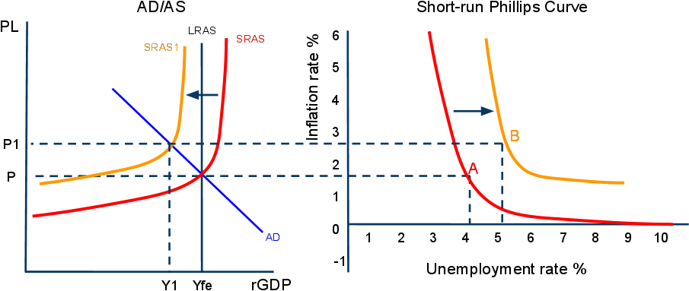
Supply Shocks in the Short-run Phillips Curve
As we have shown, a shift in AD causes a movement along the short-run Phillips Curve. However, a shift in SRAS will cause a shift in the short-run Phillips Curve. As seen below, a negative supply shock causes both unemployment and inflation to rise. This is seen as a rightward shift of the Phillips Curve.

Slide 22
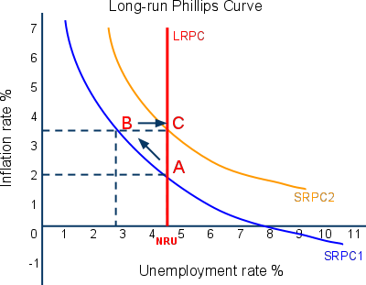
The Long-run Phillips Curve
In the long-run, you will recall, all wages and prices in an economy are flexible.
If there has been high unemployment, wages will fall in the long-run and employment and output will return to full-employment.
From short-run to long-run in the Phillips Curve: In the graph to the right, we can see…
From point A to B: AD has increased, causing higher inflation and lower unemployment in the short-run. However, in the long-run, the economy will move…
From point B to C: Because following the increase in AD, workers see their real wages fall and so eventually demand higher nominal wages. As they do so, firms reduce employment and raise prices, returning unemployment to its natural rate (NRU), now at a higher inflation rate.

Slide 23
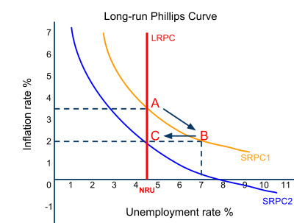
The Long-run Phillips Curve
In the long-run, you will recall, all wages and prices in an economy are flexible.
If there has been deflation in the economy, workers will accept lower wages in the long-run and employment and output will return to the full-employment level.
From short-run to long-run in the Phillips Curve: In the graph to the right, we can see…
From point A to B: AD has decreased, causing lower inflation and higher unemployment. However, in the long run the economy will move…
From point B to C: Because following the decrease in AD, workers who became unemployed eventually began accepting lower wages, leading firms to increase output and employment back to the full employment level
In the long-run, unemployment always returns to its Natural Rate, regardless of the level of inflation!

