Slide 1
Introduction to Macroeconomics
Throughout our studies of Microeconomics, we learned several key concepts, most for which there is a similar concept which we will study in Macroeconomics. The table below shows several of the Micro concepts we studied and their Macro equivalents.
Micro Concept | Macro Concept | Key Terms in Macroeconomics
Market | National Economy | Examines all the economic activity taking place in a country
Demand | Aggregate Demand (AD) | The total demand for a nation’s output of goods and services
Supply | Aggregate Supply | The total supply of goods and services by all the industries of a country
Price | Average Price Level | An index of the average prices of goods and services over time
Quantity | National Output | Total output of all the industries of a country
Decrease in Demand | Recession | A fall in total output resulting from a decrease in AD
Increase in Demand | Inflation | An increase in the average price level resulting from an increase in AD
Decrease in Supply | Supply Shock | An increase in the price level and decrease in output from a fall in AS
Increase in Supply | Economic Growth | An increase in national output resulting from an increase in AS

Slide 2
Circular Flow Diagram
Product Market, for Goods & Svcs.
Firms sell
HH buy
Revenue
Cons. Spending/Expeditures
Goods & services sold/output
Goods & svcs. bought
Firms
Produce and sell goods and services
Hire factors of production
Households
Buy/consume goods and services
Own/sell factors of production
Resource Market, for Factors Inputs
HH sell
Firms buy
Land, labor, and capital
Factor inputs
Costs of Production
Wages, rent, & profits
physical flow
money flow

Slide 3
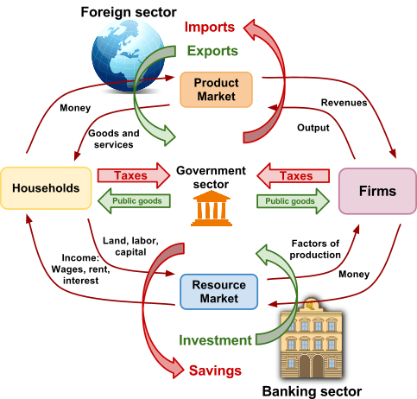
The Macroeconomic Circular Flow
In the introduction to economics unit of the course, you learned about the circular flow of income in a market economy. In macroeconomics we have added several features to this model, including:
A government sector: The government collects taxes from households and firms (these are a leakage from the circular flow) and contributes government expenditures on public goods (these are injections into the flow).
A foreign sector: A nation spends money on foreign goods (imports, this is a leakage) and earns money by selling goods to foreigners (exports, an injection).
The banking sector: Households and firms save money in the banking sector (a leakage) and banks provide households and firms with funds for investment (an injection)

Slide 4
Investment
Exports
Gov. Spending
Leakages: Taxes paid to the government, spending on imports from abroad, and money saved in banks are all considered leakages from the circular flow of income.
“Injections”
Expenditure (1)
Goods & Services
Market
Expenditure (1)
Goods &
Services (3)
Goods &
Services (3)
Injections: Government spending, export revenues and investments are all considered injections to the circular flow of income.
Firms
Households
Factors of
Production (4)
Factors of
Production (4)
Factor Market
Income, i.e. wages, rent, & profits (2)
Income, i.e. wages, rent, & profits (2)
“Leakages”
Savings
Imports
Taxes

Slide 5
Three Approaches to Measuring Output
Looking closely at the circular flow model, we can see that there is a relationship between the amount of income earned, the expenditures made and the total output. The economic activity of a nation can, in fact, be measures using any of these three methods:
The Income approach: Measures GDP by recording the income of household in the resource market side of the circular flow of income. Income includes payments households receive in the resource market in exchange for providing firms with the factors of production, including the total sum of each of the following earned by a nation’s households in a year: Wages for labor, Interest for capital, Rent for land and Profits for entrepreneurship.
National Income = W+I+R+P
The Output approach: Measures the value of the total output produced in the different sectors of the economy. When the total output of every sector of the nation’s economy is summed, total output is found.
National output = Outputs of the primary sector + the secondary sector the tertiary sector
The Expenditure approach: Counts the total spending on final new goods and services in a given year. "Final" goods are ready for consumption and do not includes goods that will be input goods or are raw materials for other production. This approach distinguishes between four types of spending on a nation’s output. These include households consumption (C), investment in capital by firms (I), government spending (G) and net exports (Xn).
Total expenditures equal C+I+G+Xn

Slide 6
THE INCOME APPROACH AND THE EXPENDITURE APPROACH TO MEASURING THE GDP OF A NATION

Slide 7
GDP:
“The market value of all final goods and services produced within a country in a given time period”

Slide 8
GDP is the Market Value…
Of All…
Final…
Goods and Services…
Produced…
Within a Country…
In a Given Time Period
GDP has to measure different products (“apples and oranges”)…it can only do that by calculating everything on the basis of its market value

Slide 9
GDP is the Market Value…
Of All…
Final…
Goods and Services…
Produced…
Within a Country…
In a Given Time Period
GDP tries to be as comprehensive as possible, but can’t measure everything. Examples: domestic services, underground economy, etc.

Slide 10
GDP is the Market Value…
Of All…
Final…
Goods and Services…
Produced…
Within a Country…
In a Given Time Period
GDP tries to be as comprehensive as possible, but can’t measure everything. Examples: owner occupied housing, domestic services, underground economy, etc.
GDP tries to avoid double counting, so it excludes “intermediate goods” that are used to produce final goods, e.g. wheat for bread…exception is “unsold inventory” at end of year

Slide 11
GDP is the Market Value…
Of All…
Final…
Goods and Services…
Produced…
Within a Country…
In a Given Time Period
GDP tries to be as comprehensive as possible, but can’t measure everything. Examples: owner occupied housing, domestic services, underground economy, etc.
GDP tries to avoid double counting, so it excludes “intermediate goods” that are used to produce final goods, e.g. wheat for bread…exception is “unsold inventory” at end of year
GDP includes both physical goods as well as services, even government services such as police and firefighters

Slide 12
GDP is the Market Value…
Of All…
Final…
Goods and Services…
Produced…
Within a Country…
In a Given Time Period
GDP only includes things produced in the current period; it excludes things that were produced earlier and resold, e.g. use cars, stock trading

Slide 13
GDP is the Market Value…
Of All…
Final…
Goods and Services…
Produced…
Within a Country…
In a Given Time Period
GDP looks at where goods are physically produced (or services performed)…so if a US citizen works in China, his/her production is counted as China’s GDP

Slide 14
GDP is the Market Value…
Of All…
Final…
Goods and Services…
Produced…
Within a Country…
In a Given Time Period
GDP is usually measured annually or quarterly…it’s a “flow” measure (vs. stock measure)…if measured quarterly, the number is usually “annualized” and “seasonally adjusted”

Slide 15
What is included in GDP?
GDP measures the value of the final output of goods and services in a nation in a year. But there are some economic transactions which are not included in GDP.
GDP includes:
GDP includes only final products and services GDP is the value of what has been produced within the borders of a nation over one year, not what was actually sold.
GDP Excludes "nonproduction transactions“:
Purely financial transactions are excluded. Public transfer payments, like social security or cash welfare benefits. Private transfer payments, like student allowances or alimony payments. The sale of stocks and bonds represent a transfer of existing assets (However, the brokers’ fees are included for services rendered.) Secondhand sales: If I buy a used car in 2008, that sale does not count towards 2008's GDP, because the car was not made in 2008! The price of the car was originally included in the year's GDP when it was produced.

Slide 16
The Components of GDP
The expenditure approach to measuring GDP measures the total spending on a nation’s output by households, firms, the government and foreigners. The four types of spending are outlined
Household Consumption (C):
The purchase by households of all goods and services, including: Non-durables: bread, milk, toothpaste, t-shirts, socks, toys, etc... Durables: TVs, computers, cars, refrigerators, etc... Services: dentist visits, haircuts, taxi rides, accountants, lawyers, etc…
Gross Private Domestic Investment- (Ig)
All final purchases of machinery, equipment, and tools by businesses. All construction (including residential). Changes in business inventories If total output exceeds current sales, inventories build up. If businesses are able to sell more than they currently produce, this entry will be a negative number.

Slide 17
The Components of GDP
Government Purchases (of consumption goods and capital goods) - (G)
Includes spending by all levels of government (federal, state and local). Includes all direct purchases of resources (labor in particular). This entry excludes transfer payments since these outlays do not reflect current production.
Net Exports- (Xn)
All spending on goods produced in the U.S. must be included in GDP, whether the purchase is made here or abroad. Often goods purchased and measured in the U.S. are produced elsewhere (Imports). Therefore, net exports, (Xn) is the difference: (exports - imports) and can be either a positive or negative number depending on which is the larger amount.

Slide 18
Components of GDP (“Y”)
Consumer Spending (“C”)
Spending by households on goods and services; but excludes purchase of new housing
Investment or Business Spending (“I”)
Spending on capital equipment, inventories and buildings, includes household purchase of new housing
Government Purchases (“G”)
Spending on goods and services by all levels of government, includes wages of government workers but excludes transfer payments
Net Exports (“X” – “M” = “NX”)
Spending on domestic goods by foreigners (X) minus spending on foreign goods by domestic residents (M)
Therefore: Y = C + I + G + (X – M)
Notes:
US 2011 Q4 data:
Total = $15.3T (seasonally adj.; qtr. rate)
Consumer: 71%
--Goods = 24% (Durable vs. Non Durable)
--Services = 47%
Investment: 13%
--Fixed Investment
Non Residential (i.e., business)
Residential
--Inventories
Government: 20%
--Federal
--Local
Net Exports: -4%

Slide 19
Nominal GDP and Real GDP
Nominal GDP measures the value of a nation’s output produced in a year, expressed in the value of the prices charged for that year.
But if the average price level of a nation’s output increases in a year, the nominal GDP could increase even if the actual amount of output does not change, since everything will appear more expensive at higher prices.
To determine the change in the real GDP, (the actual output of a nation adjusted for changes in the price level), economists must measure the value of a nation’s output in one year using the price level from a base year.
In the case of the price level increasing (inflation): real GDP will be lower than the nominal GDP
In the case of the price level decreasing (deflation): real GDP will be higher than the nominal GDP
Real GDP = the value of a nation’s output in a particular year adjusted for changes in the price level from a base year. Offers a more accurate measure of actual quantity of goods and services a nation’s produces because it adjusts for price changes.

Slide 20
Output in 2009 | Quantity produced in 2009 | Price in 2009 | Total value of output 2009
Cheese | 10 | 2 | 20
Chocolate | 20 | 2 | 40
Watches | 5 | 10 | 50
Nominal GDP: |  |  | 110
Nominal GDP and Real GDP
To adjust a nation’s nominal GDP in one year to its real GDP, we must measure the value of output using prices from a base year.
Consider the country seen here. If we want to know the 2010 real GDP with 2009 as a base year, we must find the value of 2010’s output in 2009 prices.
12 cheeses at $2 = $24
25 chocolates at $2 = $50
5 watches at $10 = $50
2010 real GDP = $124
$$The GDP Deflator= \frac{Nominal GDP}{Real GDP}$$
For this country, the GDP deflator = $\frac{160}{124}=1.29$
With this we know that prices rose by 29% between 2009 and 2010.
Output in 2010 | Quantity produced in 2010 | Price in 2010 | Total value of output 2010
Cheese | 12 | 2.50 | 30
Chocolate | 25 | 3 | 75
Watches | 5 | 11 | 55
Nominal GDP: |  |  | 160

Slide 21
Calculating real GDP using a GDP Deflator
The GDP deflator is a price index that can be used to adjust a nation’s nominal GDP for change sin the price level. The deflator is an indicator of how much prices have changed between two years.
For a base year, the deflator always equals 100, since the real GDP = nominal GDP
If, in a later year, the index is 110, this means that prices have risen by 10% between those years. If it is 120, prices have risen by 20%. If it is 95, then price fell by 5%, and so on…
Consider the table below, showing nominal and real GDP data for the United States:
Year | Nominal GDP | GDP Deflator | Real GDP
2005 | 12,638.4 | 100 | 12,638.4
2006 | 13,398.9 | 103.25 | 12,976.2
2007 | 14,061.8 | 106.29 | 13,228.9
2008 | 14,369.1 | 108.61 | 13,228.8
2009 | 14,119.0 | 109.61 | 12,880.6
Notice that for each of the years from 2007 on, real GDP was lower than nominal because the deflator increased each year, indicating that there was inflation; therefore, nominal GDP would have over-stated the changes in real output from year to year.

Slide 22
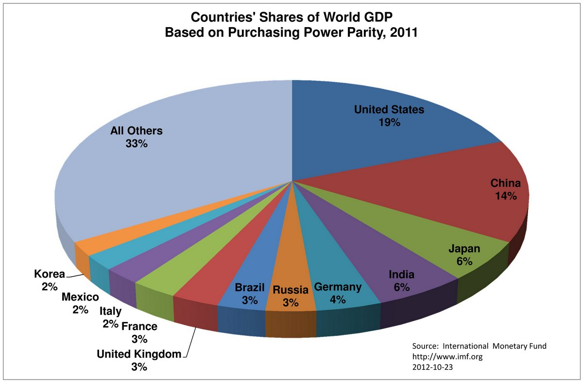
Real GDP and Real GDP per capita
A nation’s real GDP tells us the actual value of its output in a particular year, adjusted for any changes in the price level between that year and an earlier base year. However, real GDP does not tell us whether a nation is rich or poor. Consider the pie graph below:
Real GDP is better indicator of output than nominal GDP

Slide 23
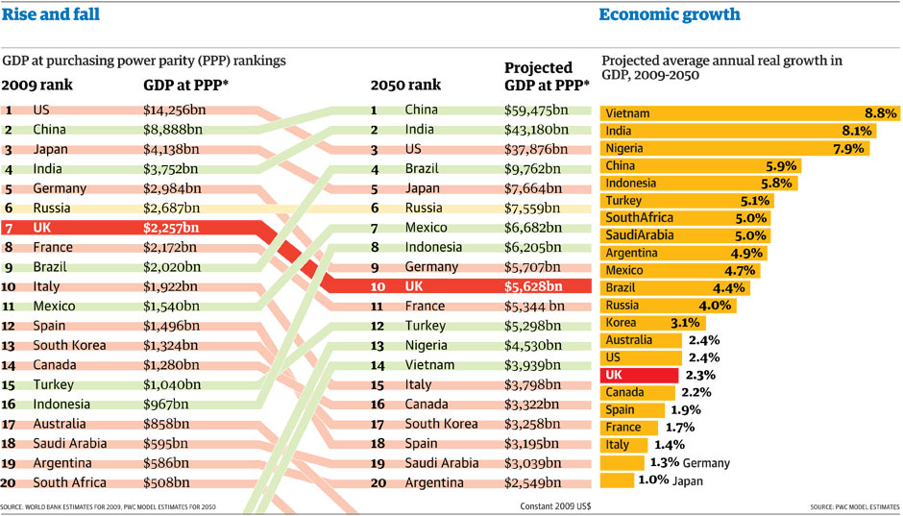

Slide 24
Per capita GDP: Measures the total GDP of a nation divided by the total population.
GDP per capita is a better indicator of the well-being of a typical person in a nation than total GDP
1 | Qatar | 100,889 | 2012
2 | Luxembourg | 77,958 | 2012
3 | Singapore | 60,799 | 2012
4 | Norway | 54,397 | 2012
5 | Brunei | 54,114 | 2012
6 | United States | 51,704 | 2012
7 | Hong Kong | 50,936 | 2012
8 | Switzerland | 44,864 | 2012
9 | San Marino | 42,724 | 2012
10 | Canada | 42,317 | 2012
Notice that only one of the richest nations (in the table) are even in the top 10 for total GDP

Slide 25
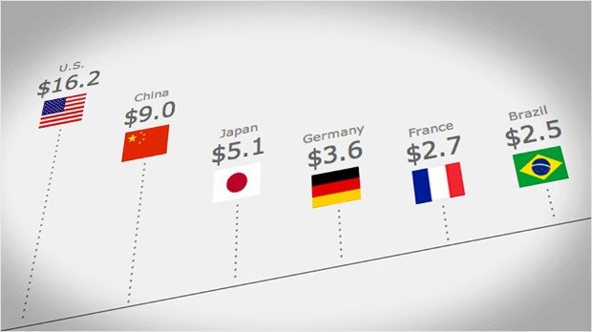
Why is GDP important?
GDP is considered by economists to be
the most important measure of economic
activity in nations for several reasons:
It tells us something about the relative size of different countries' economies
It is a monetary measure, so it tells us how much income a country earns in a year (assuming everything that is produced is sold).
When we divide GDP by the population, we get GDP per capita, which tells us how many goods and services the average person consumes in a country.
When real GDP grows more than the population, that tells us that people on average, have more stuff than they did before.
If you believe that having more stuff makes people better off, then GDP per capita tells us how well off people in society are.

Slide 26
Limitations of GDP
Data inaccuracies
Unrecorded activities
Informal transactions, e.g., volunteer work, parenting, etc.
DIY work, e.g. subsistence farming, home repair, etc.
Underground economies
External costs/benefits
Resource depletion
Pollution (or pollution clean up)
Composition of output (“bad”)
Semi-automatic rifle vs. jar of baby food
Notes:
Hidden economies as % of GDP (from World Bank study published in 2010)=>
Greece: 26.5%
Italy: 26.8%
Norway: 18.7%
Canada: 15.7%
US: 8.4%
Higher tax rates usu. = more unrecorded transactions
So can you really compare different countries??

Slide 27
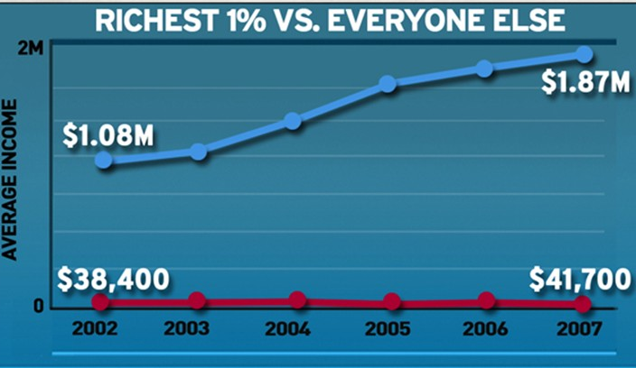
Limitations of GDP
Does not reflect improved product quality
As quality of products improve they may be sold at equal or lower price.
Nor does it measure how GDP is distributed in among the population
Indicators such as gini coefficient are not considered.
Equity is not a priority
Quality of life
Leisure time
Safety, quiet, stress, aesthetic aspects of life
Notes:
Hidden economies as % of GDP (from World Bank study published in 2010)=>
Greece: 26.5%
Italy: 26.8%
Norway: 18.7%
Canada: 15.7%
US: 8.4%
Higher tax rates usu. = more unrecorded transactions
So can you really compare different countries??

Slide 28
Alternative Measures to GDP
While gross domestic product is the primary measure of a nation’s output in a particular year, economists have developed alternative measures of output which are sometimes referred to instead of GDP. These include:
Gross National Product (GNP): Measures the total value of output produced in a year by the factors of production provided by a nation.
Differs from GDP in that it includes output produced abroad by domestically owned factories, but subtracts output produced domestically by foreign owned factories.
Does not offer as accurate a measure of the actual economic activity within a nation as GDP does, and is therefore not considered as useful as GDP for measuring output of a nation.
Green GDP: This is an under-used measure of economic activity which subtracts from real GDP the losses to the environment and biodiversity resulting from economic growth.
Places a monetary value on environmental degradation and subtracts this from the nation’s GDP
Is a measure preferred by environmentalists who believe that economic growth overstates increases in peoples’ well-being due to the fact that it ignores the externalities that accompany growth.

Slide 29
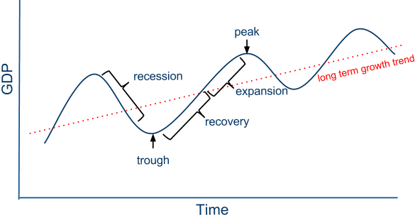
The Business Cycle
Changes in a nation’s GDP over time can be illustrated in a simple economic model known as the business cycle. There are four stages to a nation’s business cycle
A recession is a decline in total output, income, employment, and trade lasting six months or more. During recessions, unemployment increases and there is downward pressure on the price level
A recovery is when a recession has ended and national output begins to increase again
An expansion occurs when an economy is growing at a rate beyond its long-run growth trend.
Long-run Growth Trend: Notice that despite the short-term fluctuations, the economy tends to grow over time

Slide 30
The Business Cycle
Notice from the business cycle model that economic growth (an increase in GDP) occurs over time, but not always at a steady rate. Of course, each economy’s business cycle will look unique, but most economies will experience the types of fluctuations the model shows.
Possible causes of the business cycle: There are several theories regarding WHY countries grow at such volatile rates over time.
Major innovations may trigger new investment and/or consumption spending.
Changes in productivity may be a related cause.
Most agree that the level of aggregate spending is important, especially changes in the purchase of capital goods and consumer durables.
Cyclical fluctuations: Durable goods output is more unstable than non-durables and services because spending on latter usually can not be postponed.
Decrease in GDP versus a decrease in GDP growth rate:
The growth rate of an economy refers to the percentage change in GDP between two periods of time. When an economy is approaching a peak in its business cycle, the rate of growth has begun to fall.
When a recession begins, the actual output of an economy decreases. This means the growth rate has become negative.

Slide 31
The Macroeconomic Objectives
In our study of macroeconomics, we will focus on how the tools of macro can help policymakers achieve several objectives, all meant to make the lives of a nation’s people better over time.
The four Objectives of Macroeconomic Policy:
Full employment: This means most of the nation’s workers are able to find a job and that the nation’s resources are being put towards the production of goods and services
Price-level stability: Inflation will be low, meaning households’ real incomes are high. Unstable prices lead to uncertainty and unstable livelihoods for the nation’s households
Economic growth: This is defined simply as an increase in output and income over time. Economic growth is needed to sustain a growing population and assure that the average person enjoys a higher standard of living over time.
Improved equality in the distribution of income : The free market tends to result in winners and losers. To some extent, the government must look after the losers in the market system, and implement policies that improve equality of income distribution so that there is less poverty in society.

Slide 32
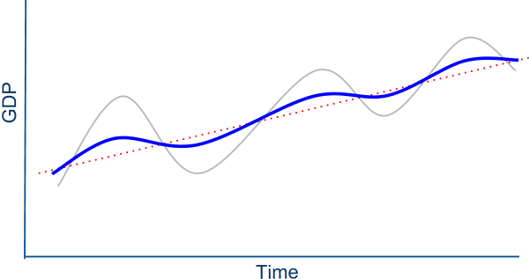
The Macroeconomic Objectives
Looking again at our business cycle model, we can see the effect of an economy which is successfully meeting its macroeconomic objectives.
The blue line represents a more stable, steadily growing economy.
Recessions are less severe, peaks and troughs less extreme
Unemployment rises by less during recessions, and inflation is lower during expansions.
An economy meeting its macroeconomic objectives will achieve growth that is closer to the long-run trend line. There will be less volatility and uncertainty in the economy!

Slide 33
Cowen and Taborrak recording://www.youtube.com/watch?feature=player_embedded&v=MLSIjW5cDes

