Slide 1
Introduction to Market Structures
Product markets come in many forms. The four market structures are introduced below.
Characteristic | Pure (or Perfect) Competition | Monopolistic Competition | Oligopoly | Monopoly
Number of Firms | VERY large number of firms | Fairly large number of firms | A few large firms dominate an industry | Only ONE firm. The firm IS the industry
Price making abilities of individual firms | Each firm is so small that changes in its own output do not affect market price, i.e. firms are price takers | Firms are small relative to the industry, meaning changes in one firms output have only a slight impact on market price | A change in one firm's output has significant impact on the market price, firms are price-makers. | Changes in the firm's output cause changes in the price, i.e. the firm is a price-maker!
Type of product | Firms all produce identical products, with no differentiation | Products are slightly differentiated. Firms will advertise to try and further differentiate product. Branding! Advertising! | Products can be identical (such as oil) or differentiated (such as Macs and Dells) Firms will likely use advertising to try and differentiate their products from competitors' | Unique product, no other firm makes anything like it.
Entry barriers | Completely free entry and exit from the industry, i.e. NO barriers to entry. | Limited barriers to entry, firms can enter or leave easily | There are significant barriers to entry | Significant barriers to entry exist, preventing new firms from entering and competing with the monopolist

Slide 2
Assumptions of the Perfectly Competitive Market Model
A perfectly competitive market is one in which:
There is a very large number of firms,
Selling identical products to one another,
In which there are no barriers to entry or exit
And in which individual firms have no control over the market price.
Example: Imagine you live in New York City and want to have a cheese pizza for lunch. Let’s assume…
There are hundreds of pizza shops in New York
Every one of them has cheese pizza on their menu
They all pay their workers minimum wage. They all buy cheese, dough and tomato sauce at the same prices
It is cheap and easy to open a pizza shop, just as it is to shut one down if needed.
Based on these characteristics, the market for cheese pizzas in New York is close to perfectly competitive. You will pay the same price no matter where you order your pizza from!

Slide 3
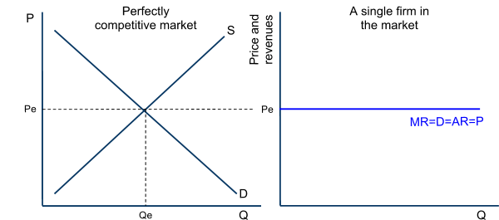
Perfectly Competitive Firms are “Price Takers”
Note from the graph below that:
The firm has no “price-making power” because if it raises its price, it will sell no output, and
if it lowers its price, it will not be able to cover its costs of production.
Demand for the individual firm’s output is perfectly elastic
To maximize its profits, a firm should produce where its marginal revenue equals its marginal costs.

Slide 4
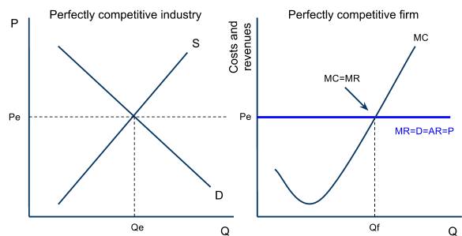
Profit Maximization for the Perfect Competitor
A firm should produce at the quantity at which its marginal revenue (MR) equals its (MC)
In the graph below:
The firm is facing a marginal revenue equal to Pe, determined by the market price at any given time.
The firm’s marginal cost increases steadily due to diminishing returns (to make more pizzas in the short-run, more cooks must be hired, but because capital is fixed the marginal product of cooks decreases as more are added)
Based on its MC and MR, the firm will maximize its profits (or minimize its losses) by producing at Qf

Slide 5
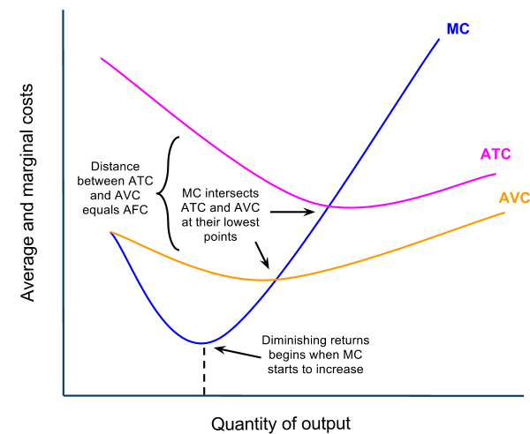
Determining Short-run Economic Profits or Loss
A firm will maximize its profits (or minimize its losses) by producing at the quantity where MR=MC.
To determine whether a firm is earning profits, breaking even, or earning losses at this quantity, we must consider both the firm’s average revenue (the price) and its average total cost.
Short-run Costs of Production: Recall from our earlier unit that a firm faces the following short-run production costs:
Marginal Cost, slopes upwards because of diminishing marginal returns
Average variable cost, the per unit labor costs of production
Average total cost, the AVC plus the AFC (the per-unit costs of fixed capital resources)
Remember; MC must intersect the average cost curves at their lowest points.

Slide 6
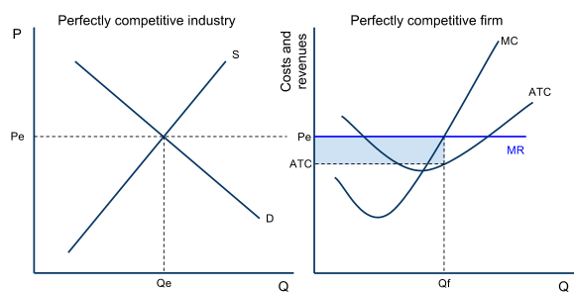
Profit Maximization in the Short-run: The Profit-earning Firm
If, when producing at its MC=MR point, a firm in a perfectly competitive market is selling its output for a price that is greater than its average total cost, then the firm is earning economic profits.
Economic profits mean the firm is covering all of its explicit and implicit costs, and is earning additional revenue beyond these as well.
Study the graph, and note:
The market demand is relatively high, the firm has a price that is greater than their ATC
The firm’s economic profit is the blue area (P-ATC)xQ
The firm is maximizing its profits by producing where MR=MC.
Due to the absence of entry barriers, profits won’t be sustained in the long-run, as new firms will enter the market.

Slide 7
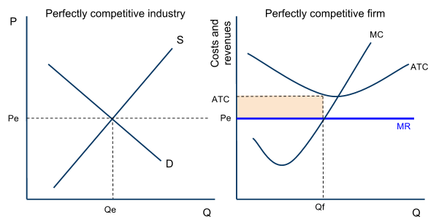
Profit Maximization in the Short-run: The Loss-minimizing Firm
If, when producing at its MC=MR point, a firm in a perfectly competitive market is selling at a price that is lower than its average total cost, the firm will be minimizing its losses, but earning no economic profit at all.
The loss minimizing firm will either exit the industry in the long-run, or hope other firms exit until the supply decreases, causing the price to rise once again.
Study the graph, and note:
Demand is relatively low, so the price the firm can sell output for is below its ATC
The firm’s economic losses are the yellow area (ATC-P)xQ
The firm is minimizing its losses by producing where MR=MC.
Due to the absence of entry barriers, losses in the long-run will be eliminated as firms exit the industry to avoid further losses.

Slide 8
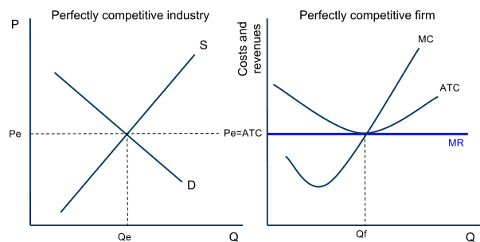
Profit Maximization in the Short-run: The Breaking-even Firm
If, when producing at its MC=MR level of output, the price the firm can sell its output for is exactly equal to the firm’s minimum average total cost, then the best the firm can hope to do is to break even.
Breaking even means a firm is covering all of its explicit and implicit costs, but earning no additional profit. The firm is earning only a NORMAL PROFIT.
Study the graph, and note:
The market has set a price equal to the firm’s minimum ATC
The firm is just covering all its costs, meaning it is earning zero economic profits, but no losses
Producing at any quantity other than Qf, the firm would earn economic losses.
There is no incentive for firms to enter or exit this market.

Slide 9
Profit Maximization in the Long-run
Recall from an earlier unit that the long-run is defined as:
The period of time over which firms can adjust their plant size in response to changes in the level of demand for their product. New firms can enter a market and existing firms can exit a market in the long-run. The long-run is the variable-plant period.
Entry and exit in the long-run: In perfectly competitive markets, firms can enter or exit the market in the long-run.
If economic profits are being earned, firms will be attracted to the profits and will want to enter the market
If economic losses are being earned, some firms will wish to minimize their losses by shutting down and leaving the market
Due to the entry and exit of firms in perfectly competitive markets, economic profits and losses will be eliminated in the long-run and firms will only BREAK EVEN.
When all the firms in a perfectly competitive market are breaking even, a market is in its long-run equilibrium state. No firms will with to enter OR exit a market in which firms are breaking even!

Slide 10
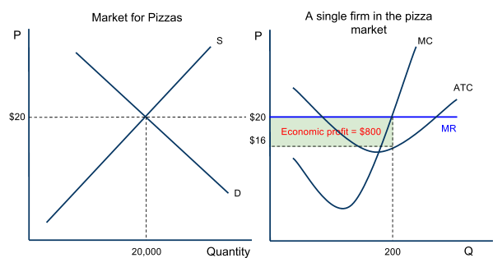
Profit Maximization in the Long-run – Entry Eliminates Profits
When individual firms are earning economic profits in a perfectly competitive market, new firms will be attracted, leading to an increase in market supply and a fall in the price.
Consider the pizza market:
At the current level of demand and supply, the price ($20) per pizza is greater than the typical firm’s ATC ($16).
Pizza shops are making 200 pizzas each at a profit of $4 per pizza for a total profit of $800.
Due to the low entry barriers, sellers of other products will be attracted to the pizza market, where easy profits can be earned.

Slide 11
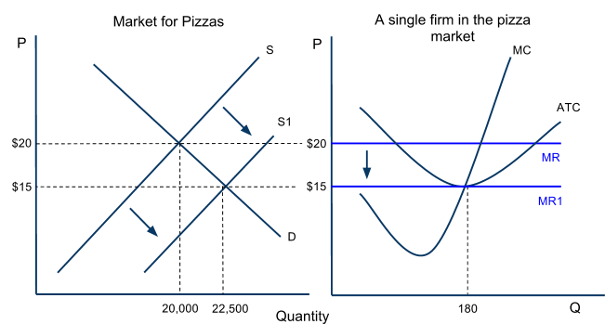
Profit Maximization in the Long-run – Entry Eliminates Profits
The number of sellers is a determinant of supply, so the market supply will increase
The increased competition in the pizza market causes the price of pizzas to fall and the market quantity to increase
For the individual firm in the market:
The price of pizza falls from $20 to $15.
MR falls, causing the firm to reduce its output to maintain its MR=MC level
Economic profit is eliminated
The firm output is reduced as it faces more competition
The market is in equilibrium again when the individual firm is only breaking even

Slide 12
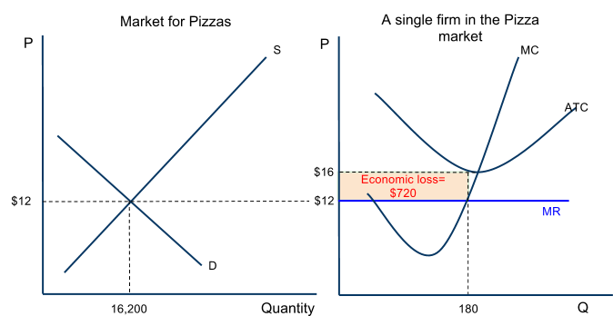
Profit Maximization in the Long-run – Exit Eliminates Losses
When individual firms are earning losses in a perfectly competitive market, certain firms will choose to leave the market to avoid losses and to seek profits elsewhere.
Consider the pizza market:
The current level of demand and supply sets the market price ($12) is lower than the typical firm’s ATC ($16)
Pizza shops are making 180 pizzas each at a loss of $4 per pizza, for a total loss of $720
Due to the fact that it is easy to exit the market, some pizza shops will chose to shut down and seek profits elsewhere.

Slide 13
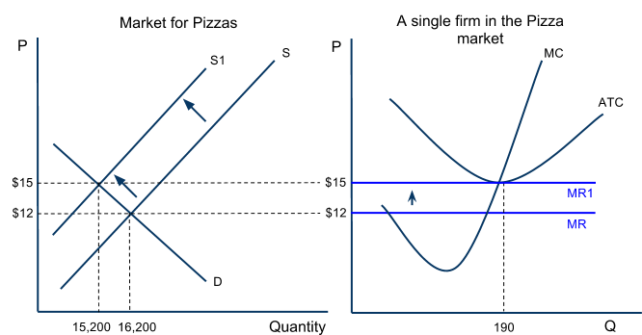
Profit Maximization in the Long-run – Exit Eliminates Losses
The experience of earning losses will make some firms wish to leave the market
The number of sellers is a determinant of supply, so the market supply will decrease causing the price of pizzas to rise and the market quantity to decrease
For the individual firm that remains in the market:
The price of pizza rises from $12 to $15
MR rises, causing the firm to increase its output to maintain its MR=MC level
Losses are eliminated, as the price rises to the firm’s minimum ATC
The firm’s output increases as it now faces less competition

Slide 14
Long-run Equilibrium in Perfect Competition
A perfectly competitive market is in its long-run equilibrium ONLY when the typical firm is breaking even.
Equilibrium is defined as “a state of balance”
If any profits or losses are being earned, a PC market is out of balance, and firms will enter or exit the market until equilibrium is restored.

Slide 15
Perfect Competition Quick Quiz
Discuss the following questions with your class.
How will the existence of economic profits in a purely competitive market affect the total supply in that market?
How will the existence of economic losses among the firms in a purely competitive market affect the total supply in the market?
!

Slide 16
Perfect Competition Quick Quiz
Discuss the following questions with your class.
How will the existence of economic profits in a purely competitive market affect the total supply in that market?
Answer: Because there are NO BARRIERS TO ENTRY, new firms will enter a market where profits are being earned. As new firms enter, market supply will shift out, lowering the market price faced by firms, eliminating economic profits.
How will the existence of economic losses among the firms in a purely competitive market affect the total supply in the market?
Answer: Because firms are loss averse, and there are NO BARRIERS TO EXIT, some firms will leave the industry, reducing market supply, increasing the price, eliminating losses for the remaining firms!

Slide 17
The Shut-down Rule
If losses are being earned, some firms will exit the market until the remaining firms are breaking even once again.
Revisiting our assumptions about perfect competition: Recall that we said that PC firms face identical costs of production. That is not 100% true, because one cost, the level of normal profit, can vary from seller to seller, even in perfect competition.
Normal profit is the implicit, subjective value of each business owner’s skills and time.
For this reason, some sellers will be willing to tolerate greater losses for longer periods of time than other sellers.
In other words, among firms facing identical explicit costs (wages, interests, rents), some will shut down sooner when earning losses than others due to their different levels of implicit costs (normal profit)

Slide 18
The Shut-down Rule
A firm facing economic losses has two choices:
Continue to operate your business, and hope that your average revenue (price) is at least high enough to cover your average variable costs (these are your operating costs in the short-run… you have to earn enough to pay your workers, at least!), OR…
Shut down and give up your fixed costs, which are those that must be paid EVEN if you shut your business down. A firm’s loss when it shuts down is its total fixed costs, those payments to owners of capital and land resources (rent for your landlord, interest owed to the bank on money you borrowed to buy capital).
These tradeoffs give business owners a clear rule for WHEN TO SHUT DOWN:
If the price of your product is lower than a firm’s average variable cost
or…
If the firm’s total losses when continuing to operate are greater than its total fixed costs

Slide 19
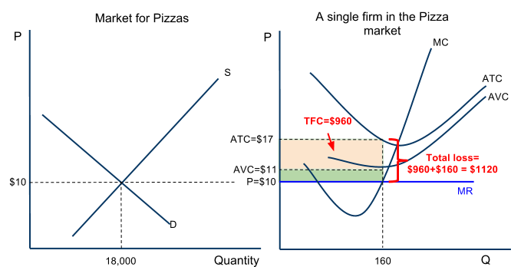
Consider the Pizza Market:
The price ($10) is lower than the firm’s AVC ($11). The firm cannot even afford to pay its workers.
The firm’s total losses (17-10)x160, are greater than its total fixed costs (17-11)x160. The firm would minimize its losses by shutting down
This firm should exit the market

Slide 20
Marginal Cost as the Individual Firm’s “Supply” Curve
The MC increases as output increases because of diminishing marginal returns
Since the MC increases at higher level of output, firms require a higher prices in order for them to increase output, so they can maintain the MR=MC level and maximize profits.
In other words, the MC curve represents the relationship between price and quantity supplied. This is a direct relationship (demonstrating the law of supply!)
What would cause the firm's supply (MC) curve to shift?
Changes in the prices of variable inputs: For example, a higher minimum wage will shift the cost curve of a firm employing minimum wage workers UP. This corresponds to a leftward shift of the firm's supply curve.
Improvements in technology will shift MC down: Since better technology makes all workers more productive (shift the MP and AP curves up, thus the MC and AVC curves down). This corresponds with an outward shift of the firm's supply curve.
P
PC Firm
MC
Firm's Supply curve
AVC
Q

Slide 21
Marginal Cost as the Individual Firm’s “Supply” Curve
As we have just shown, if the price of a good ever falls below a firm’s AVC, the firm will no longer produce the good.
Observations about the relationship between MC and Price:
As price rises above AVC, the firm will increases its quantity in direct relationship with the price
As price decreases, but remains above AVC, the firm will reduce its output.
In this regard, the firm’s MC above its AVC is similar to a firm’s supply curve. The quantity supplied by the firm reflects a direct relationship with the price of the good
P
PC Firm
MC
P₄
MR₄
Firm's Supply curve
P₃
MR₃
AVC
P₂
MR₂
P₁
MR₁
Q₁
Q₂
Q₃
Q₄
Q

Slide 22
Marginal Cost as the Individual Firm’s “Supply” Curve
Since an individual firm’s MC curve is analogous to the firm’s supply, the sum of all the firms’ MC curves in a particular market should give us the market supply for a goods. Assume the following:
PC Firm
PC Market with 200
identical firms
P
MC
P
Firm's Supply curve
S=MC
AVC
x200=
$5
$5
MR=AR
D
10
Q
2000
Q

Slide 23
Efficiency in Perfectly Competitive Markets
In long-run equilibrium, purely competitive firms will produce the efficient level of output and price. Efficiency in economics is measured in two ways: Firms can be productively efficient and an industry can be allocatively efficient.
Productive Efficiency is achieve if firms produce at their minimum average total cost:
Interpretation: Firms are using resources to their maximum efficiency by producing their output at the lowest possible average total cost. Competition forces firms to use resources as efficiently as possible.
Allocative Efficiency is achieved if a market produces at the quantity where marginal benefit equals marginal cost (where Price = Marginal Cost)
Interpretation: The right amount of output is being produced. There is neither under nor over-allocation of resources towards a good in a purely competitive industry.
If the price were higher than the marginal cost, this is a signal that marginal benefit exceeds marginal cost and more output is desired,
If price were lower than marginal cost, the signal from buyers to sellers is that marginal cost exceeds marginal benefit and less output is desired.
Only when P = MC is the right amount of output being produced.

Slide 24
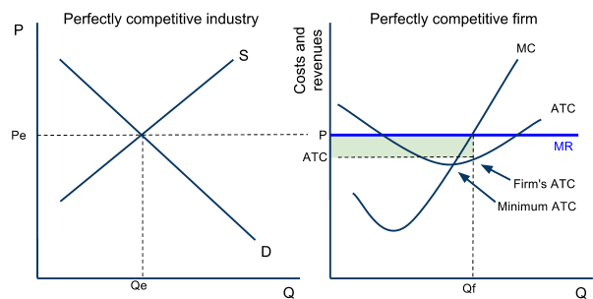
Efficiency in Perfectly Competitive Markets – Productive Efficiency
Price acts as a signal in competitive markets of the demands (and therefore the marginal benefit) of consumers. Price will always equal firms’ minimum ATC in the long-run, assuring that perfectly competitive sellers will be productively efficient.
If price is high enough that firms are earning profits, then the signal from buyers to sellers is WE WANT MORE
If price is low enough that firms are earning losses, then the signal from buyers to sellers is WE WANT LESS
Consider the market and firm here:
As new firms enter, price will fall to minimum ATC, and firms will be more productively efficient!

Slide 25
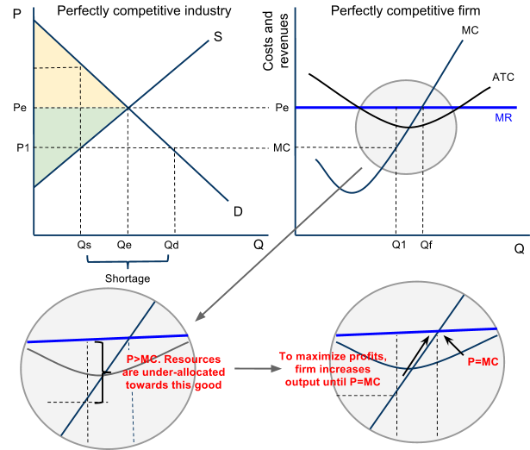
Efficiency in Perfectly Competitive Markets – Allocative Efficiency
Study the graphs here:
Assume the firm (which represents all firms in this market) produces at Q1.
Market quantity supplied will be only Qs. At Qs, the demand (MB) is greater than the supply (MC) of the good.
When all firms produce where P=MC, the shortage that existed at Qs is eliminated and resources are efficiently allocated toward this good!
MR

Slide 26
Perfect Competition Practice Problems
Describe the situation in the market below and firm below:
Show the firm's: i) MR, ii) Output, iii) Economic profit or loss
Assuming this is a PC market, describe and illustrate the long run adjustments that will restore this market to Equilibrium. Show on the graphs, for both the industry and the firm, the price and output after long-run adjustments
MC
P
Industry
P
Firm
ATC
S_{industry}
AVC
P_{e}
MR=D=AR=P₁
D_{industry}
Q
Q

Slide 27
Perfect Competition Practice Problems
Describe the situation in the market below and firm below.
Show the firm's i) MR, ii) Output, iii) Economic profit or loss
Assuming this is a PC market, describe and illustrate the long run adjustments that will restore this market to Equilibrium. Show on the graphs, for both the industry and the firm, the price and output after long-run adjustments
P
Industry
S_{industry}
P
Firm
MC
ATC
AVC
P_{e}
MR=D=AR=P₁
D_{industry}
Q
Q

Slide 28
Perfect Competition Practice Problems
Describe the situation in the market below and firm below.
Show the firm's i) MR, ii) Output, iii) Economic profit or loss
Assuming this is a PC market, describe and illustrate the long run adjustments that will restore this market to Equilibrium. Show on the graphs, for both the industry and the firm, the price and output after long-run adjustments
MC
ATC
P
Industry
S_{industry}
Firm
AVC
P
P_{e}
MR=D=AR=P₁
D_{industry}
Q
Q

Slide 29
Perfect Competition Practice Problems
Describe the situation in the market below and firm below. Assume price of a close substitute drops.
Illustrate the changes that will occur in this market.
Show the new industry price and output.
Show the new firm price and output
P
Industry
S_{industry}
P
Firm
MC
ATC
AVC
P_{e}
MR=D=AR=P₁
D_{industry}
Q
Q

Slide 30
Perfect Competition Practice Problems
Describe the situation in the market and firm below.
Assume this product is featured in a new movie and consumers' tastes shift towards it overnight. Illustrate the changes that will occur in this market:
Show the new industry price and output
Show the new firm price and output
P
Industry
S_{industry}
P
Firm
MC
ATC
AVC
P_{e}
MR=D=AR=P₁
D_{industry}
Q
Q

Slide 31
Perfect Competition Practice Problems
Luigi's, a typical profit-maximizing pizzeria, is operating in a perfectly competitive industry that is in long-run equilibrium.
Draw correctly labeled side-by-side graphs for the pizza market and for Luigi's and show each of the following.
Price and output for the market
Price and output for Luigi's
Assume that pizza is a normal good and that consumer income falls. Assume that Luigi's continues to produce. On your graphs in part (a), show the effect of the decrease in income on each of the following in the short run.
Price and output for the industry
Price and output for Luigi's
Area of loss or profit for Luigi's
Following the decrease in consumer income, what must be true for Luigi's to continue to produce in the short run?
Assume that the market adjusts to a new long-run equilibrium. Compare the following between the initial and the new long-run equilibrium.
Price in the industry
Output of a typical firm
The number of firms in the dairy industry

Slide 32
Might not shutdown
Won’t shutdown
Will shutdown
Might not shutdown

