Slide 1
1.4 Market Failure
Unit Overview
Market Failure Market failure as a failure to allocate resources efficiently The meaning of externalities Negative externalities of production and consumption Positive externalities of production and consumption Lack of public goods Common access resources and the thread to sustainability Asymmetric information Abuse of monopoly power
Market Failure Online: Price controls Taxes Subsidies Market failure Externalities Taxes Coase Theorem Environment Public goods Market Failure Video Lessons Practice Activities Microeconomics Glossary

Slide 2
Market Failure
Up to this point we have focused on the efficiency of the free market.
Markets are efficient because, when in equilibrium, they are allocatively efficient
The socially optimal amount of output will be produced: Marginal Social Benefit will equal Marginal Social Cost
P
S=MPC=
MSC
P_{e}
D=MSB
Q_{e}
Q

Slide 3
Market Failure
When governments intervene in free markets (indirect taxes, subsidies, price controls), resources become misallocated and there is a loss of total welfare.
P
Price Ceiling
S
P_{e}
P_{c}
Shortage
D
Indirect Tax
P
S
P
S_{+tax}
Subsidy
Q_{S}
Q_{e}
Q_{D}
Q
S
2.20
S_{+subsidy}
1.55
1.25
MYR0.50
2.00
MYR0.50
1.05
1.70
D
D
Q_{tax}
Q_{e}
Q
Q_{e}
Q_{subsidy}
Q

Slide 4
Market Failure
Market Failure Definition: Markets are NOT always efficient. There are several circumstances under which resources will be mis-allocated by the free market. In other words, either too much of a good will be produced or not enough will be produced by the free market. Examples of market failures include:
Negative Externalities of Production and Consumption
Positive Externalities of Production and Consumption
Lack of Public Goods
Common Access Resources and the Tragedy of the Commons
Asymmetric Information
Abuse of Monopoly Power

Slide 5
Externality Definition: Any time the production or consumption of a good creates spillover benefits or costs on a third party not involved in the market. In such cases, resources will either be under-allocated (positive externalities) or over-allocated (negative externalities) towards the production of certain goods.
Examples of Positive Externalities (known as merit goods) | Examples of Negative Externalities (known as demerit goods)
Receiving a college education makes the consumer more likely to contribute to the well-being of society as a whole | Driving sports-utility vehicles contributes to traffic and contributes more to global warming
Riding bicycles to work reduces congestion on the roads and makes for less traffic for everyone else | Producing electricity using coal creates greenhouse gas emissions and air pollution
Getting vaccines against communicable diseases reduces the chance you will get others sick | Smoking cigarettes contributes to lung disease among not just the smokers, but those who suffer from second-hand smoke

Slide 6
Negative Externalities of Production: These arise when the production of a good creates spillover costs on a third party, which is often times the environment as a whole.
The Marginal Social Cost of producing a good is greater than the Marginal Private Cost of producing it… Example: A polluting industry. In the graph
P
…
MPC = The private costs of producing the good
MSC = the cost to society of producing the good, includes the MPC plus any external costs
Qe = the actual output in the market
Qso = The socially optimal output in the market
Pe = the equilibrium price in the market
Pso = the socially optimal price if all social costs were considered in the good’s production
S=MPC
P_{e}
D=MSB
Q_{e}
Q

Slide 7
Negative Externalities of Production
A polluting industry creates costs for society that are not paid by the polluting firm. These external costs of production may include:
Greenhouse gas emissions which contribute to global warming
Air pollution
Contributions to lung disease and cancer rates among the population
Water pollution which destroys fish stocks
Soil contamination which harms agricultural productivity.
The existence of all these externalities creates a social cost that exceeds the private cost!
As a result, there is a loss of total welfare in the industry represented by the gray triangle.
P
Polluting industry
MSC
S=MPC
MSC>MSB
P_{so}
P_{e}
Welfare Loss
D=MSB
Q_{so}
Q_{e}
Q
At the equilibrium output of Qe, the marginal social cost exceeds the marginal social benefit, meaning…
Too much of the good is being produced by the free market! This is a market failure!

Slide 8
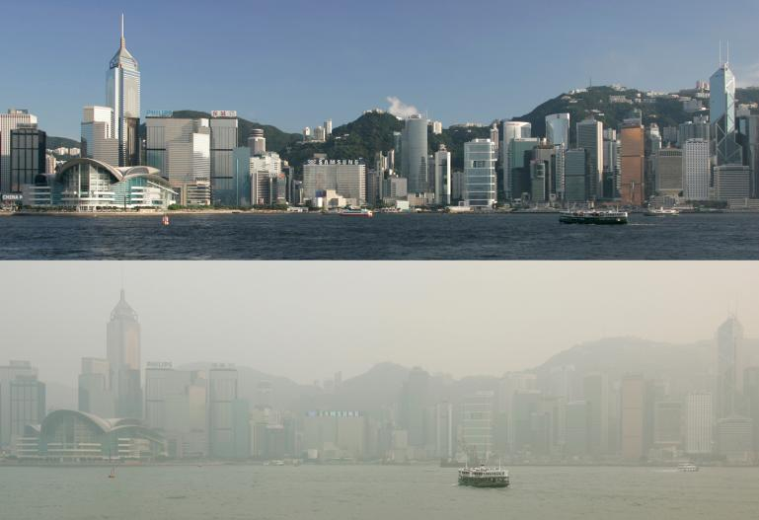
Air pollution in Hong Kong

Slide 9
Government Responses to Negative Externalities
Whenever a market fails by allocating too many resources towards the production of the good, the government can potentially improve market efficiency by intervening to reduce the quantity produced and consumed to a more socially optimal level (where MSB=MSC).
Corrective taxes: This is a per-unit tax on a good meant to reduce the supply, increase the price, and reduce the quantity demanded to a more socially optimal level. Unlike a tax on a good that is produced efficiently by the free market, this is a corrective tax because it is meant to correct a failing market and help the market achieve a higher level of efficiency.
Regulation/Legislation: Laws that limit the quantity of a good produced or require it to be produced in an environmentally friendly way may increase the costs of production to firms and reduce the quantity to a more socially optimal level.
Banning: Many goods which create negative externalities are simply banned. Examples include: Drinking among minors, narcotics, prostitution, automatic weapons, etc…
Tradeable Permits: Issuing permits to producers of goods which create negative environmental externalities will create a physical limit on the amount of pollution or of the harmful activity, reducing the overall cost to society of the activity.

Slide 10
Government Responses to Negative Externalities – Corrective Taxes
A tax meant to correct a market failure is sometimes referred to as a Pigouvian Tax, after the economist Arthur Pigou, who first proposed using taxes to reduce the output of harmful goods.
Recall that a tax is a determinant of supply, s
A tax on a good which created externalities of production or consumption will increase the marginal private costs of production and reduce the supply to a level closer to the marginal social costs (which include all external costs).
Polluting industry
MSC=S_{w/tax}
The tax reduces the supply of both goods, causing the equilibrium price to rise and the quantity demanded to fall. If the size of the tax reflects the size of the external costs, then the new equilibrium output (Qe) will equal the socially optimal level of output (Qso)
Cigarette Market
P
P
S_{w/tax}
S=MPC
S=MSC
P_{e1}
P_{e1}
P_{e}
P_{e}
P_{so}
D=MSB
MSB
D=MPB
Q_{so}
Q_{e}
Q
Q_{so}
Q_{e}
Q

Slide 11
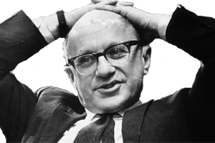
Friedman on Negative externalities of production.

Slide 12
Polluting industry
MSC=S_{w/tax}
P
Evaluation of Corrective Taxes
Corrective taxes are a popular response to negative
externalities among economist, but among policy-makers,
they are rarely popular. Some arguments against
corrective taxes include:
Higher costs for producers: Producers will reduce
their output of the goods being taxed. This is bad for
business.
Higher prices for consumers: Consumers of the goods being taxed face higher prices, reducing consumer surplus and the real incomes of households.
Less employment: As the taxed industries reduce their output, they may be forced to lay off workers, increasing unemployment in the economy.
Loss of competitiveness in global market: This is a major one. Policy-makers fear that if they impose taxes on their nation’s producers, but other nations’ governments do not impose taxes on their producers, then the domestic industries will suffer while foreign producers thrive.
S=MPC
P_{e1}
P_{e}
D=MSB
Q_{so}
Q_{e}
Q

Slide 13
Government Responses to Negative Externalities – Tradeable Permits
A second method for reducing the negative externalities arising from production or consumption of certain goods is the use of tradeable permits.
For example, in Europe there is a market for permits to emit carbon dioxide, a greenhouse gas widely believed to contribute to global warming. Here’s how it works…
A government or multi-national governing body issues or auctions off permits to polluting industries which allow them to emit a certain amount of carbon.
Some firms pollute beyond their permitted amount, so will either have to acquire more permits or reduce their emissions.
To acquire more permits, they must buy them in the market from firms that do not need all of their permits
The supply of permits is fixed and determined by the government, the demand for permits therefore determines the price of pollution. The more firms want to pollute, the more expensive it becomes to pollute.
There is a strong incentive for firms to reduce their emissions, because they can then sell the permits they do not need, adding to firm profit.
Market for CO2 emissions permits
S₂₀₂₀
S₂₀₁₂=supply of carbon emissions permits(determined by officials based on environmental studies)
Price per pollution permit
P₂₀₁₂
P₂₀₀₈
D₂₀₁₂
D₂₀₀₈
Q₂₀₂₀
Q₂₀₁₂
Quantity of pollution permits

Slide 14
Government Responses to Negative Externalities – Tradeable Permits
A tradeable permit scheme has several advantages over corrective taxes, and some disadvantages…
Advantages of tradeable permits:
Creates a strong incentive to reduce pollution, since permits can be sold off for profit
Creates a clear price for pollution, internalizing the costs which firms would have externalized without the scheme.
Places a clear limit on the quantity of pollution that will be created each year
Price of permits can be increased over time by reducing the number of permits available.
Disadvantages of tradeable permits:
The price of permits is determined by the free market, and may be too low to create strong incentives to reduce pollution
The amount of permits is decided by government, and may be too high if polluting industries are allowed to influence policy
It is costly and difficult to monitor industries to make sure everyone who pollutes has the permits to do so.
Market for CO2 emissions permits
S₂₀₂₀
S₂₀₁₂
Price per pollution permit
P₂₀₁₂
P₂₀₀₈
D₂₀₁₂
D₂₀₀₈
Q₂₀₂₀
Q₂₀₁₂
Quantity of pollution permits

Slide 15
Government Responses to Negative Externalities – Regulation
Regulation of polluting or harmful industries is another option for governments to attempt and promote a more socially optimal level of output of a demerit good.
Monitoring: The government must monitor emissions of polluters, which can be costly and difficult.
Enforcement: The government must have a way to enforce legislation on polluters.
Penalties: The penalties for violations must be significant enough to dissuade firms from ignoring legislation
Incentives: If the penalty is not harsh enough, the firm will simply ignore regulations and pollute anyway. The fine must be greater than the cost of pollution abatement, otherwise firms will keep polluting.
Effect of regulation: Similar to a tax or the requirement that firms must buy permits for pollution, regulation will add to the cost of producing harmful goods. Firms face higher costs in adhering to regulations, reducing the supply of demerit goods and creating incentives for firms to produce goods in more environmentally and socially responsible ways.

Slide 16
Government Responses to Negative Externalities – Regulation
The intended effect of government regulations of externalizing industries is to force the polluters to incur costs associated with pollution control. Firms forced to reduce their pollution will face higher costs, shifting the market supply curve for a polluting product to the left. Equilibrium quantity should fall closer to the socially optimal level.
Clean air and water legislation and "CAFE" standards are examples.
Corporate Average Fuel Economy – Wikipedia
Clean Water Act – Wikipedia
Clean Air Act - Wikipedia
Polluting Industry
P
S_{with abatement costs}
S=MPC
P_{b}-P_{s}=cost of pollution abatement
P_{b}
P_{e}
D=MSB
Q_{so}
Q_{e}
Q

Slide 17
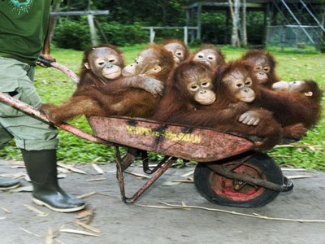
Positive Externalities of Production
A positive externality of production exists if the production of a good or service provides spillover benefits to a third part not involved in the market. For example, consider the market for ECO-TOURISM.
In many parts of the world, including in the Amazon rainforest, in Costa Rica, in Malaysian Borneo, Western Canada and elsewhere, a large eco-tourism industry has developed.
Positive externalities of eco-tourism include:
Protection of eco-systems that might otherwise be exploited or developed
Forests left standing act as a “carbon sink”, absorbing CO2 emitted from the production of other consumer goods.
Wildlife populations may remain protected and intact whereas they otherwise may dwindle due to habitat destruction and over-hunting
Water resources (rivers, lakes) are protected, allowing downstream users to benefit from clean water for cooking, cleaning, drinking, etc…

Slide 18
Positive Externalities of Production
The existence of a positive production externality can be illustrated graphically as a market in which the Marginal Private Cost of production (MPC) is greater than the Marginal Social Cost of production (MSC). As a result, the free market will provide a quantity of the good which is less than the socially optimal quantity.
In the market on the right:
Operating a business in the industry is expensive, so the MPC is relatively high.
There are external benefits of operating an eco-tourism business, which are reflected in the lower MSC.
The equilibrium price (Pe) is higher than what is socially optimal (Pso). The quantity demanded would be greater for eco-tourism if the price was lower.
The equilibrium quantity (Qe) is less than what is socially optimal (Qso). Society would be better off with more businesses offering eco-tourism services.
P
Eco-tourism industry
S=MPC
MSC
distance b/w MPC
& MSC = external benefits
P_{e}
P_{so}
D=MSB
Q_{e}
Q_{so}
Q
Q_{so} > Q_{e}: resources are under-allocated towards the eco-tourism industry

Slide 19
Positive Externalities of Production
Because not enough eco-tourism services will be provided by the free market, there is an area of potential welfare gain in the market diagram. If a greater quantity of the merit good were produced and consumed, society as a whole would be better off.
At the equilibrium quantity and price:
The MSB is greater than the MSC. Society benefits more than it costs to provide Qe, resources are under-allocated towards eco-tourism
Society stands to gain an amount of welfare equal to the gray triangle if more eco-tourism can be provided.
The price (Pe) is too high, and therefore the equilibrium quantity demanded (Qe) too low.
Increased provision of merit goods like eco-tourism would benefit society as a whole
P
Eco-tourism industry
S=MPC
MSC
P_{e}
P_{so}
MSB>MSC
Potential Welfare Gain
D=MSB
Q_{e}
Q_{so}
Q

Slide 20
P
S=MPC
MSC
P_{e}
D=MSB
Q_{e}
Q

Slide 21
Government Responses to Positive Externalities
When a market fails by under-allocating resources towards the production of a good, society stands to benefit from increasing the production and consumption of the good in the market. Therefore, government policies aimed at increasing either the supply or the demand for the good can improve efficiency in the market for merit goods. Such policies include:
Corrective subsidies (to producers): A subsidy is a payment from the government to producers. Subsidies lower the marginal private costs of production, increasing the supply, reducing the price and increasing the quantity demanded for the good being subsidized.
Corrective subsidies (to consumers): A subsidy to consumers of a good will increase the marginal private benefit of consumption (since individuals now get paid to buy a good) and increase the demand for the good. The higher price incentivizes firms to provide a greater quantity, resulting in a more efficient allocation of resources towards the good
Government provision: Many merit goods are provided by the government, such as education, health care, infrastructure like bridges and airports, police security, and so on.
Positive advertising: Government programs that educate consumers about the positive private and social benefits of a good may increase demand for the good, incentivizing firms to produce more of it. Examples include healthy eating campaigns, safe sex campaigns (to encourage condom use) promoting flue shots (and other vaccines), and so on…

Slide 22
Government Responses to Positive Externalities – Corrective Subsidies
A subsidy to producers reduces the marginal private costs of production and increases the supply of the good being subsidized.
In the markets below, the government is subsidizing eco-tourism providers and private schools. Both subsidies lead to a greater equilibrium quantity, a lower equilibrium price, and an increase in total welfare in society.
P
Eco-tourism industry
S=MPC
P
Market for Education
S_{with subsidy}
=MSC
S=MSC
=MPC
P_{e}
S_{with subsidy}
P_{so}
P_{so}
P_{e}
D=MPB
D=MSB
MSB
Q_{e}
Q_{so}
Q
Q_{e}
Q_{so}
Q

Slide 24
Positive Externalities of Consumption
A positive externality of consumption exists if the consumption of a good or service provides spillover benefits to a third part not involved in the market. For example, consider the market for EDUCATION.
Getting an education provides many benefits for the student, such as better job opportunities, higher pay, an earlier retirement and better travel opportunities. However, receiving an education also benefits society as a whole.
Positive externalities of education include:
An educated citizen will be more productive in his or her life, contributing more to national output,
He or she will pay more in taxes, which go towards providing benefits for everyone in society, even those without an education.
He or she is more likely to become a business owner, offering employment opportunities to others in society which may not otherwise have been provided.
Education is a merit good, which provides spillover benefits to society as a whole.

Slide 25
Positive Externalities of Consumption
Because there are external benefits of consuming education:
The Marginal Social Benefits of receiving an education (MSB) are greater than the Marginal Private Benefits of receiving an education (MPB).
If left to the free market, too few people will receive the highest levels of education
In the market on the right:
Private demand for education is equal to the marginal private benefit.
The quantity of education society will consume if it is left entirely to the free market is Qe, but this is less than what is socially optimal (Qso)
There are external benefits of receiving an education, represented by the vertical distance between MPB and MSB
P
Market for Education
S=MSC
=MPC
P_{so}
P_{e}
distance b/w MSB
& MPB = external benefits
D=MPB
MSB
Q_{e}
Q_{so}
Q
Q_{so} > Q_{e}: resources are under-allocated towards the education industry

Slide 26
Positive Externalities of Consumption
Anytime the free market provides too little of a good or service, there is a potential gain in total welfare of the good being produced at a greater quantity.
At the equilibrium price and quantity:
The marginal social benefit of education is greater than the marginal social cost, indicating that not enough education is being provided.
At the socially optimal quantity (Qso), the MSB=MSC, indicating that this is the allocatively efficient level of education to provide.
If demand were greater, the price would be higher and more institutions would provide education, increasing the quantity supplied.
Increased provision of merit goods like education would benefit society as a whole
P
Market for Education
S=MSC
=MPC
MSB>MSC
P_{so}
P_{e}
Potential Welfare Gain
D=MPB
MSB
Q_{e}
Q_{so}
Q

Slide 27
Negative Externalities of Consumption
Some goods are over-consumed by the free market. This would be the case if the process of consuming a good created spillover costs on a third party. The classic example of a negative consumption externality is cigarettes.
Consider the market seen here:
The Marginal Private Benefit (MPB) of smoking cigarettes is greater than the Marginal Social Benefit (MSB)
Smoking creates costs (negative benefits) on non-smokers, so society benefits as a whole less than the smokers themselves
There are no externalities in the production of cigarettes, so the supply curve represents the private costs and the social costs.
The equilibrium price (Pe) is greater than the price would if demand represented the social benefits of smoking (Pso)
The equilibrium quantity (Qe) is greater than the socially optimal quantity (Qso)
Cigarette Market
P
S=MSC
=MPC
P_{e}
P_{so}
distance b/w MSB
& MPB = external costs
MSB
D=MPB
Q_{so}
Q_{e}
Q
Q_{e} > Q_{so}: resources are over-allocated towards the cigarette industry

Slide 28
Negative Externalities of Consumption
Some goods are over-consumed by the free market. This would be the case if the process of consuming a good created spillover costs on a third party. The classic example of a negative consumption externality is cigarettes.
Smoking harms third parties who do not buy or sell cigarettes, therefore this is a negative consumption externality.
Cigarette Market
Notice on the graph:
At Qe (the actual quantity of cigarettes consumed in a free market), the MSC of smoking exceeds the MSB.
Too many cigarettes are being produced and consumed at Qe, resulting in a loss of total welfare equal to the gray triangle.
Resources will be over-allocated towards the production and consumption of cigarettes by the free market. This is a market failure!
P
S=MSC
=MPC
P_{e}
Welfare Loss
P_{so}
MSC>MSB
MSB
D=MPB
Q_{so}
Q_{e}
Q

Slide 29
Negative Externalities of Consumption and Production
Try and determine whether each of the things described below are examples of negative externalities of production or of consumption. Organize them into one of the two categories.
Negative Externality of Production | Negative Externality of Consumption
airport noise
traffic
cigarette smoke
acid rain
body odor
nuclear waste
fast food
water pollution
air pollution
drunk driving
drunk driving
global warming
over-fishing

Slide 30
P
MSC
S=MPC
P_{e}
D=MSB
Q_{e}
Q

Slide 31
Public Goods
So far we have heard about markets failing when they:
Produce too much of a good (negative externalities)
Produce too little of a good (positive externalities)
But what if a market produced NONE of a good. A good which is not provided by the free market AT ALL is known as a PUBLIC GOOD.
Public Good: A good which provides benefits to society which are non-rivalrous, and the benefits of which are non-excludable by the provider of the good. Because of these characteristics, public goods will not be provide by the free market at all (hence, represent a market failure)
To be considered public, a good must be:
Non-rivalrous in consumption Non-excludable by the provider

Slide 32
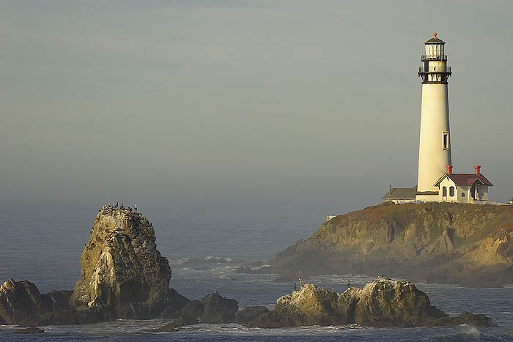
Public Goods - Examples

Slide 33
Public Goods - Examples

Slide 34
Public Goods - Examples

Slide 35
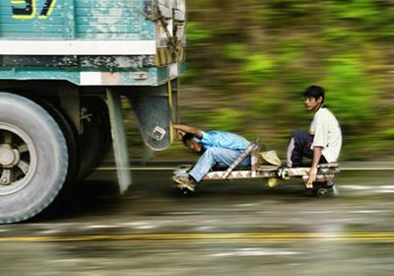
Why Do Public Goods Cause a Market Failure?
Because of the FREE RIDER problem
A “free rider” is someone who gets the benefits of a good or service but doesn’t pay for it

Slide 36
Public Goods – the problem
Something may be good for society…
In other words, its total benefits for all users combined exceeds its total cost
But the costs exceed the benefits for any single person or firm which decides to produce it
Therefore, it will not get produced

Slide 37
Public Goods – Example
Batu has 500 residents who love fireworks
Residents were polled and each said that a fireworks show is worth at least MYR10
The total cost of putting on a fireworks show is MYR1,000
Should it be done?
Would it be done? Imagine a business person who tried to sponsor it and sell tickets at MYR5 each…
How about if the city government added MYR2 to each residents tax to put it on?

Slide 38
Why does the Government Provide Public Goods?
1. On grounds of equity – so that people on all levels of income can have access to them
– Providing these on grounds of need rather than ability to pay
2. On grounds of efficiency
– Easier to provide them collectively
– Economies of scale from providing to all?
3. To overcome the free-rider problem
– One basic purpose of government is to provide goods that market forces will not
4. Even though the state may finance these goods – others can provide them at the point of need

Slide 39
Examples of Public Goods
To determine whether a good is a public good or a private good, we must consider its characteristics regarding rivalry and excludability. Consider the various goods in the table below, and organize them along a spectrum from purely public to purely private.
Purely Public………………………………………Quasi-Public…..………………..……………………..Purely Private (non-rivalrous and non-excludable)…………………………………………………………………………………………………………………………………………………….……(rivalrous and excludable)
Groceries
City bus service
Health care
Elementary schooling
Postal service
Air travel
College education
Interstate highway facilities
National Defense
Professional sports stadiums
Light houses
Cable TV
Park Benches
Police protection
Garbage collection
Toll roads
Recreational facilities
Drinking Water
Electric power
Sewage Treatment
Radio
National rail line

Slide 40
Terminology Alert!
When markets fail, governments may be able to correct the problem
EXLUDABLE GOOD:
anything which someone can be prevented from using
RIVAL GOOD:
anything for which one person’s use diminishes the value to another person

Slide 41
Common Resources
A common resource is something which meets the following two conditions:
It is impossible to charge people for using it…and you can’t stop people who don’t pay from using it, and
The use by one person reduces its availability to another person
In other words….

Slide 42
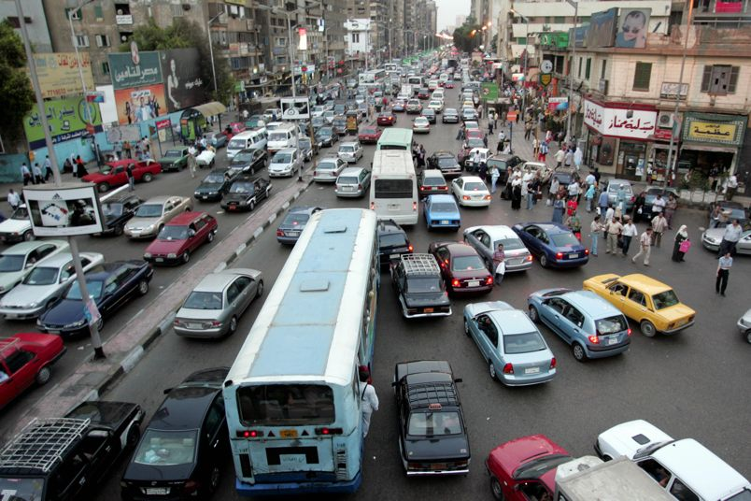
Common Resources - Examples

Slide 43
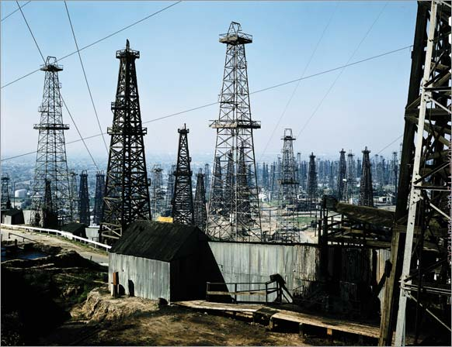
Common Resources - Examples

Slide 44
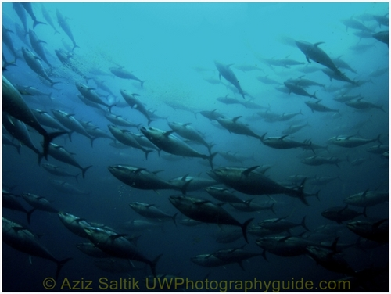
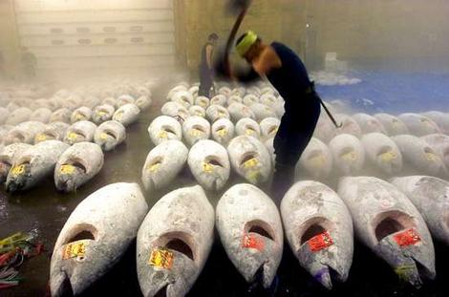
Common Resources - Examples

Slide 45
Common Access Resources
In addition to merit goods, demerit goods and public goods, a third type of market failure arises from the existence of common access resources:
Common Access Resources: Those “gifts of nature” over which there is no private ownership, and therefore no effective means of regulating the use of the resource.
Examples of common access resources include:
Fish in the sea
Trees in a forest
Common pastureland
Fresh water in aquifers or in rivers
In each of these cases, the lack of ownership over the resources creates an incentive for potential users to exploit them to the fullest extent possible, so as to extract as much benefit as possible before other users extract and exploit the resource. This is known as :
The Tragedy of the Commons
Thousands of fishermen empty lake in minutes - Human Planet

Slide 46
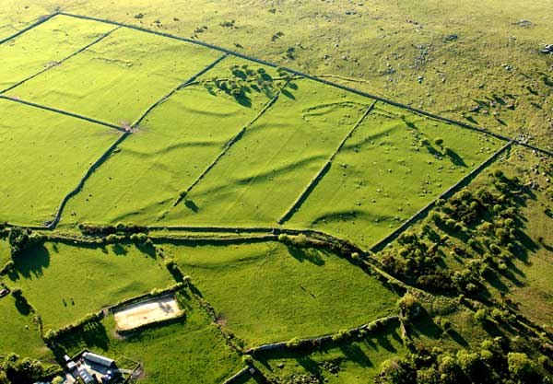
Why do Common Resources Cause a Market Failure?
Because of our old friend the THE TRAGEDY OF THE COMMONS
My use of something reduces your enjoyment…
Your use reduces my enjoyment…
But neither of us can prevent the other from using it…
So we both try to get as much as we can before it’s gone

Slide 47
Common Access Resources – possible solutions
In his essay, Hardin explained that when there exist a common resource, for which there is no private owner, the incentive among rational users of that resources is to exploit it to the fullest potential in order to maximize their own self gain before the resource is depleted.
The tragedy of the commons, therefore, is that common resources will inevitably be depleted due to humans’ self-interested behavior, leaving us with shortages in key resources essential to human survival.
This represents a market failure because, without allocation of property rights over or effective management of common access resources, they will be exploited unsustainable
Sustainability: The ability of an activity or a resources to endure for the use and enjoyment of future generations.
Possible Solutions to the Tragedy of the Commons:
Privatization: | Assigning private ownership over a resource creates an incentive among the private owners to protect and manage its use in a sustainable manner, so as to benefit from its existence into the future.
Government management: | Strict government control over the access to and use of common resources may limit access to them to a sustainable level.
Tradeable permits: | Issuing permits to private users to allow a certain amount of extraction in a period of time may limit the exploitation of the resource to sustainable level.

Slide 48
Summary
RIVAL?
YES
NO
XXX
XXX
YES
EXCLUDABLE?
Common Resources
roads
Shared natural resources
Fish in ocean
Wildlife
XXX
NO

Slide 49
Summary
RIVAL?
YES
NO
XXX
XXX
YES
EXCLUDABLE?
Common Resources
roads
Shared natural resources
Fish in ocean
Wildlife
Public Good
Lighthouses
National defense
Basic R&D
NO

Slide 50
Summary
RIVAL?
YES
NO
Private Goods
Restaurant food
Clothing
Everything you buy at the store
XXX
YES
EXCLUDABLE?
Common Resources
roads
Shared natural resources
Fish in ocean
Wildlife
Public Good
Lighthouses
National defense
Basic R&D
NO

Slide 51
Summary
RIVAL?
YES
NO
Private Goods
Restaurant food
Clothing
Everything you buy at the store
Natural Monopolies
Uncongested toll roads
Satellite TV
Windows?
YES
EXCLUDABLE?
Common Resources
roads
Shared natural resources
Fish in ocean
Wildlife
Public Good
Lighthouses
National defense
Basic R&D
NO

Slide 52
The Tragedy of the Commons – an essay by Garrett Hardin, 1968
After reading the excerpt from Hardin’s essay, discuss the following questions with your class
What is Garret Hardin most concerned about?
How can "the commons" best be defined?
Are individuals who overuse "the commons" acting irrationally? Explain.
Besides the "common pasture", what other resources does Hardin identify as "commons"?
What are some of the possible solutions he suggests for the problems faced by America's National Parks?
How are air and water different from pastures, the oceans, and national parks in the "tragedy" presented by the common resources?
What are some of the possible solutions Hardin suggests for the "cesspool" tragedy represented by the pollution of our air and water?
What do you think a hard-core, free-market economist would say is the solution to "the tragedy of the commons"?

Slide 53
Asymmetric Information as a Market Failure
Yet another type of market failure arises from the existence of asymmetric information.
Asymmetric Information: When the seller of a product knows something about it that is not revealed to the buyer.
Without perfect knowledge, buyers may not buy the optimal quantity of a product, thus resources may be misallocated towards its production and consumption.
Without all the information about a product, Demand (marginal private benefit) may be greater than what is socially optimal (marginal social benefit), resulting external costs for society caused by consumers demanding too much of certain goods.
Market Failures arising from Information Asymmetry
Adverse Selection: | Typical market failure in the market for insurance; if the buyer of insurance does not share with the insurer complete information about the level of risk he or she presents, insurance will be provided at too low a cost to too many risky individuals. The cost of covering the dishonest are thereby shared by the more honest customers, for whom the cost of insurance is, as a result, higher than it would be otherwise.
Moral Hazard: | Also a type of information asymmetry, if the consequences of one’s actions are born by society as a whole or by a third party, rather than by the individual himself, he is more likely to take risky actions that he would not take if the consequences were fully born by himself. For example, if you have a rental car with full insurance, you are more likely to drive recklessly than in your own car, on which you have a high co-pay.

Slide 55
The Financial Crisis as a Market Failure
In the US and other countries, households were offered “sub-prime” loans, which allowed those who would not have typically qualified for a home loan to borrow money and buy a house.
Borrowers were told that the debt they were taking on would not be a problem due to the fact that “home prices always rise”, information that was thought to be factual by most who bought homes at the time.
Banks "bundled" these loans into securities that they sold to investors all over the world, who assumed that the lending banks were correct in their assumption that house prices would continue to rise.
Developers built houses in record numbers based on the assumption that they'd be able to sell them at higher and higher prices.
Supply of houses grew faster than demand, and eventually house prices began to fall.
Borrowers found they could not make their monthly payments because their loans were "adjustable rate" meaning they required higher payments over time, causing foreclosures to increase and the supply of houses for sale to grow even more, forcing prices down even more.
Now investors and banks all over the world hold securities made up of bad loans to Americans that were made based on the incorrect assumption that house prices would always rise. With bad assets on their "balance sheets" banks are unable to make new loans to consumers and firms, so spending in the economy has slowed, meaning recession and high unemployment
The asymmetric information at the root of the financial crisis was the belief that “home prices always rise”. When this turned out to be false, there were too many homes on the market and trillions of dollars in households investments were lost, throwing the global economy into a recession.

Slide 56
The Abuse of Monopoly Power as a Market Failure
The final type of market failure we will examine is the abuse of monopoly power by firms which control a large share of a particular market.
Monopoly Power: When a single firm controls a large share of the total market for a particular good, that firm is able to charge a HIGHER PRICE and produce a LOWER QUANTITY than what is socially optimal.
The source of monopoly power arises from a large firm’s price-making abilities.
In more competitive markets, hundreds of small firms compete with one another for the business of consumers.
Competition forces firms to produce their goods efficiently (at a low cost) and sell their goods for a low price
Without competition, monopolists are not forced to produce at the lowest cost, nor do they have to sell for the lowest price.
Monopolists (or firms with significant market power), are both productively and allocatively inefficient, since without competition, such firms are able to charge higher prices and produce smaller quantities!

Slide 57
The Abuse of Monopoly Power as a Market Failure – Graphical Portrayal
A monopolist’s price-making power allows it to produce a lower quantity and charge a higher price than what is achieved in a more competitive market.
P
Competitive Market
P
Monopolistic Market
S=MSC
S=MSC
P_{M}
P_{so}
P_{so}
D=MSB
MR
D=MSB
Q_{so}
Q
Q_{M}
Q_{so}
Q
In the competitive market, the price and quantity are always determined by the intersection of demand and supply, which represent MSC and MSB, and therefore is allocatively efficient.
A monopolist, on the other hand, will produce at a level based on its marginal revenue and marginal cost, rather than on consumers’ demand. Therefore, the monopolist will charge a higher price and produce a lower quantity than is achieved in a competitive market. Resources are under-allocated towards a monopolist’s output, therefore monopoly power is a market failure.

Slide 58
The Tragedy of the Commons – an essay by Garrett Hardin, 1968
Read the following excerpt from the famous essay by ecologist Garrett Hardin
Even at this late date, cattlemen leasing national land on the western ranges demonstrate no more than an ambivalent understanding, in constantly pressuring federal authorities to increase the head count to the point where overgrazing produces erosion and weed-dominance. Likewise, the oceans of the world continue to suffer from the survival of the philosophy of the commons. Maritime nations still respond automatically to the shibboleth of the "freedom of the seas." Professing to believe in "the inexhaustible resources of the oceans," they bring species after species of fish and whales closer to extinction (9).
The National Parks present another instance of the working out of the tragedy of the commons. At present, they are open to all, without limit. The parks themselves are limited in extent--there is only one Yosemite Valley--whereas population seems to grow without limit. The values that visitors seek the parks are steadily eroded. Plainly, we must soon cease to treat the parks as commons or they will be of no value anyone.
What shall we do? We have two options.
We might sell them off as private property.
We might keep them as public property, but allocate the right enter them. The allocation might be on the basis of wealth, by the use of an auction system. It might be on the basis merit, as defined by some agreed-upon standards. It might be by lottery. Or it might be on a first-come, first-served basis, administered to long queues.
These, I think, are all the reasonable possibilities. They are all objectionable. But we must choose--or acquiesce in the destruction of the commons that we call our National Parks.

Slide 59
The Tragedy of the Commons – an essay by Garrett Hardin, 1968
Read the following excerpt from the famous essay by ecologist Garrett Hardin
“The tragedy of the commons develops in this way. Picture a pasture open to all. It is to be expected that each herdsman will try to keep as many cattle as possible on the commons. Such an arrangement may work reasonably satisfactorily for centuries because tribal wars, poaching, and disease keep the numbers of both man and beast well below the carrying capacity of the land. Finally, however, comes the day of reckoning, that is, the day when the long-desired goal of social stability becomes a reality. At this point, the inherent logic of the commons remorselessly generates tragedy.
As a rational being, each herdsman seeks to maximize his gain. Explicitly or implicitly, more or less consciously, he asks, "What is the utility to me of adding one more animal to my herd?" This utility has one negative and one positive component.
1) The positive component is a function of the increment of one animal. Since the herdsman receives all the proceeds from the sale of the additional animal, the positive utility is nearly +1.
2) The negative component is a function of the additional overgrazing created by one more animal. Since, however, the effects of overgrazing are shared by all the herdsmen, the negative utility for any particular decision-making herdsman is only a fraction of -1.
Adding together the component partial utilities, the rational herdsman concludes that the only sensible course for him to pursue is to add another animal to his herd. And another; and another.... But this is the conclusion reached by each and every rational herdsman sharing a commons. Therein is the tragedy. Each man is locked into a system that compels him to increase his herd without limit--in a world that is limited. Ruin is the destination toward which all men rush, each pursuing his own best interest in a society that believes in the freedom of the commons. Freedom in a commons brings ruin to all.

Slide 60
The Tragedy of the Commons – an essay by Garrett Hardin, 1968
Read the following excerpt from the famous essay by ecologist Garrett Hardin
In a reverse way, the tragedy of the commons reappears in problems of pollution. Here it is not a question of taking something out of the commons, but of putting something in--sewage, or chemical, radioactive, and heat wastes into water; noxious and dangerous fumes into the air, and distracting and unpleasant advertising signs into the line of sight. The calculations of utility are much the same as before. The rational man finds that his share of the cost of the wastes he discharges into the commons is less than the cost of purifying his wastes before releasing them. Since this is true for everyone, we are locked into a system of "fouling our own nest," so long as we behave only as independent, rational, free-enterprises.
The tragedy of the commons as a food basket is averted by private property, or something formally like it. But the air and waters surrounding us cannot readily be fenced, and so the tragedy of the commons as a cesspool must be prevented by different means, by coercive laws or taxing devices that make it cheaper for the polluter to treat his pollutants than to discharge them untreated. We have not progressed as far with the solution of this problem as we have with the first. Indeed, our particular concept of private property, which deters us from exhausting the positive resources of the earth, favors pollution. The owner of a factory on the bank of a stream--whose property extends to the middle of the stream, often has difficulty seeing why it is not his natural right to muddy the waters flowing past his door. The law, always behind the times, requires elaborate stitching and fitting to adapt it to this newly perceived aspect of the commons.
The pollution problem is a consequence of population. It did not much matter how a lonely American frontiersman disposed of his waste. "Flowing water purifies itself every 10 miles," my grandfather used to say, and the myth was near enough to the truth when he was a boy, for there were not too many people. But as population became denser, the natural chemical and biological recycling processes became overloaded, calling for a redefinition of property rights.

Slide 61
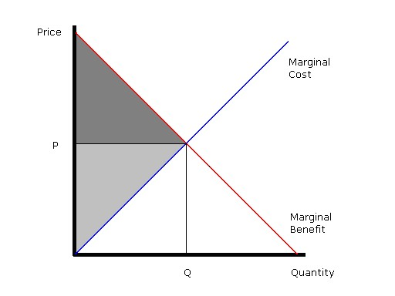

Slide 62
What gets in the way?
Market failure is most often associated with
Market power : any form of imperfect competition (monopoly being the most imperfect form ) will result in a degree of inefficiency in that price will be higher than market allocative efficiency and quantity will be less. Market participants that have market power are therefore sometimes referred to as "price makers," while those without are sometimes called "price takers." Significant market power is when prices exceed marginal cost and long run average cost, so the firm makes economic profits.

Slide 63
Cont…
Assymetric information: "What We Don't Know". This creates an imbalance of power in transactions which can sometimes cause the transactions to go awry, a kind of market failure in the worst case.
e.g Signalling: What does the completion of a college degree tell a prospective employer?
Screening: What could the presence of a Louis Vuitton bag for sale in a shop make a customer think?

Slide 64
Signalling
Assuming that people who are skilled in learning can finish college more easily than people who are unskilled, then by finishing college the skilled people signal their skill to prospective employers. No matter how much or how little they may have learned in college, finishing functions as a signal of their capacity for learning. However, finishing college may merely function as a signal of their ability to pay for college, it may signal the willingness of individuals to adhere to orthodox views, or it may signal a willingness to comply with authority.

Slide 65
Screening
In such a market, the average value of the commodity tends to go down, even for those of perfectly good quality. Because of information asymmetry, unscrupulous sellers can "spoof" items (like replica goods such as watches) and defraud the buyer. As a result, many people not willing to risk getting ripped off will avoid certain types of purchases, or will not spend as much for a given item. It is even possible for the market to decay to the point of nonexistence.

Slide 66
More than just me
We live in a society with other people with whom we interact. The actions undertaken – the production and consumption of goods and services – impact on the integrated whole – each other and the environment.
We can now expand out the idea of marginal benefit from just satisfaction from consumption experienced by the individual to the satisfaction from consumption as experienced by SOCIETY AS A WHOLE.

Slide 67
MSB = MSC – economic and social efficiency
This will not happen if resources are not allocated in an optimal and socially efficient manner and thus
MARKET FAILURE ENSUES
So governments step in to address the problem and help society to allocate its resources
Remember in the vast majority of situations markets and market prices successfully allocate resources into the goods and services society wants.

Slide 68
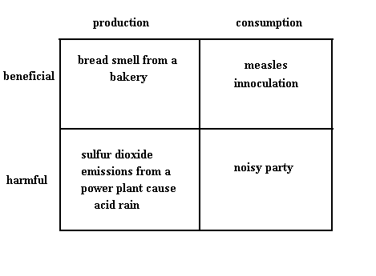
And away from those that are not wanted
BUT this only happens MOST of the time.
When it doesn’t the outcome will either be inefficient or inequitable

Slide 69
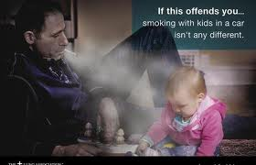
Consumption externality

Slide 70
Externalitiee are
Any transaction where anyone other than the buyer or seller (i.e. third party) experiences a benefit or a loss as a result of that transaction.
If the side affects – the spill overs – are good then it is a positive externality -- there is a benefit; enjoyment
If they are bad there will be a cost; suffering.

Slide 71
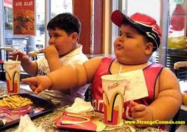
The key point is
When an externality or a spill over occurs there is a difference between society’s experience and that of the individual consumer or firm.

Slide 72
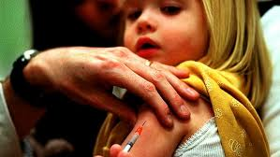
Positive
When there is an externality that is positive the utility experienced by the consumer is only part of the overall benefit to society..others share it as well. (pp 125 -126)

Slide 73
Spill overs for the third party
Negative externality of consumption: bad ☹
Negative externality of production: bad☹
Positive externality of consumption: good ☺
Positive externality of production: good ☺

